Slide 1
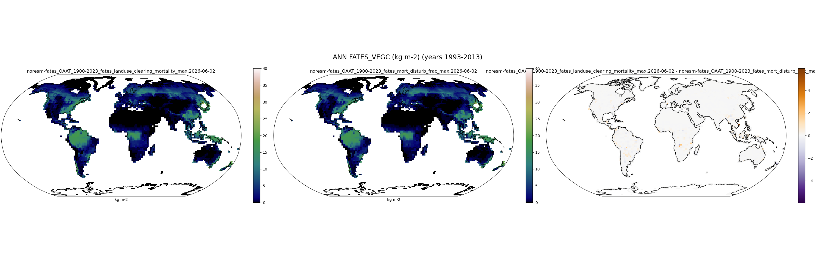
FATES_VEGC
OAAT_1900-2023_fates_landuse_clearing_mortality (max)

Slide 2

FATES_VEGC
OAAT_1900-2023_fates_landuse_clearing_mortality (min)

Slide 3
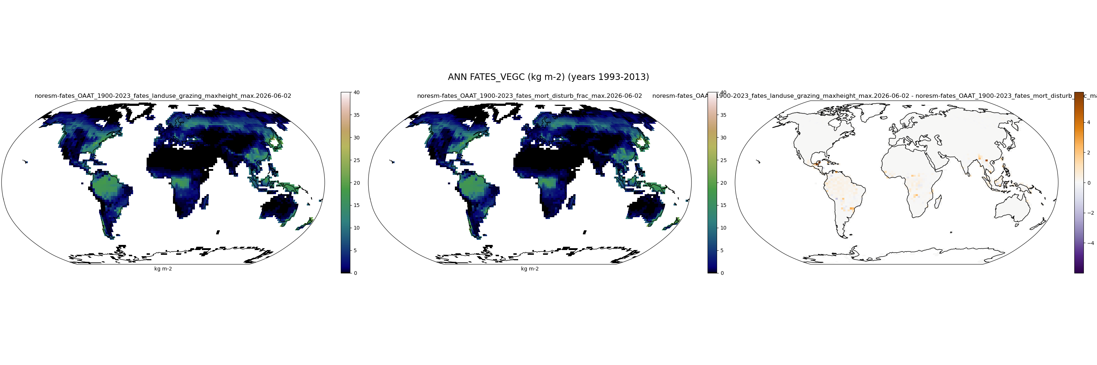
FATES_VEGC
OAAT_1900-2023_fates_landuse_grazing_maxheight (max)

Slide 4

FATES_VEGC
OAAT_1900-2023_fates_landuse_grazing_maxheight (min)

Slide 5

FATES_VEGC
OAAT_1900-2023_fates_landuse_grazing_rate (max)

Slide 6

FATES_VEGC
OAAT_1900-2023_fates_landuse_logging_collateral (max)

Slide 7

FATES_VEGC
OAAT_1900-2023_fates_landuse_logging_collateral (min)

Slide 8

FATES_VEGC
OAAT_1900-2023_fates_landuse_logging_dbh (max)

Slide 9

FATES_VEGC
OAAT_1900-2023_fates_landuse_logging_dbh (min)

Slide 10

FATES_VEGC
OAAT_1900-2023_fates_landuse_logging_direct_frac (max)

Slide 11

FATES_VEGC
OAAT_1900-2023_fates_landuse_logging_export_frac (max)

Slide 12

FATES_VEGC
OAAT_1900-2023_fates_landuse_logging_export_frac (min)

Slide 13

FATES_VEGC
OAAT_1900-2023_fates_landuse_logging_mechanical (min)

Slide 14

FATES_VEGC
OAAT_1900-2023_fates_landuse_luc_frac_burned (max)

Slide 15

FATES_VEGC
OAAT_1900-2023_fates_landuse_luc_frac_burned (min)

Slide 16

FATES_VEGC
OAAT_1900-2023_fates_mort_disturb_frac (min)

