Slide 1
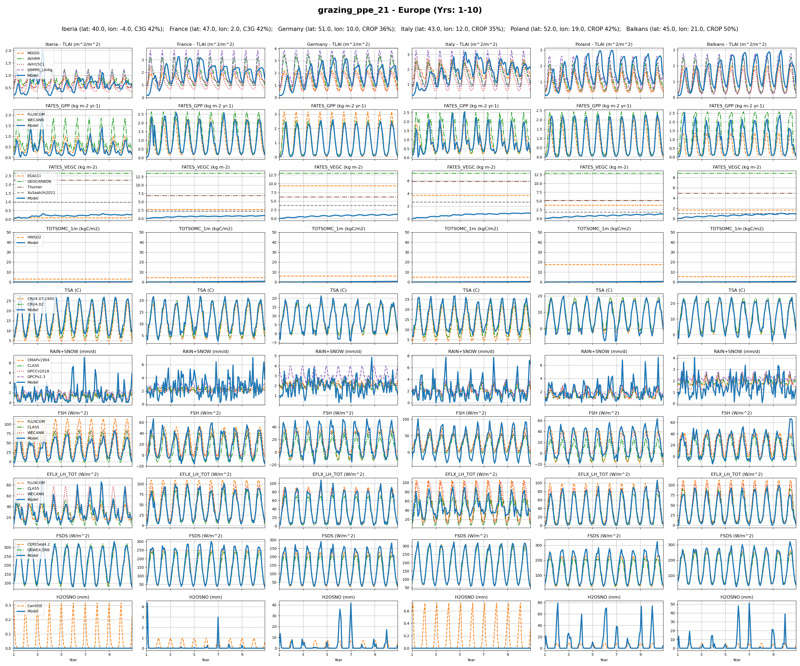
Europe
0

Slide 2
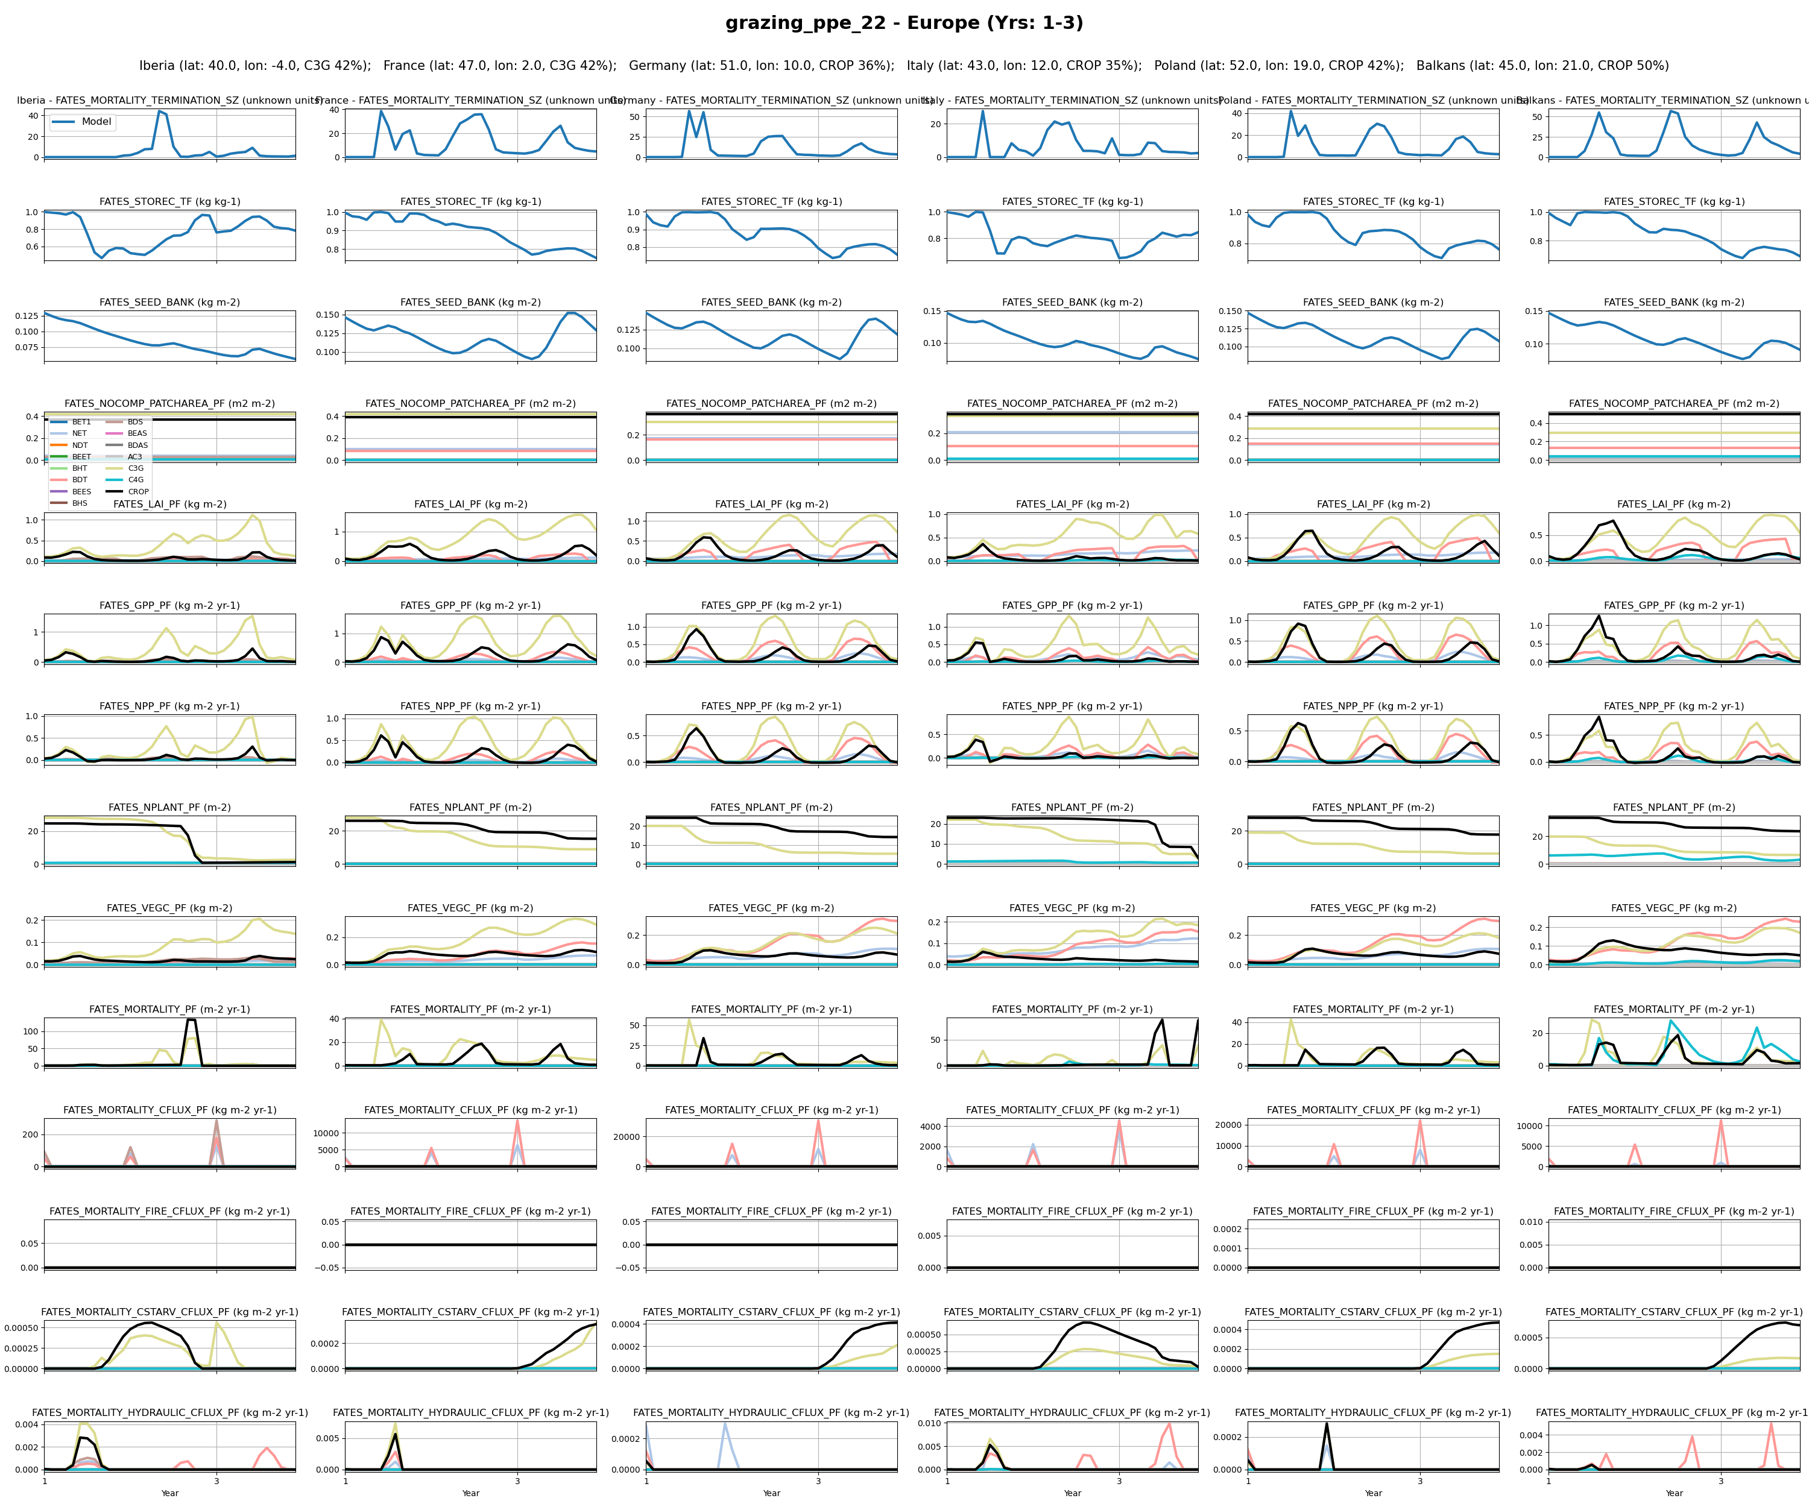
Europe
1

Slide 3
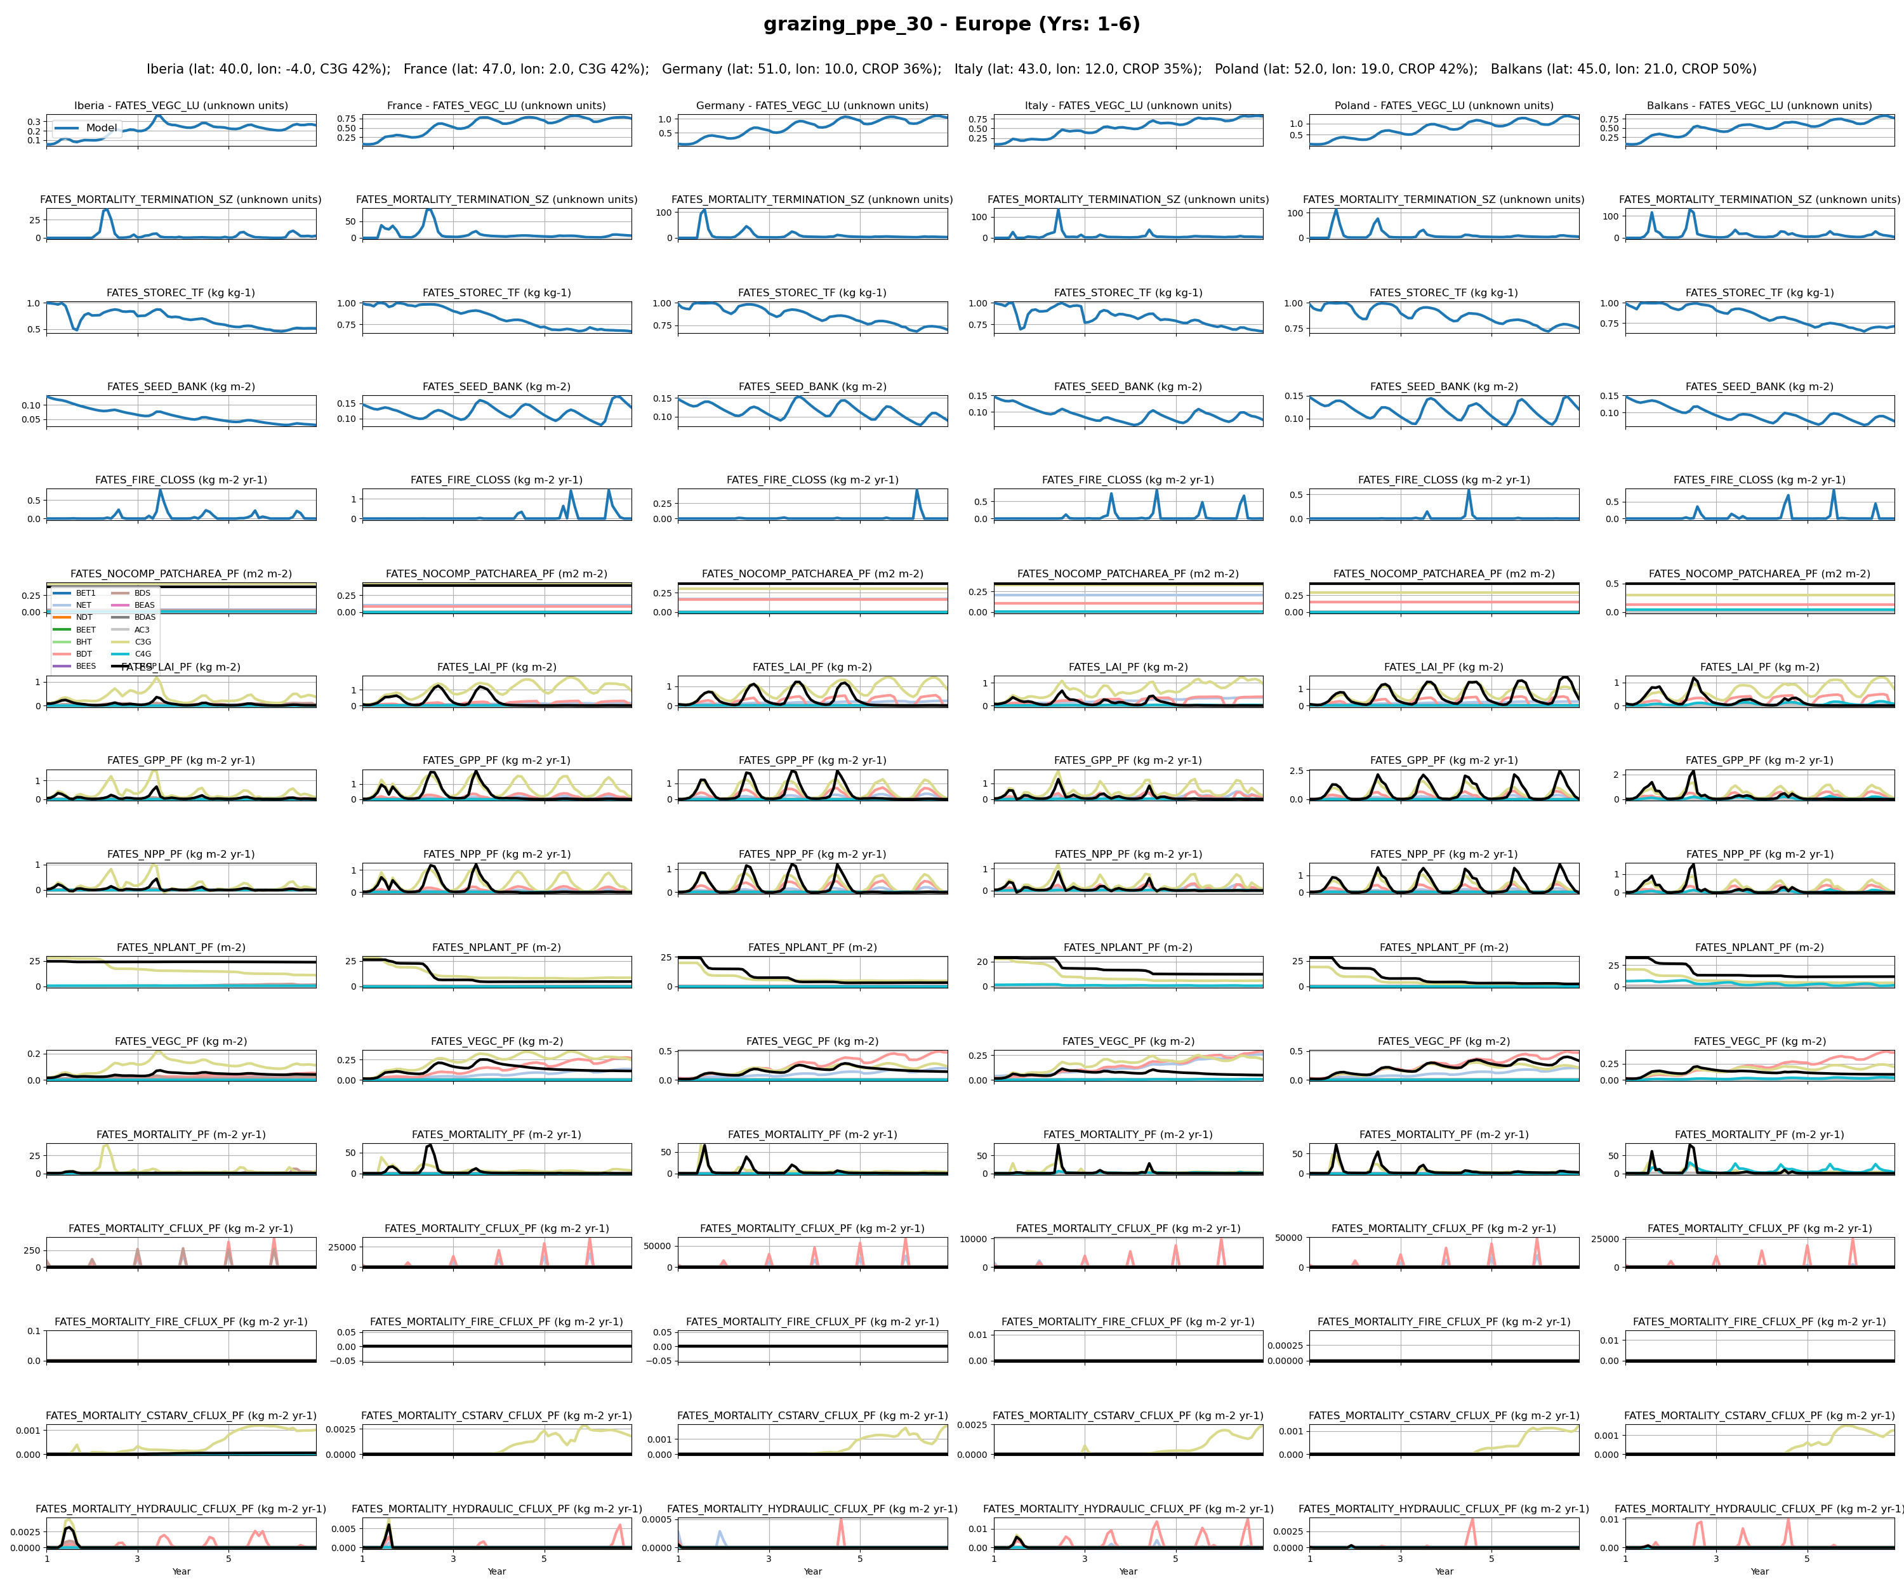
Europe
2

Slide 4
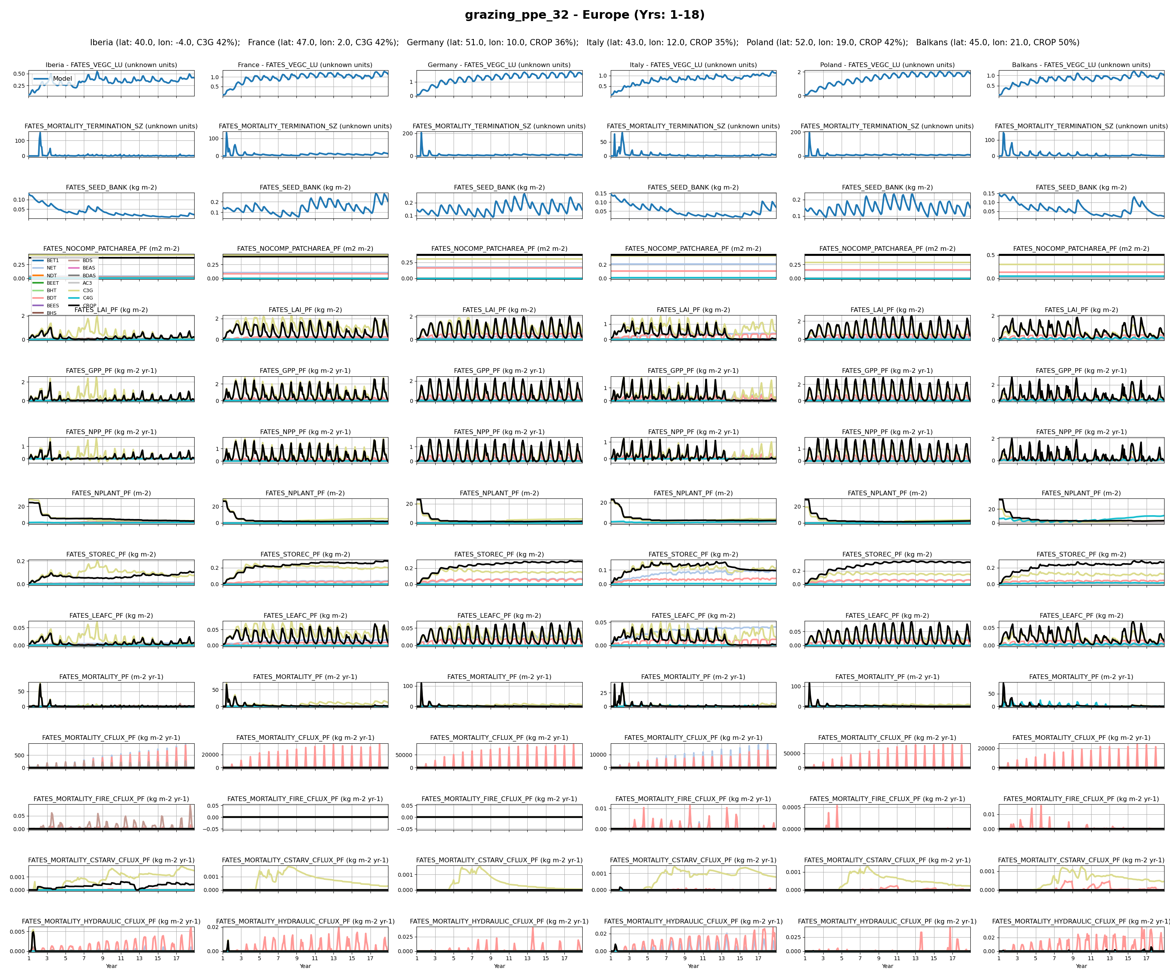
Europe
3

Slide 5
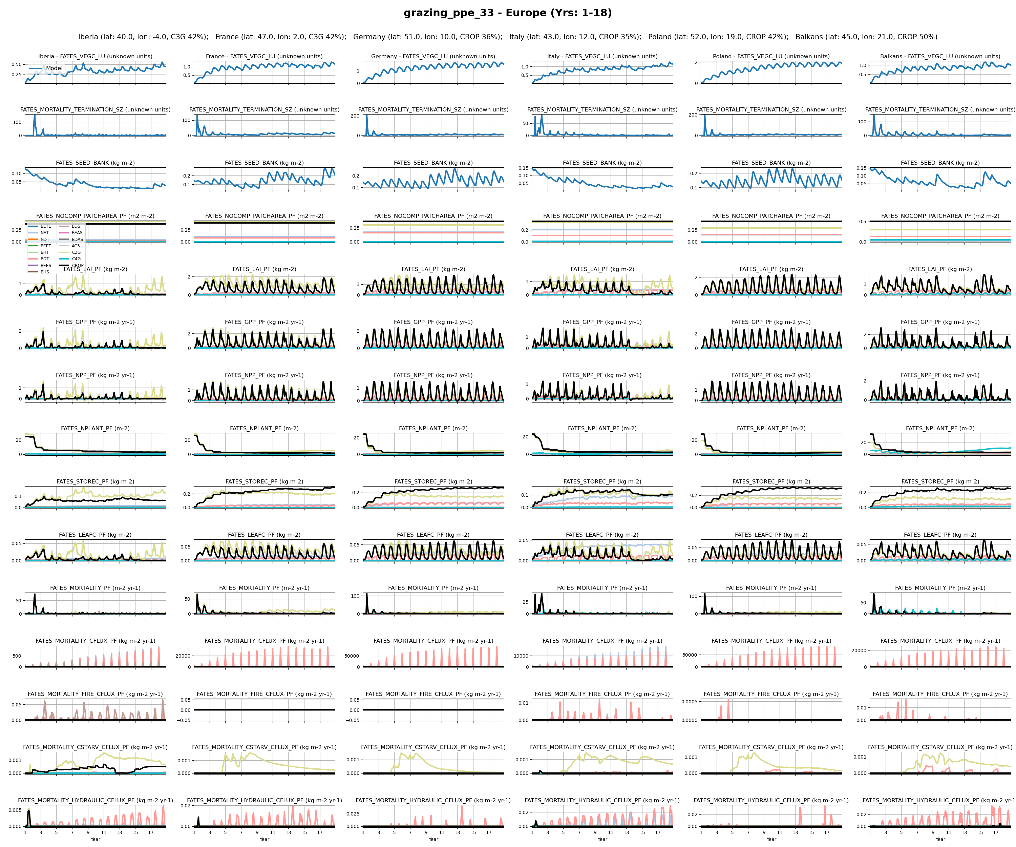
Europe
4

Slide 6
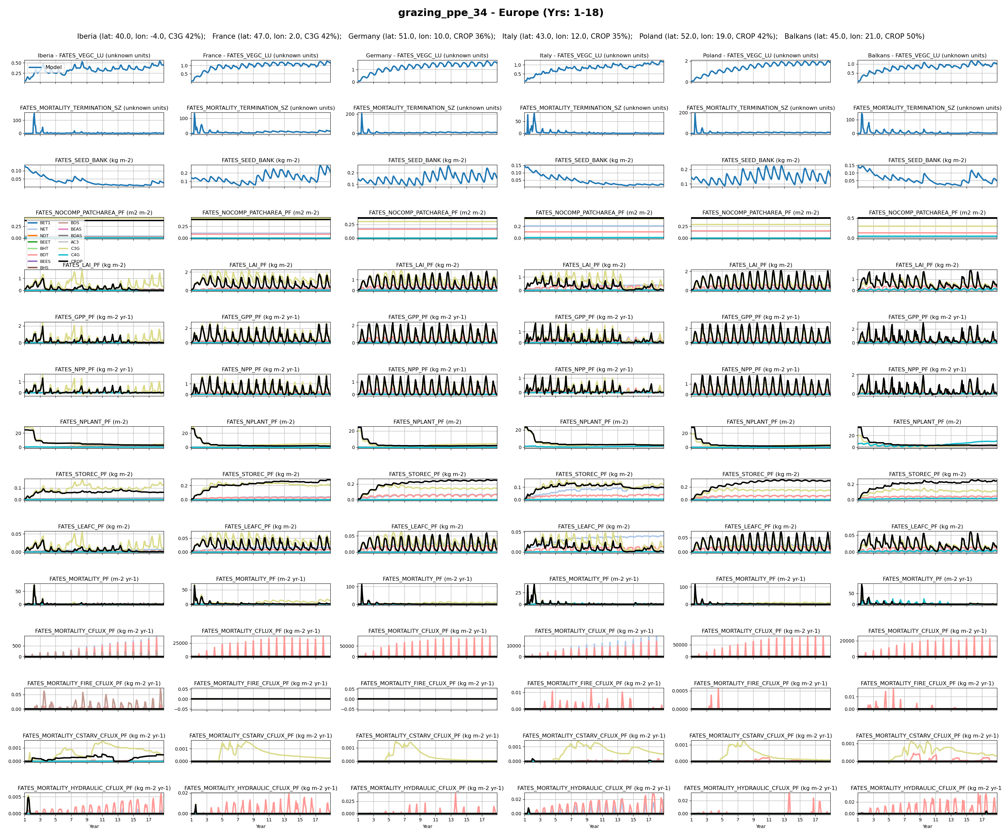
Europe
5

Slide 7
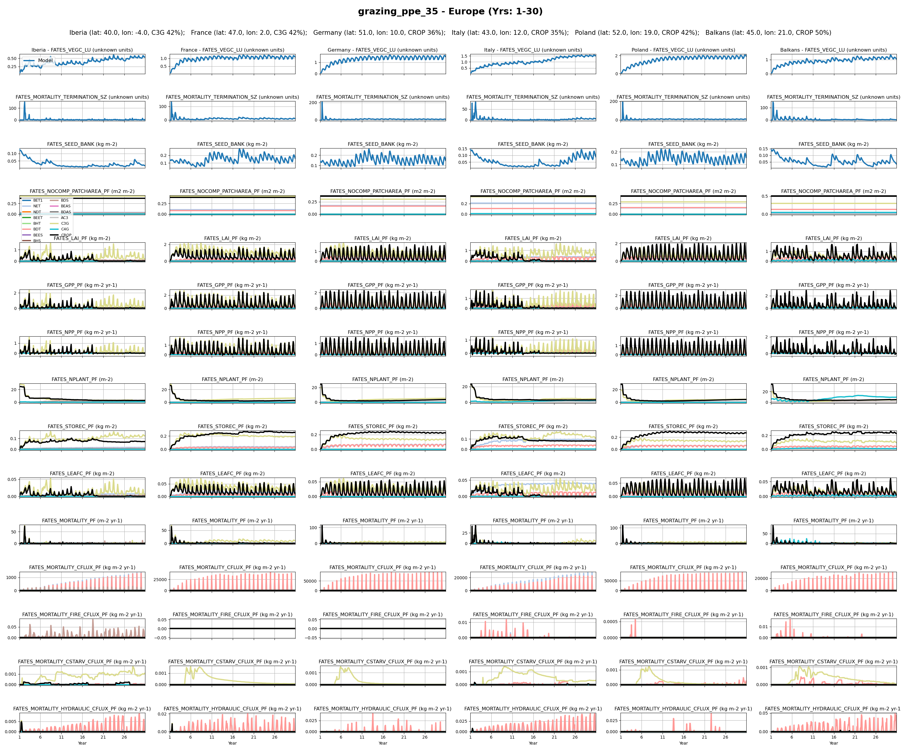
Europe
6

Slide 8
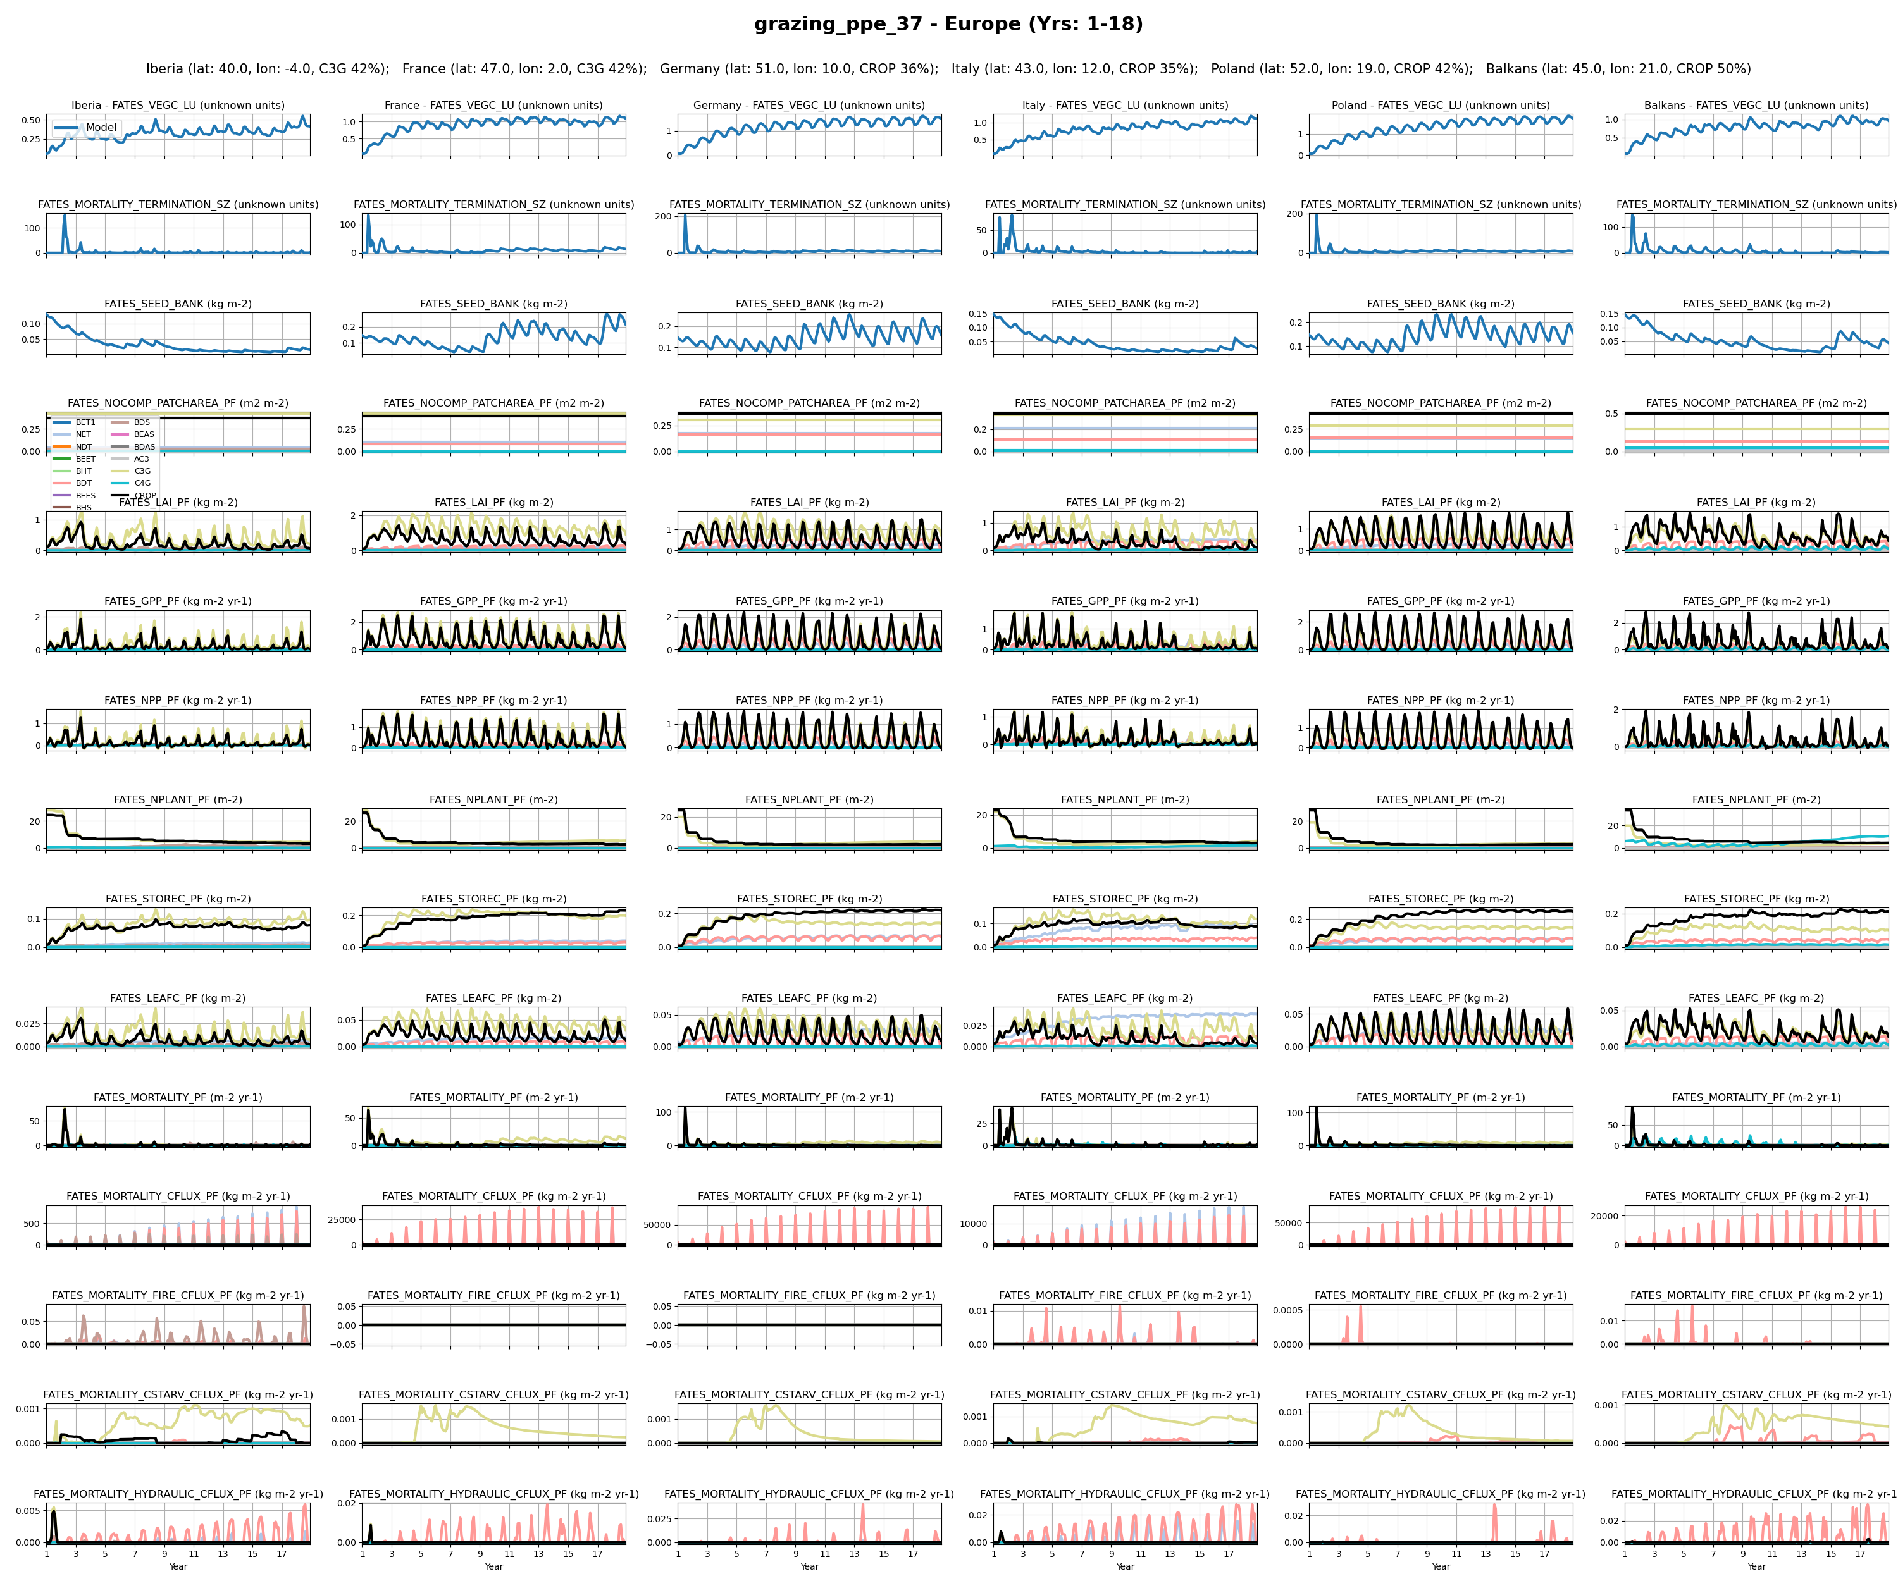
Europe
7

Slide 9
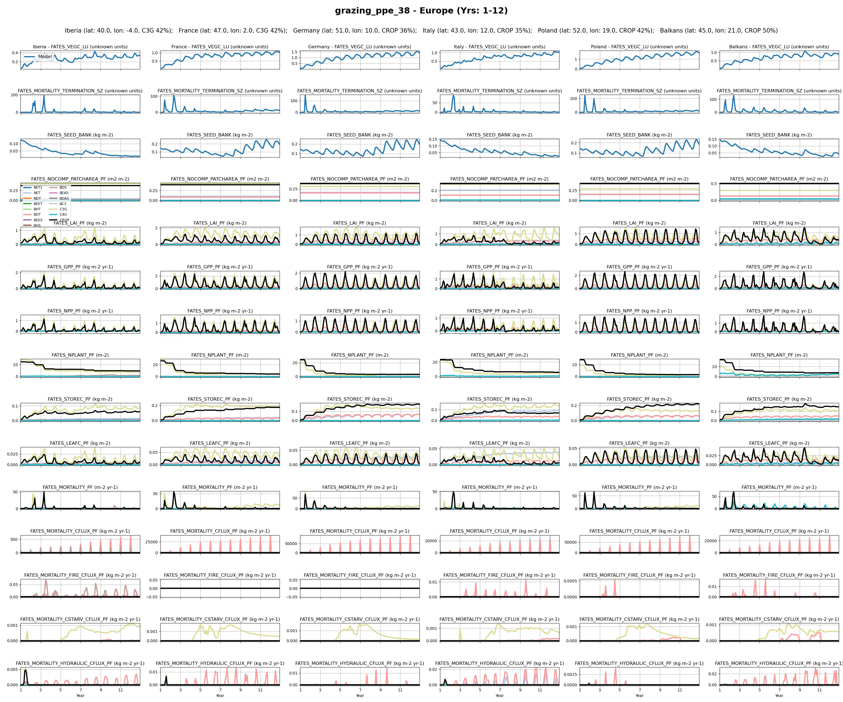
Europe
8

Slide 10
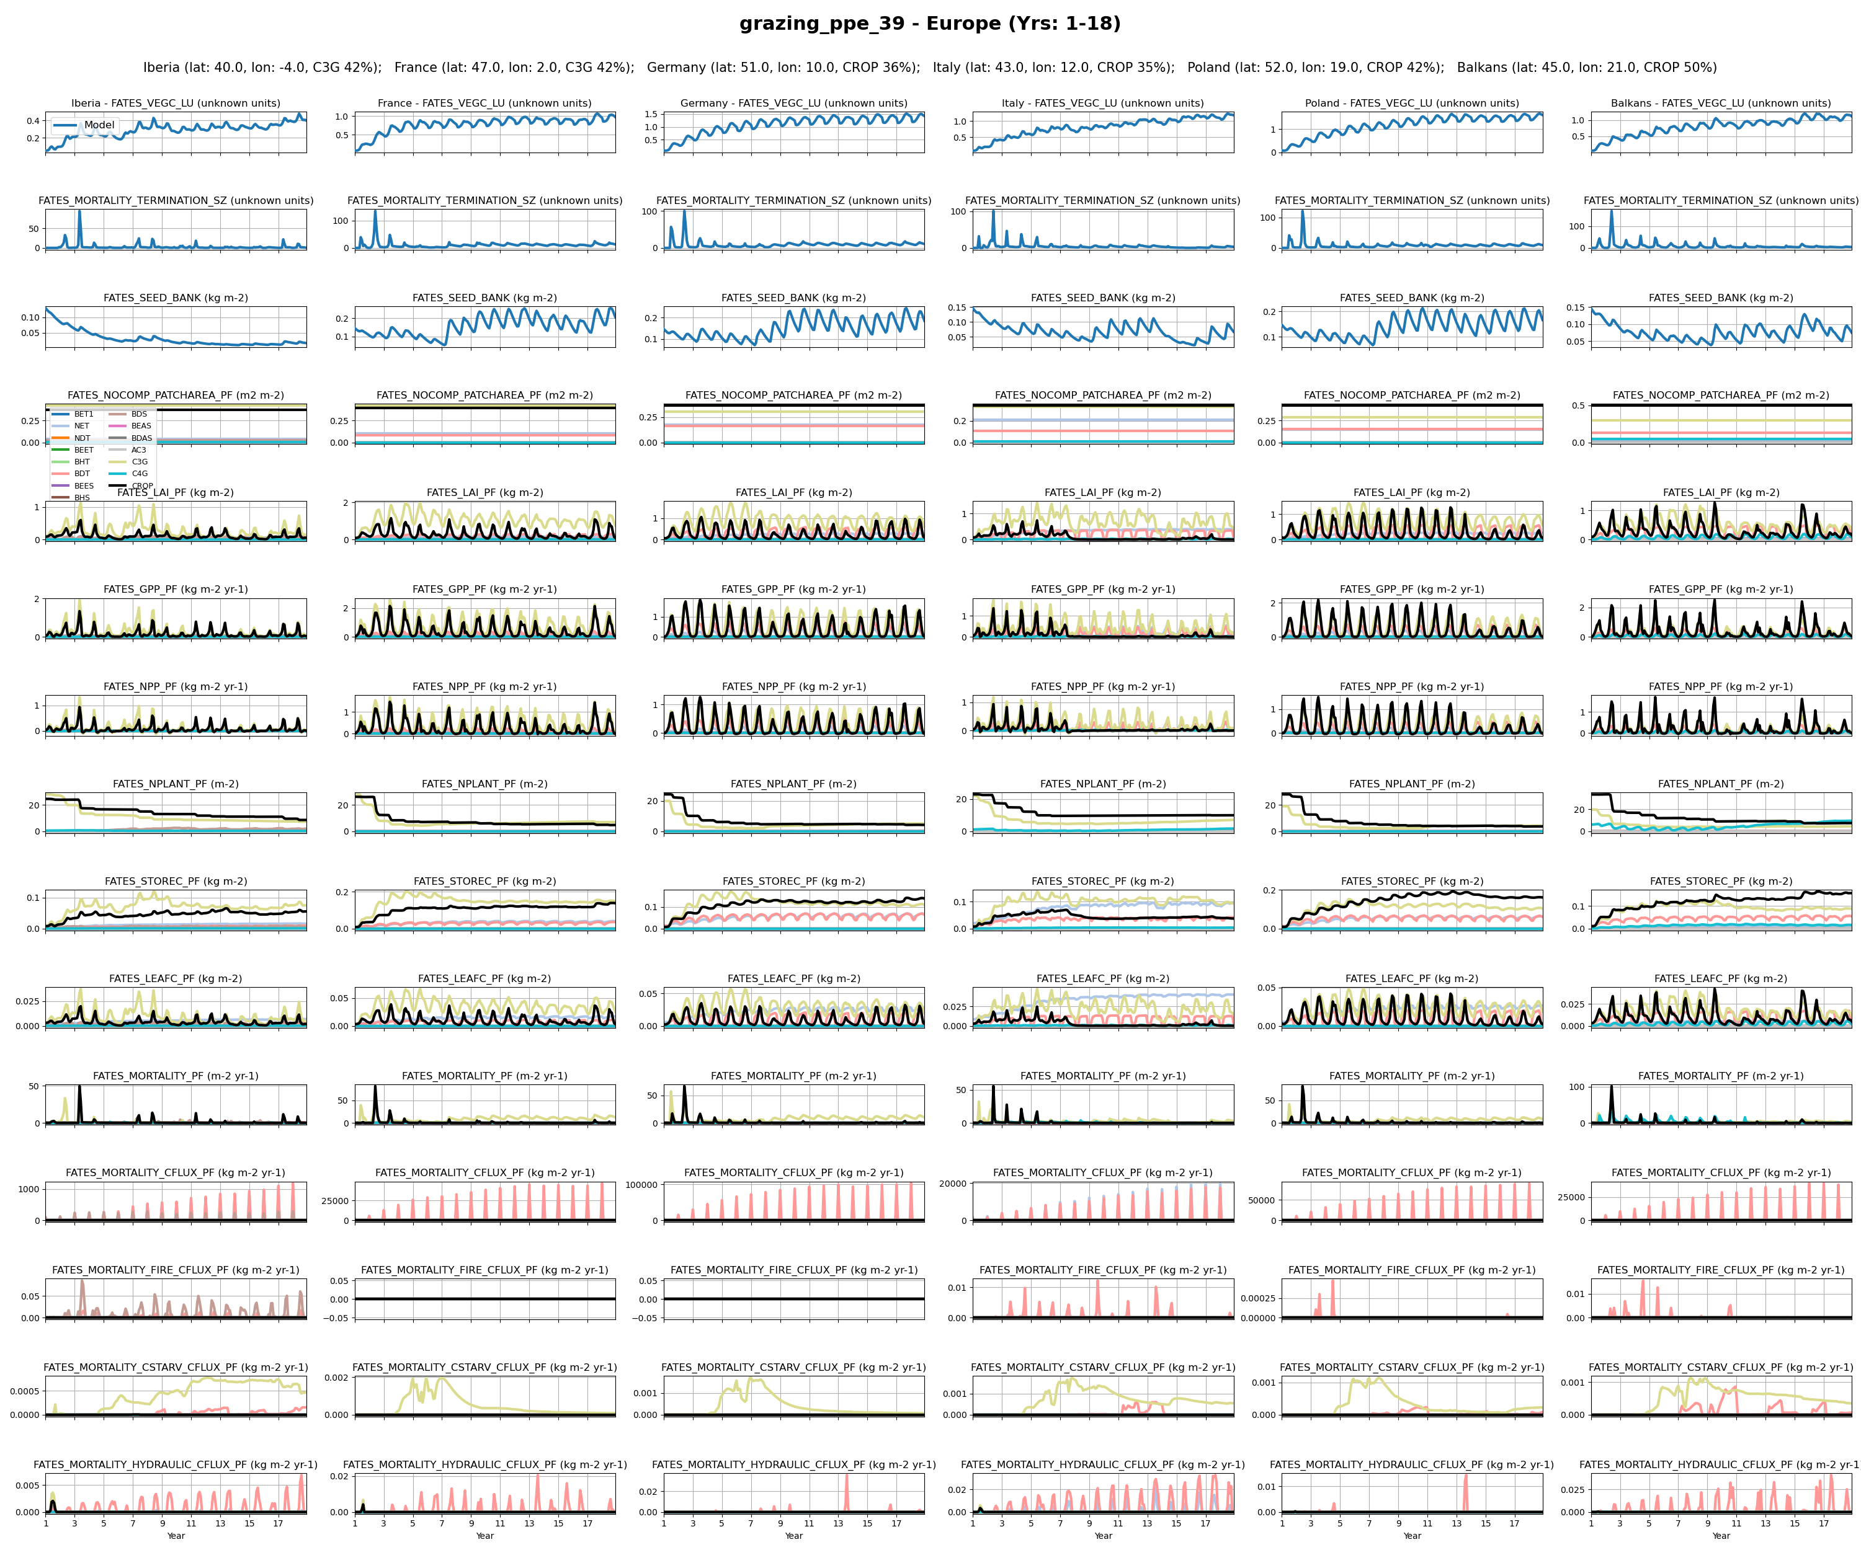
Europe
9

Slide 11
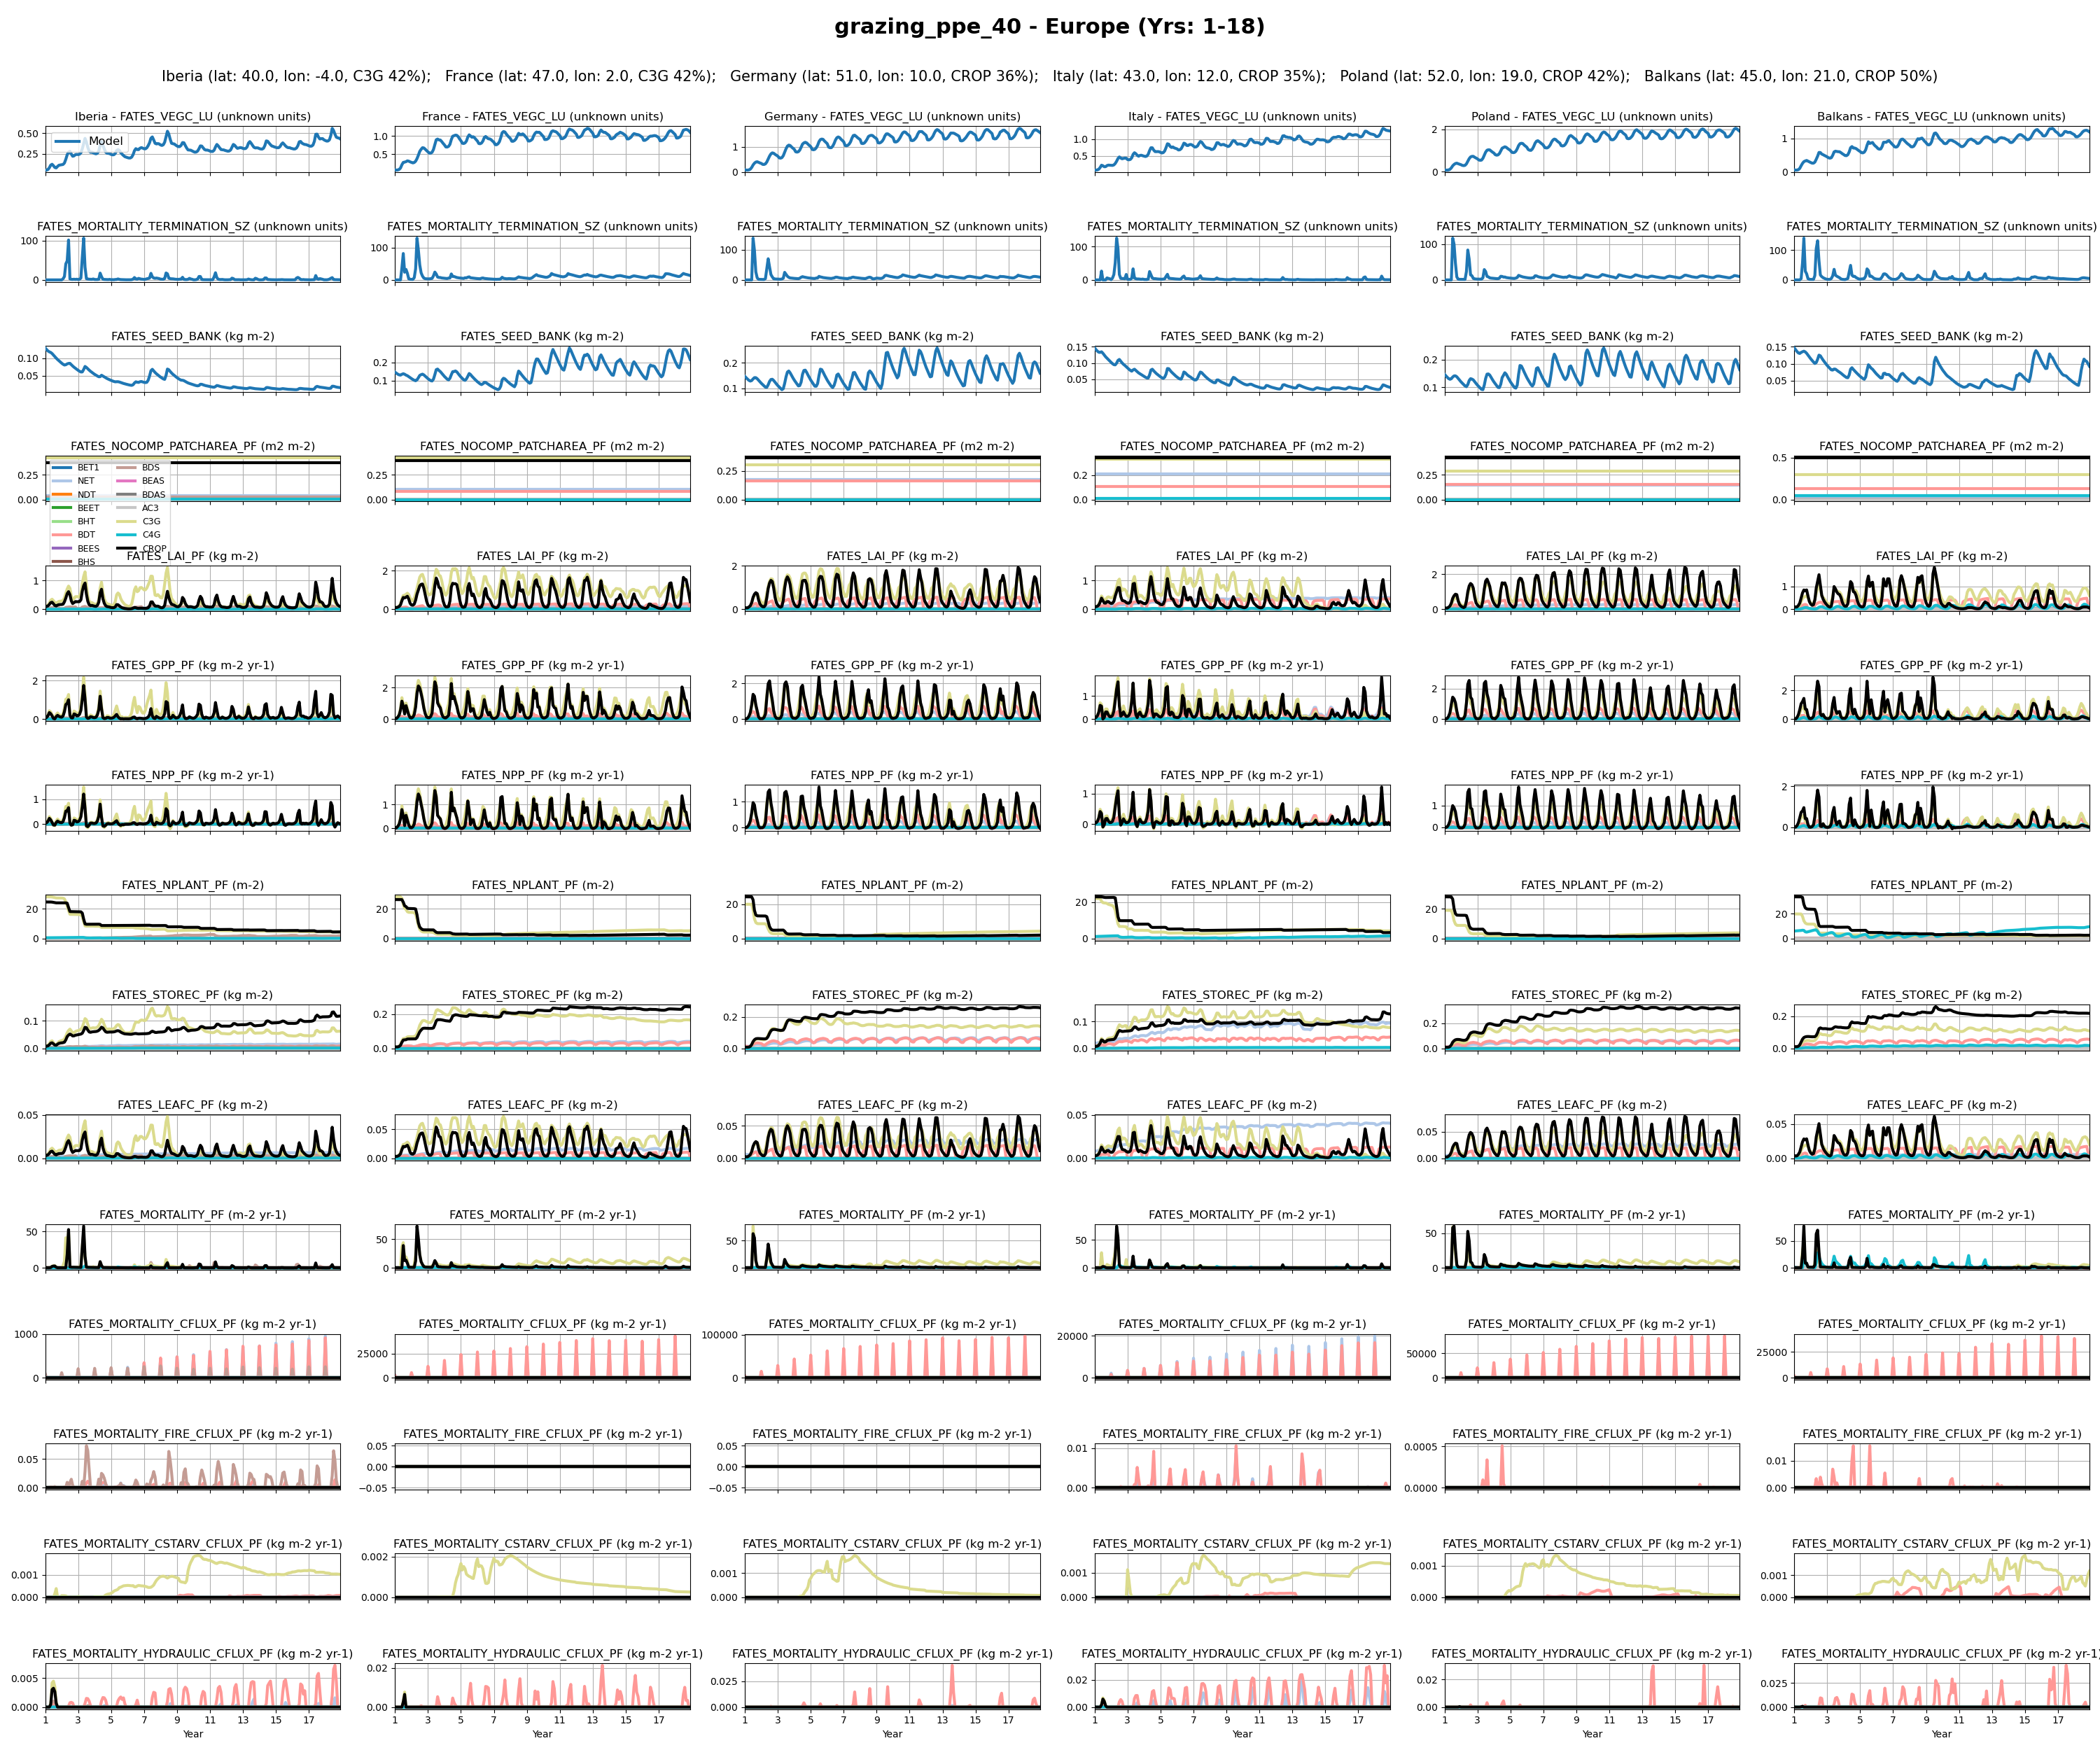
Europe
12

Slide 12
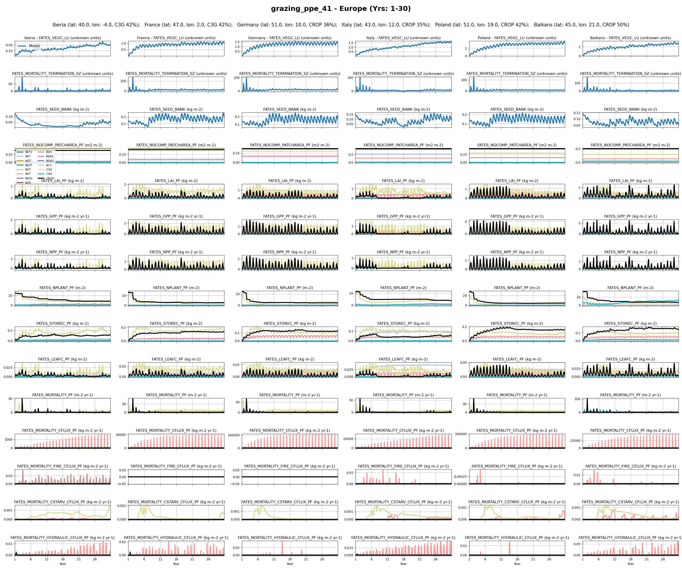
Europe
14

Slide 13
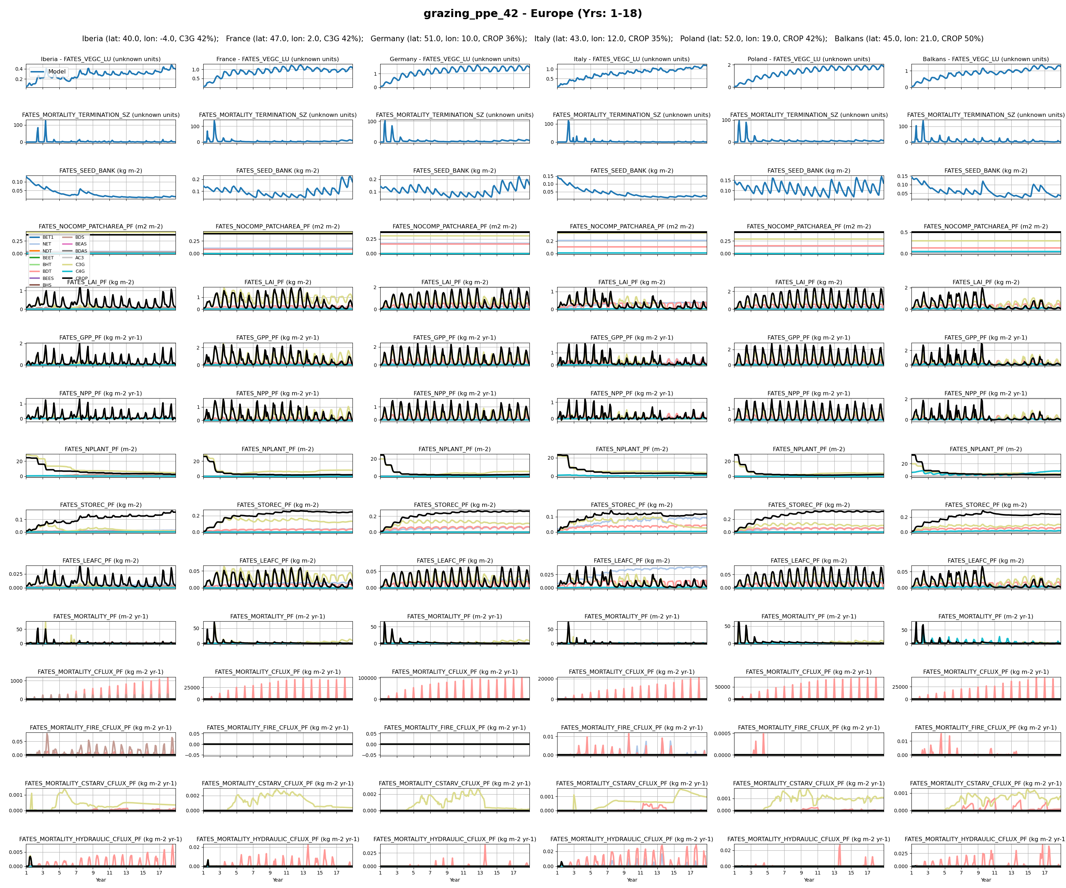
Europe
16

Slide 14
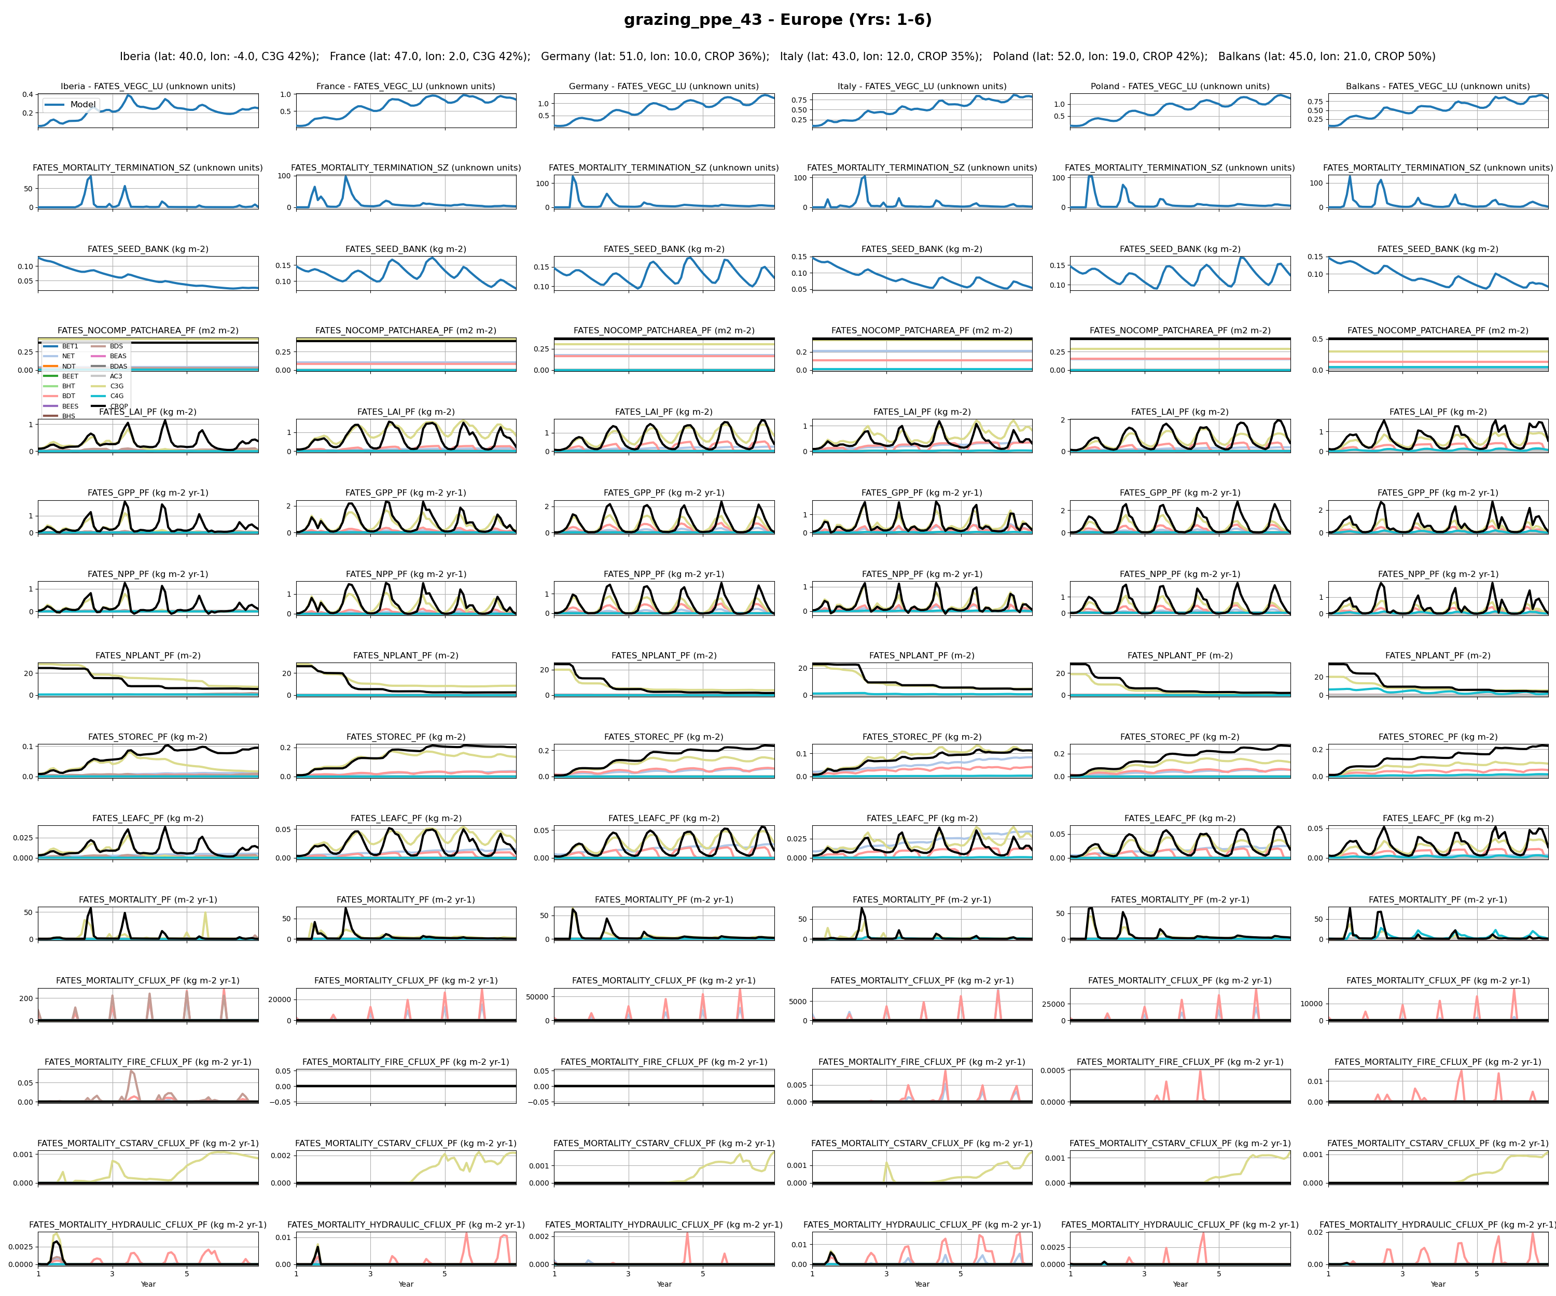
Europe
18

Slide 15
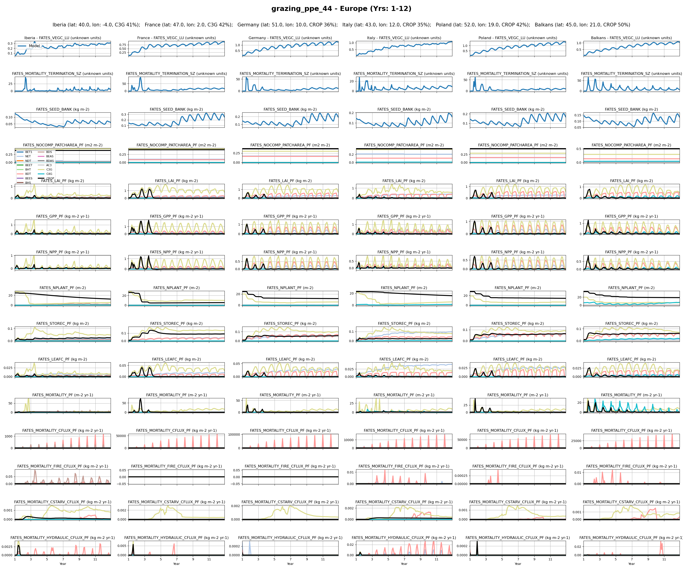
Europe
20

Slide 16
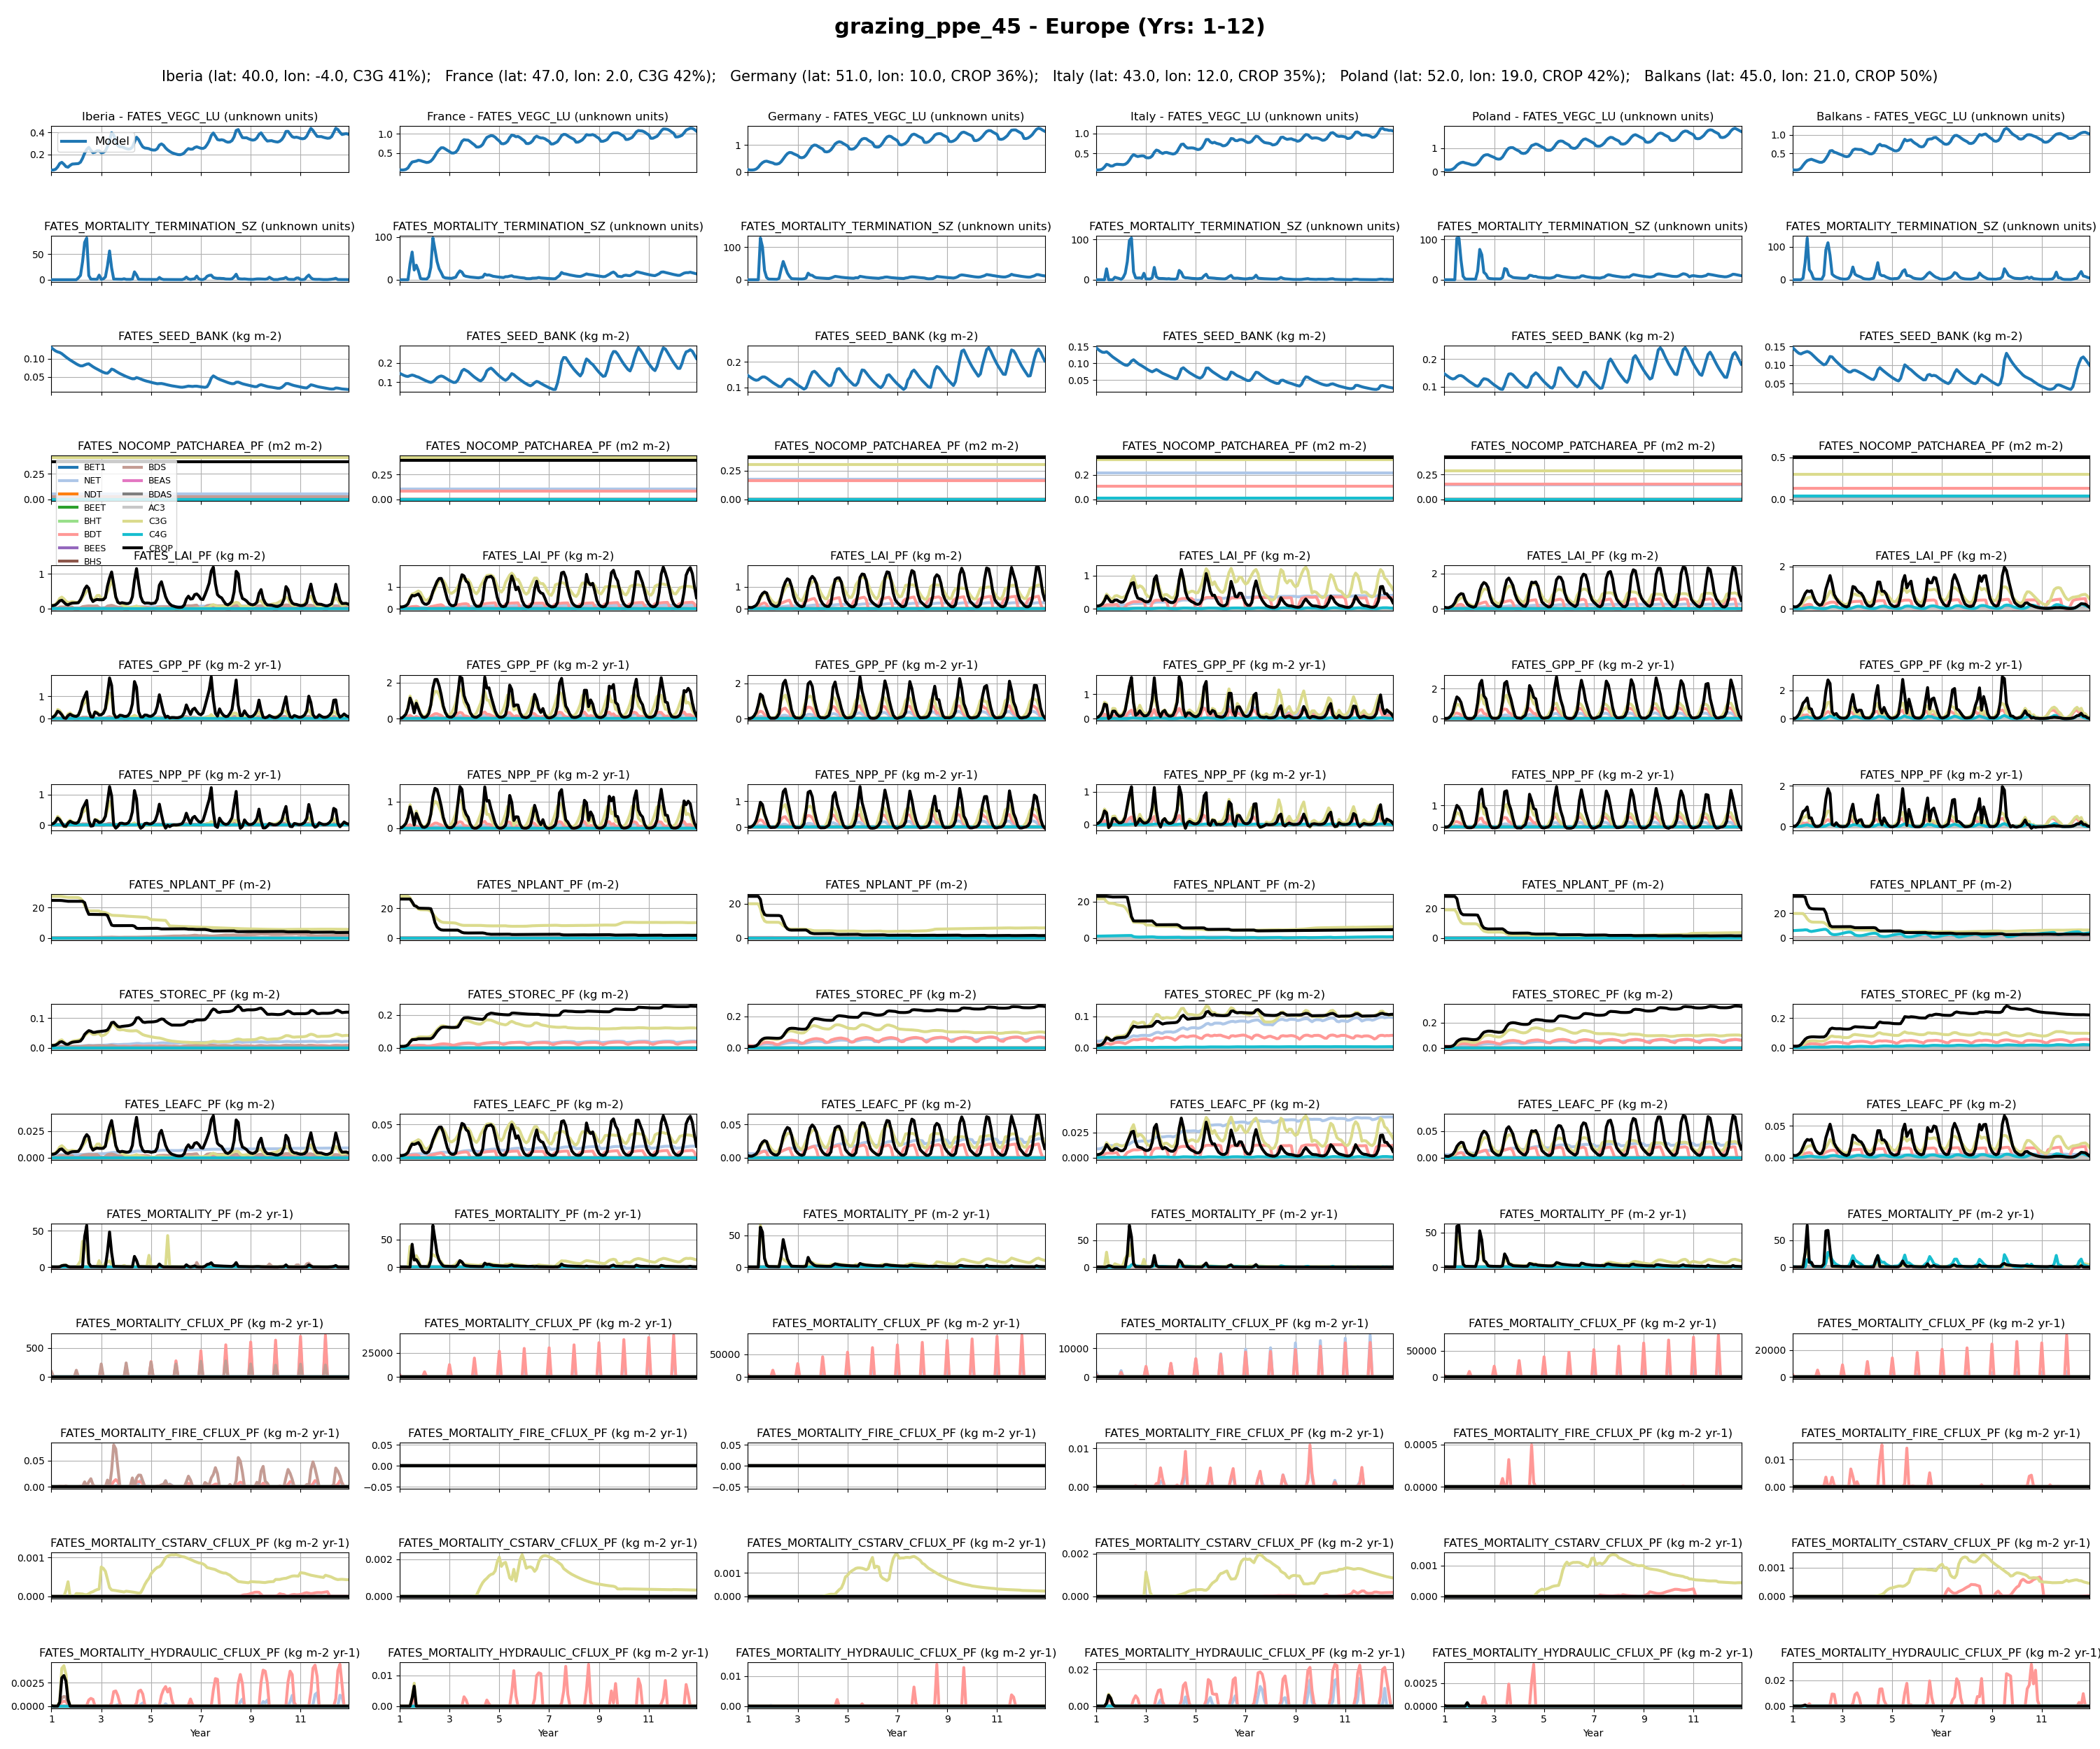
Europe
21

Slide 17
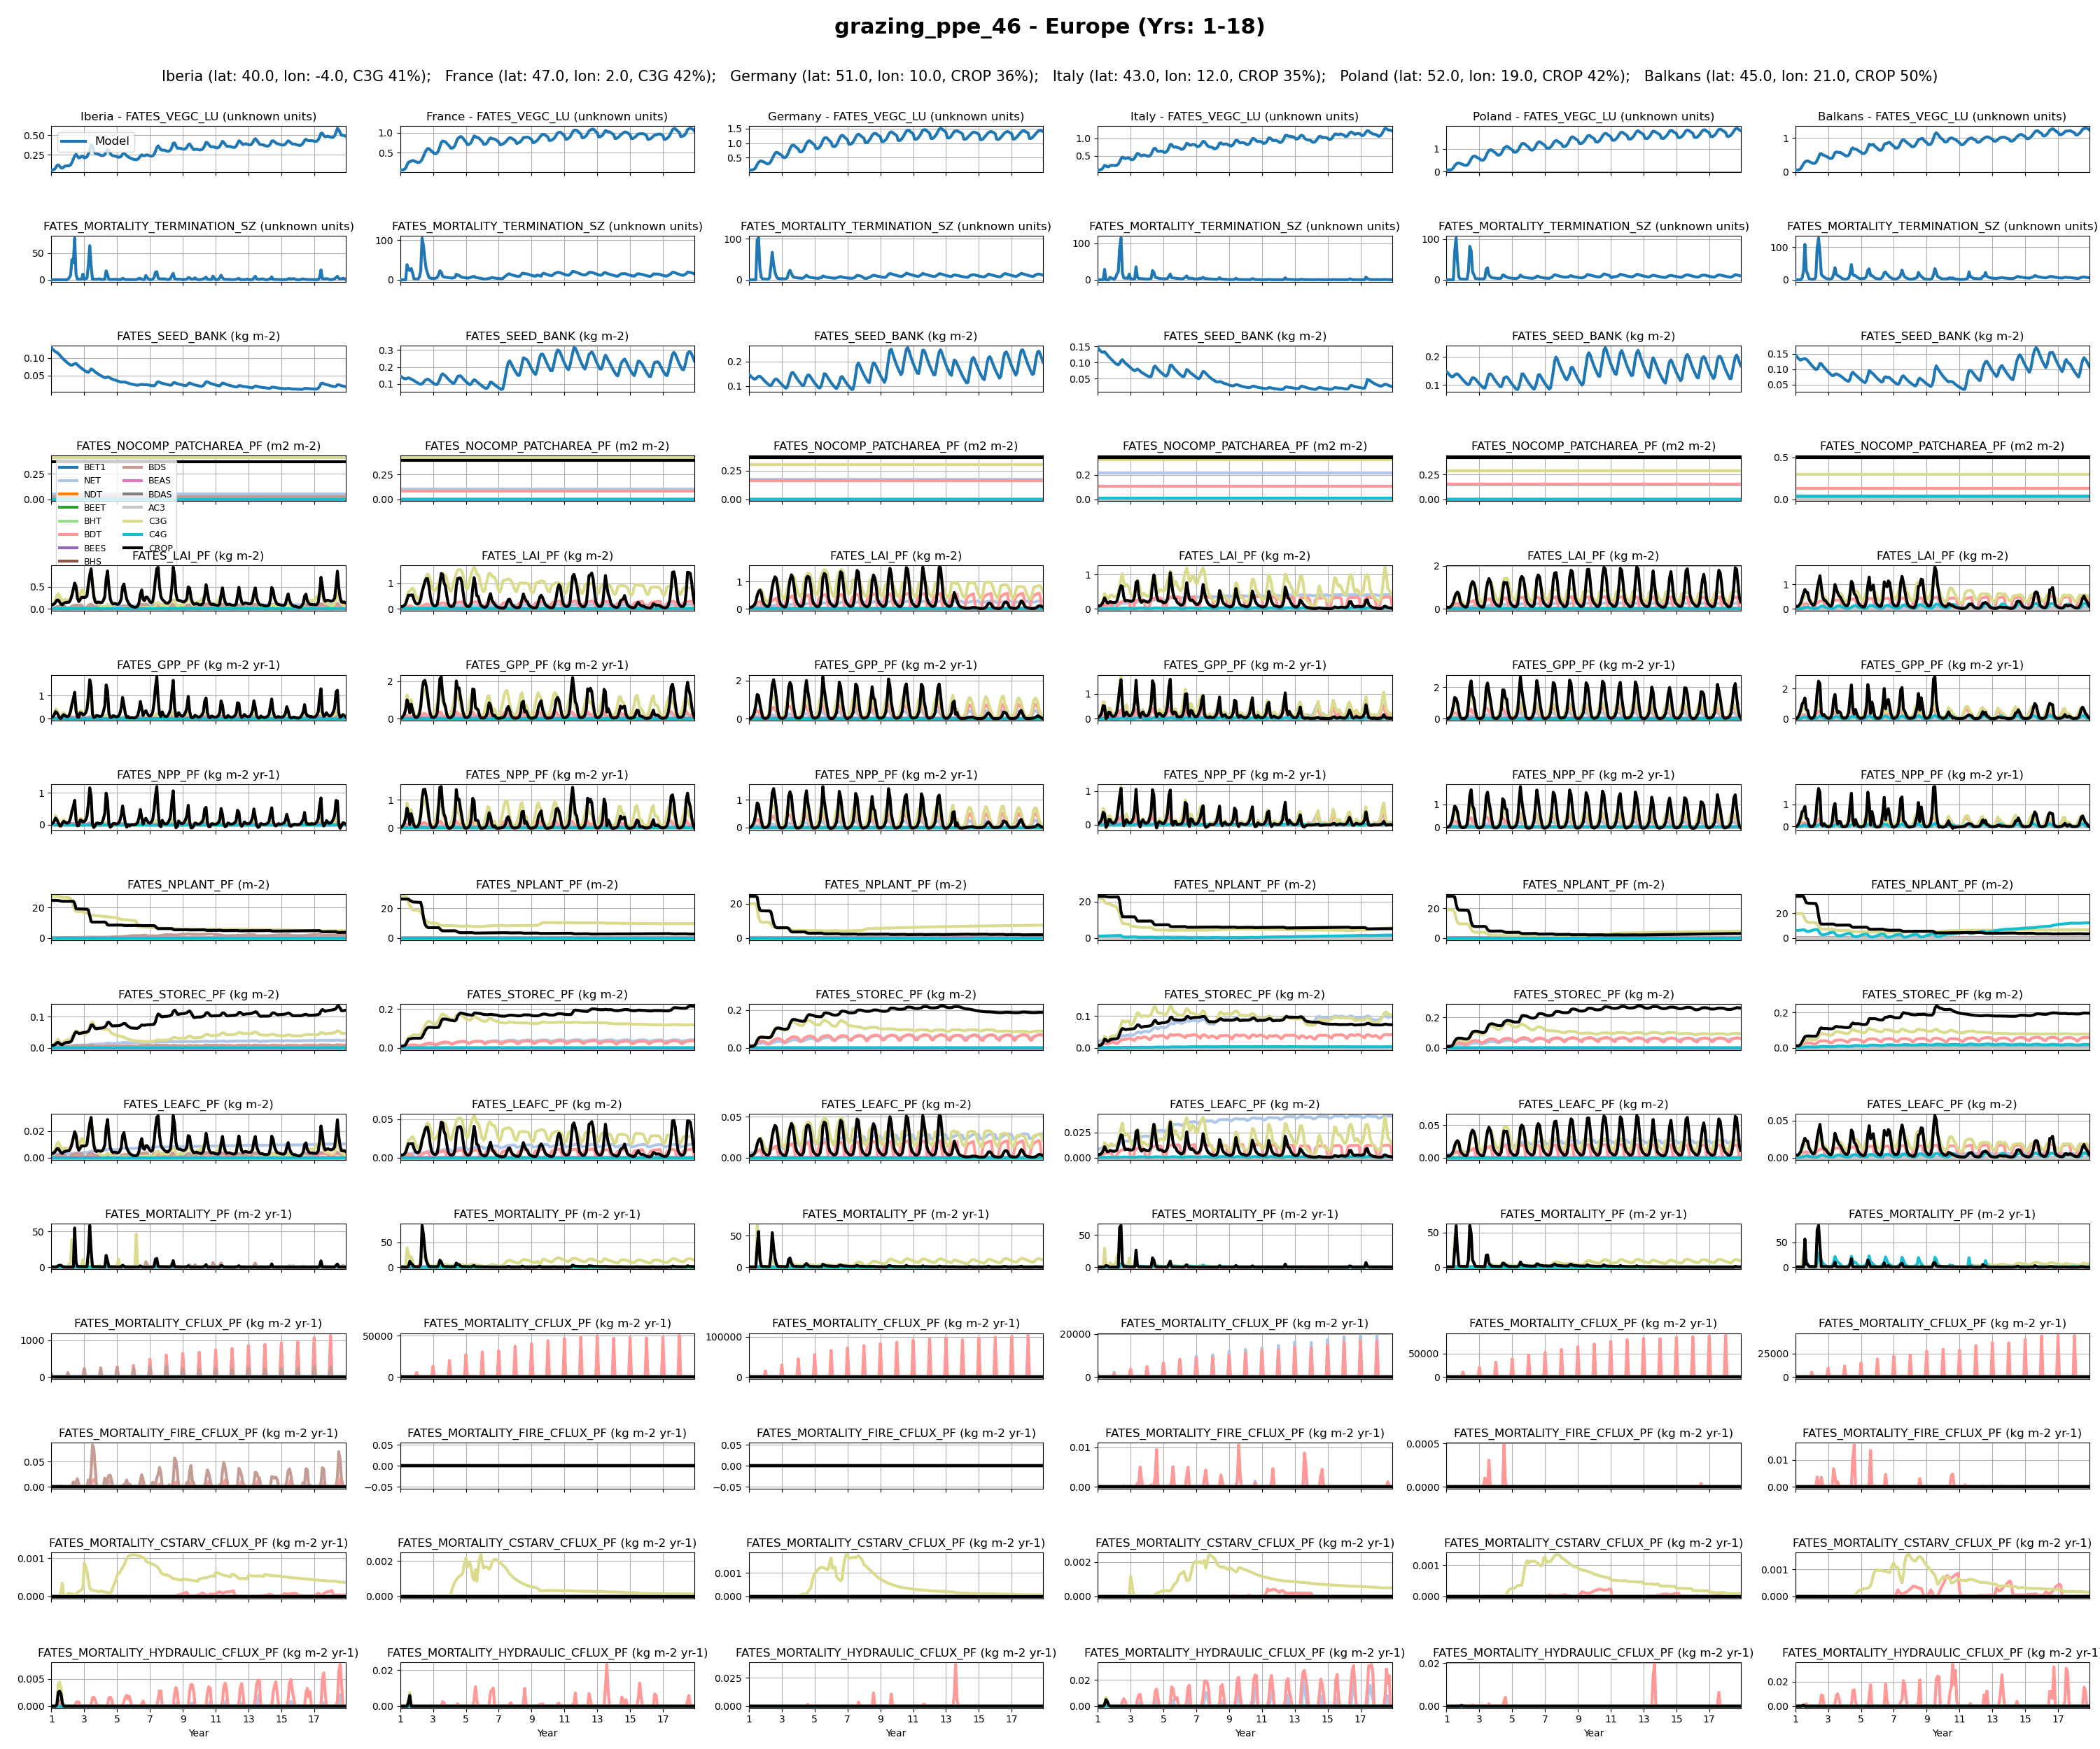
Europe
22

Slide 18
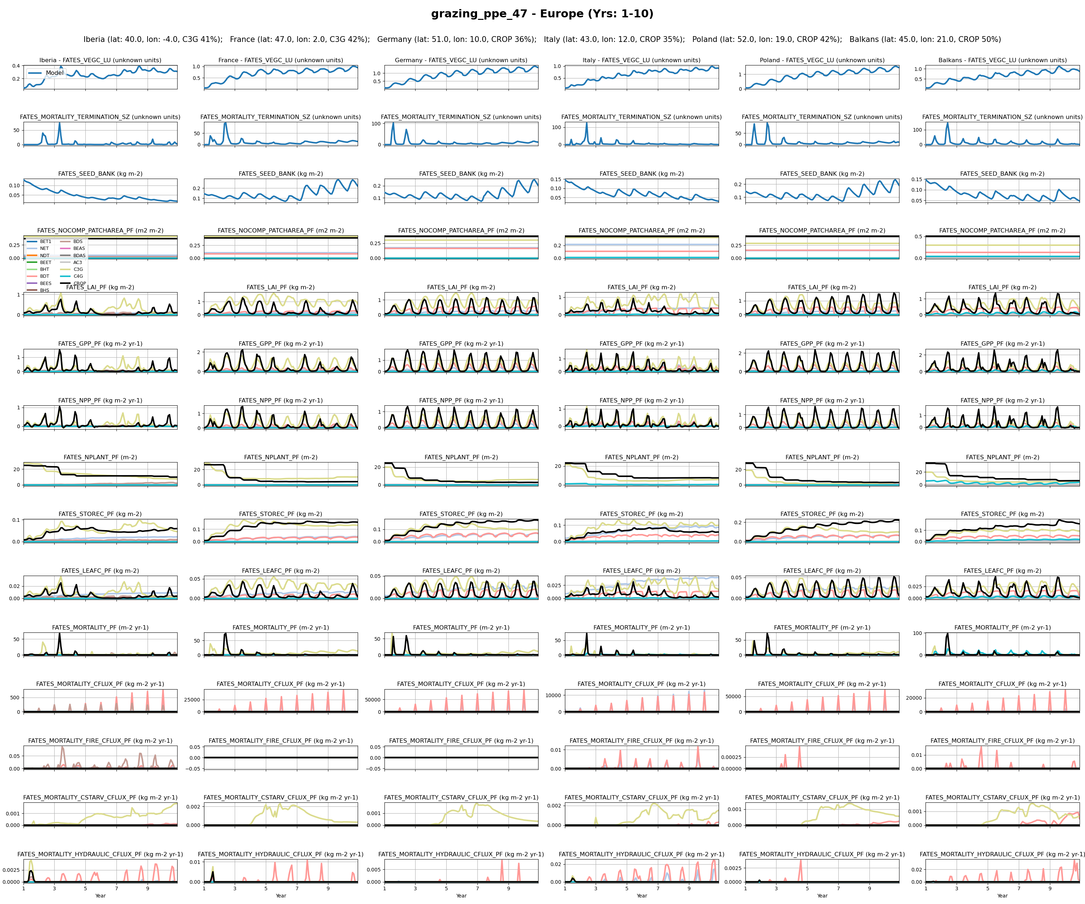
Europe
23

Slide 19
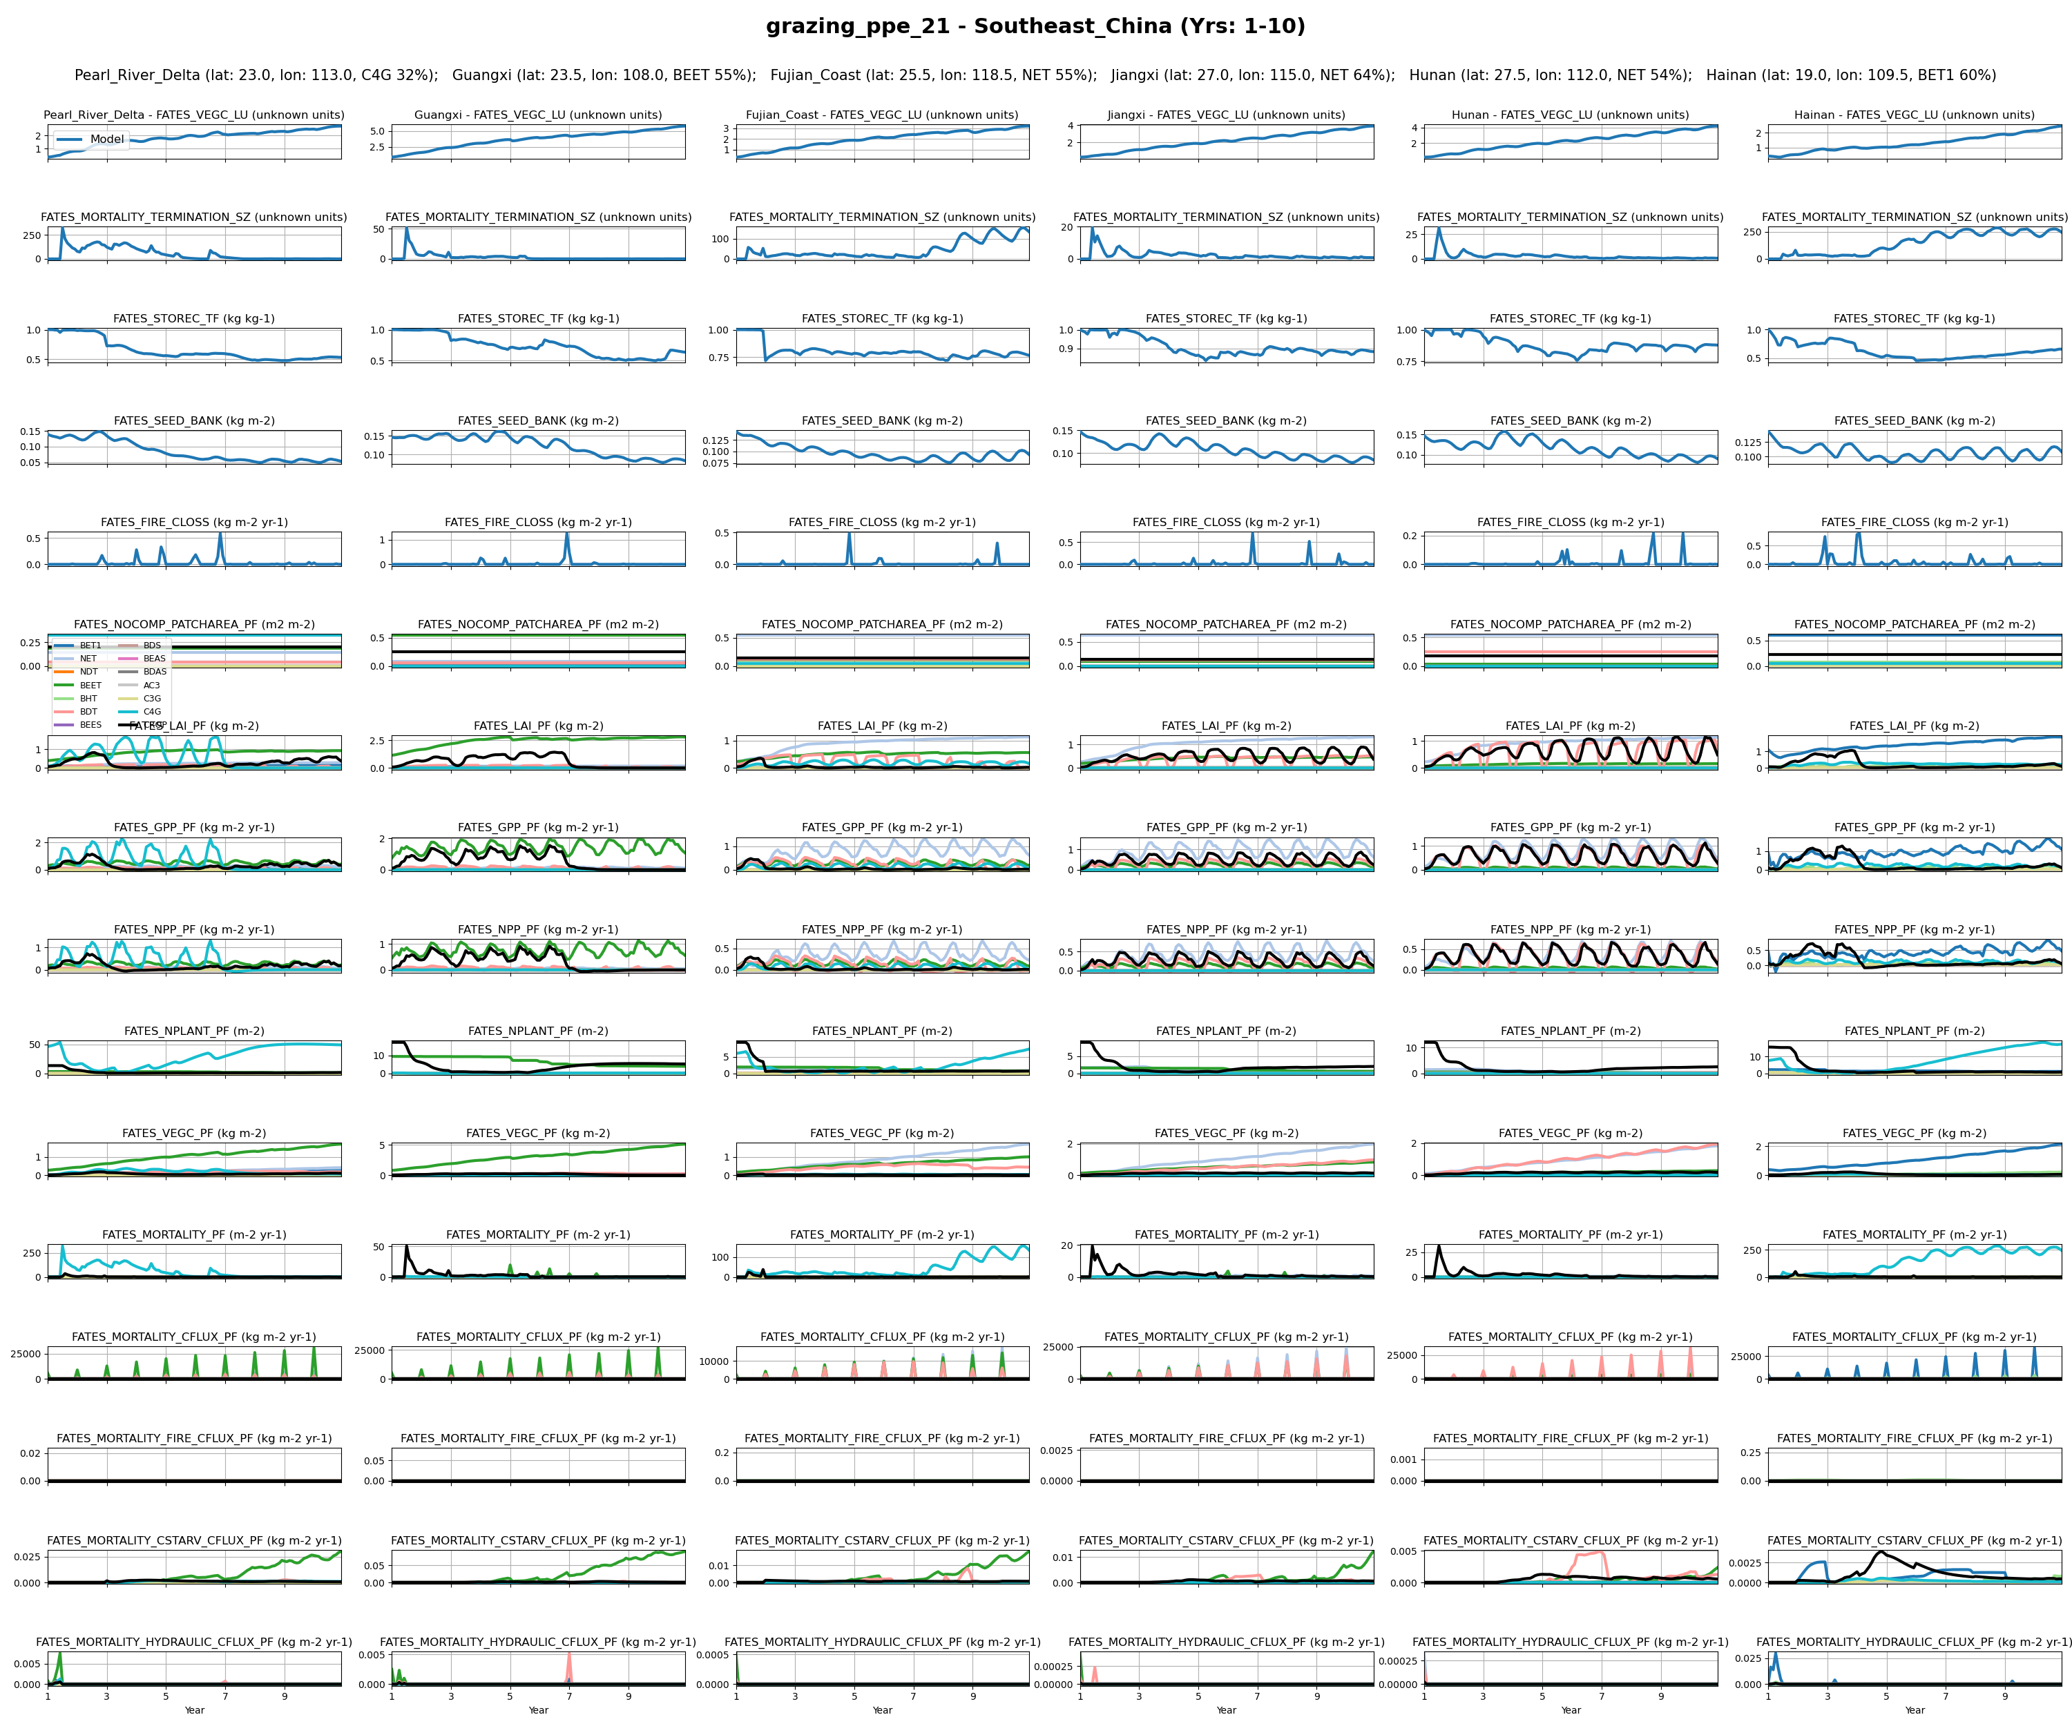
Southeast_China
0

Slide 20
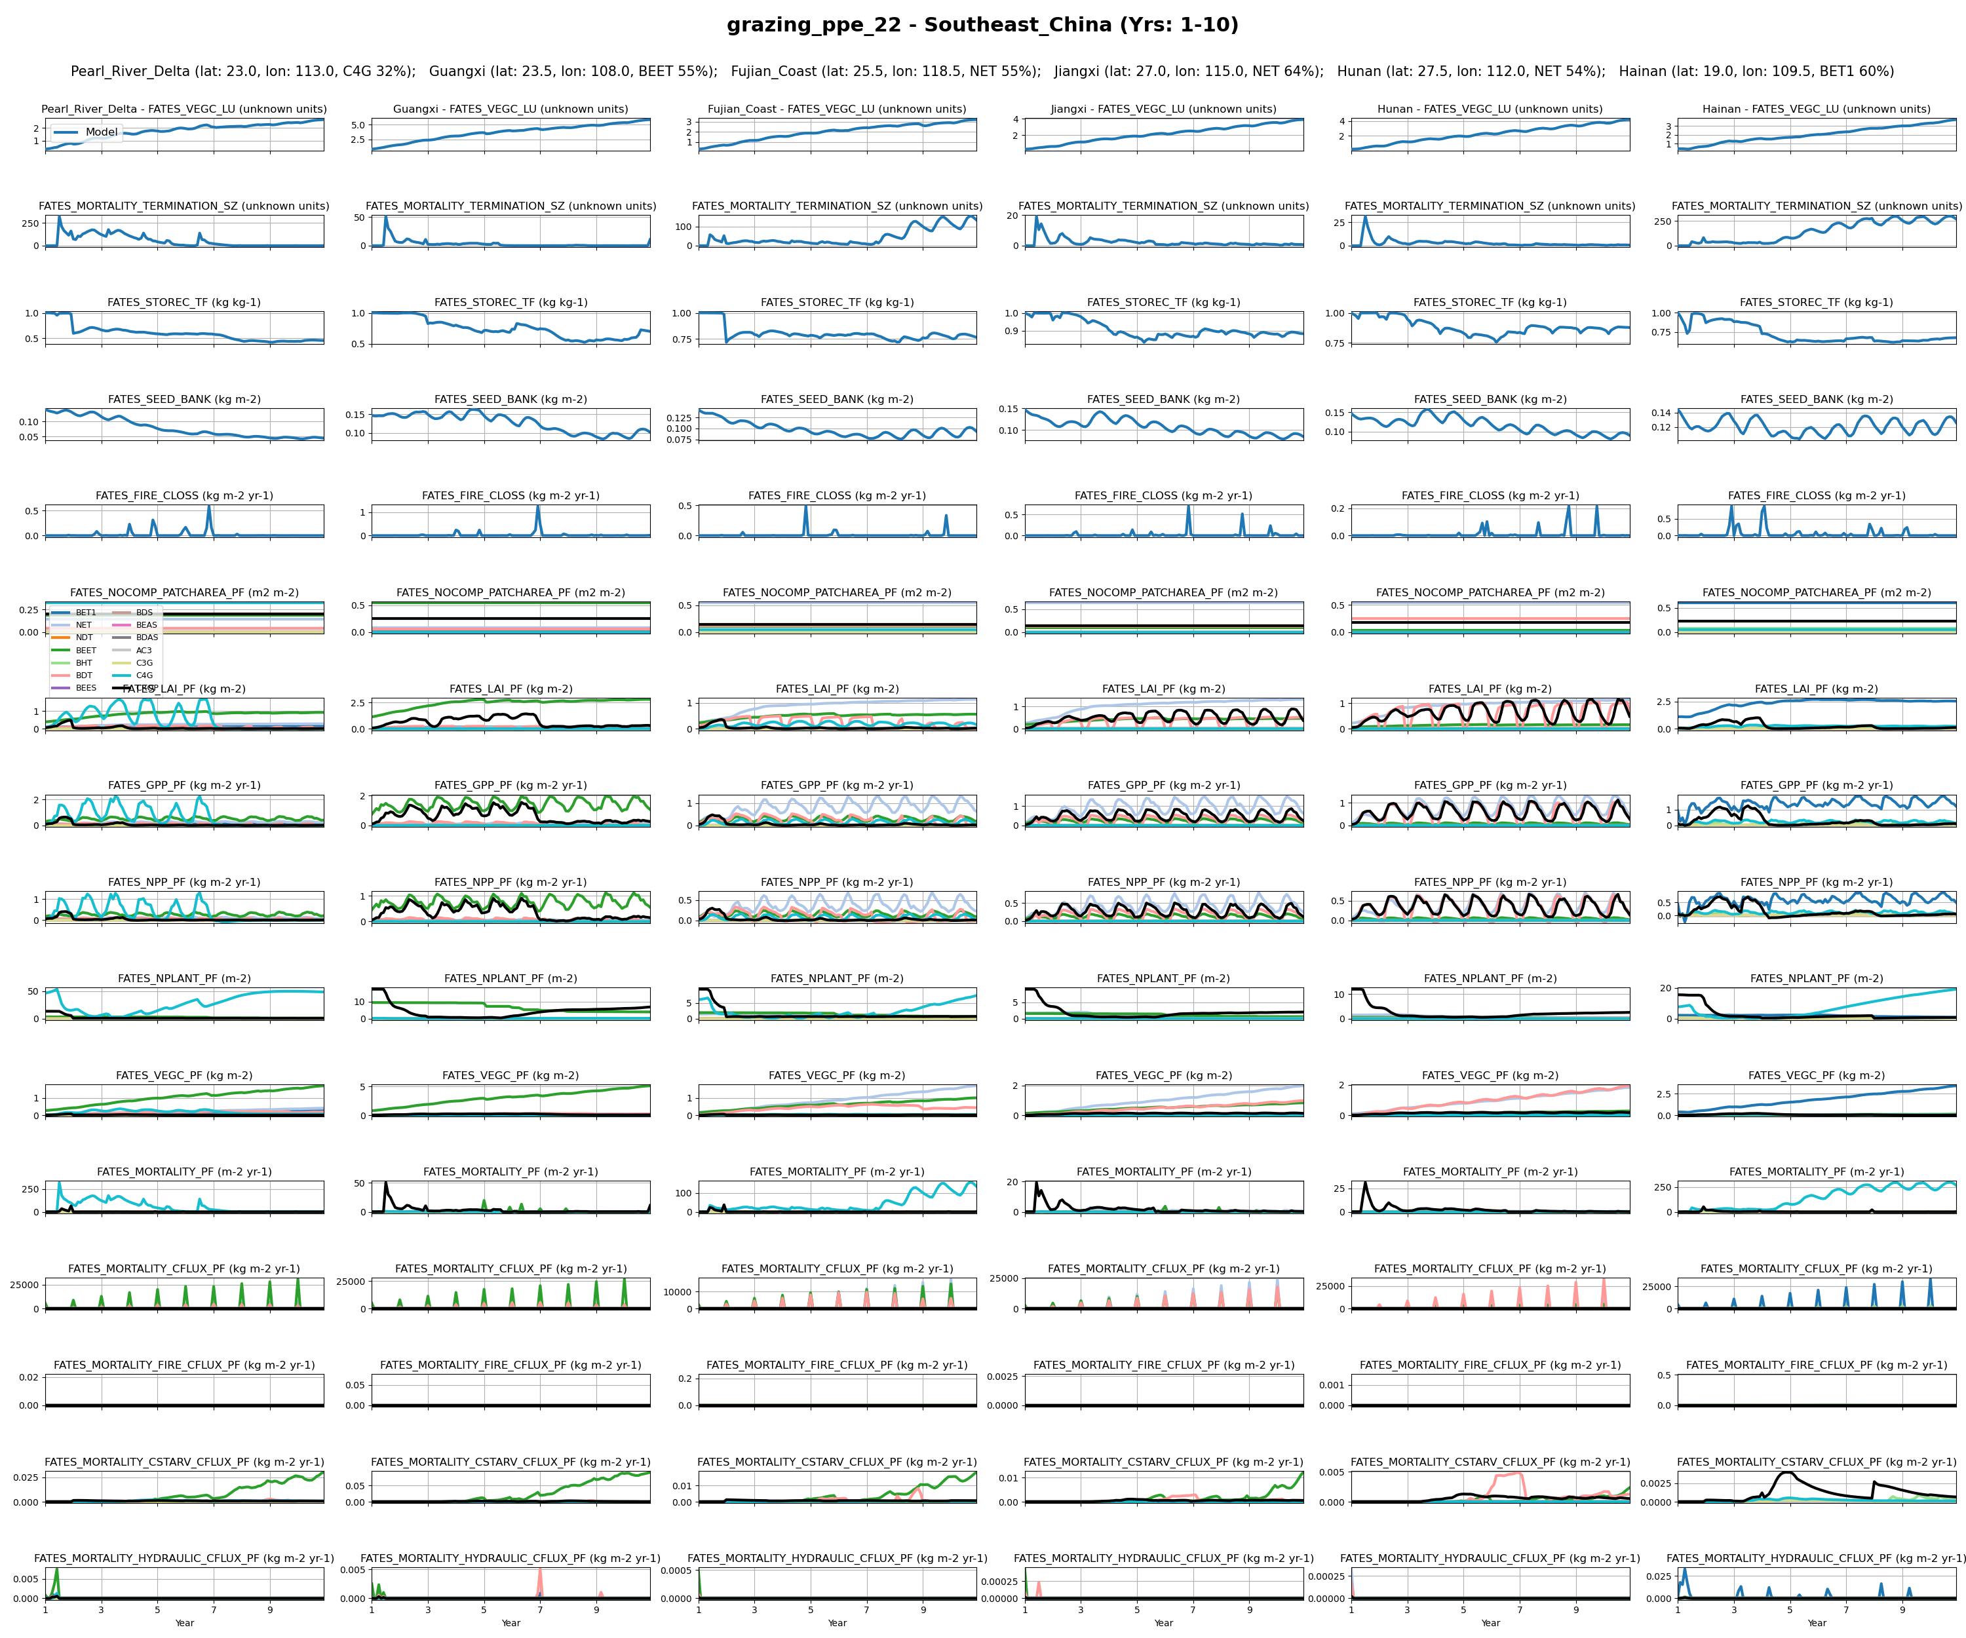
Southeast_China
1

Slide 21
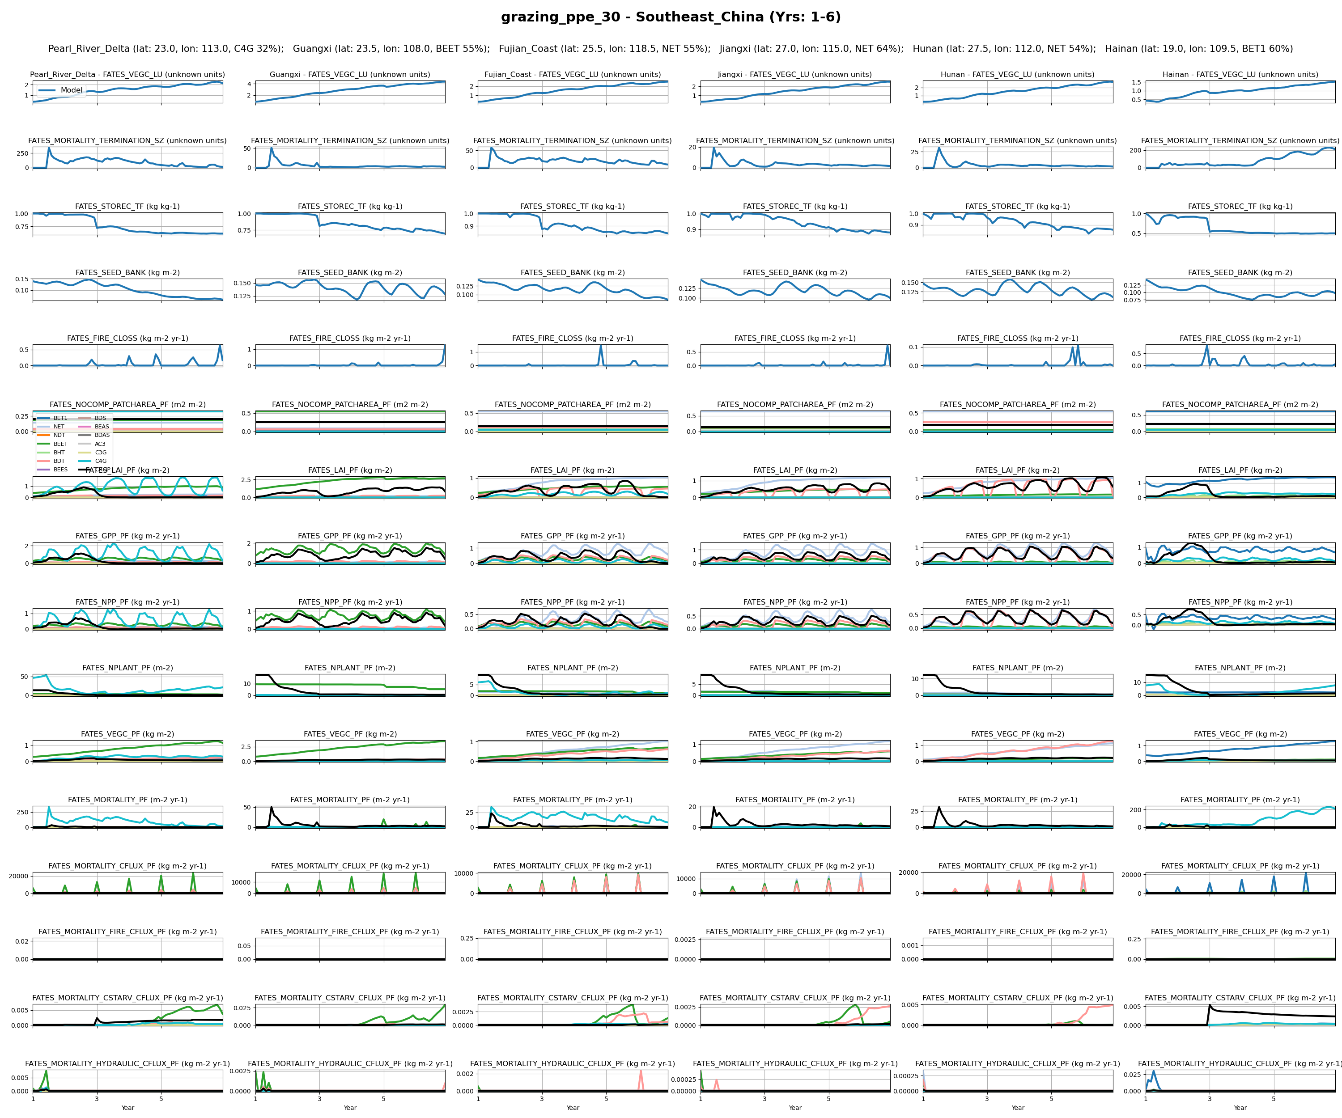
Southeast_China
2

Slide 22
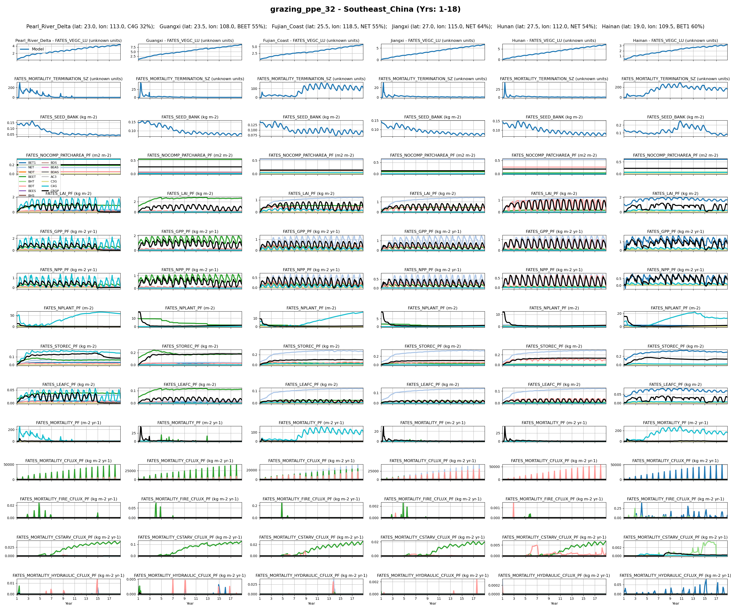
Southeast_China
3

Slide 23
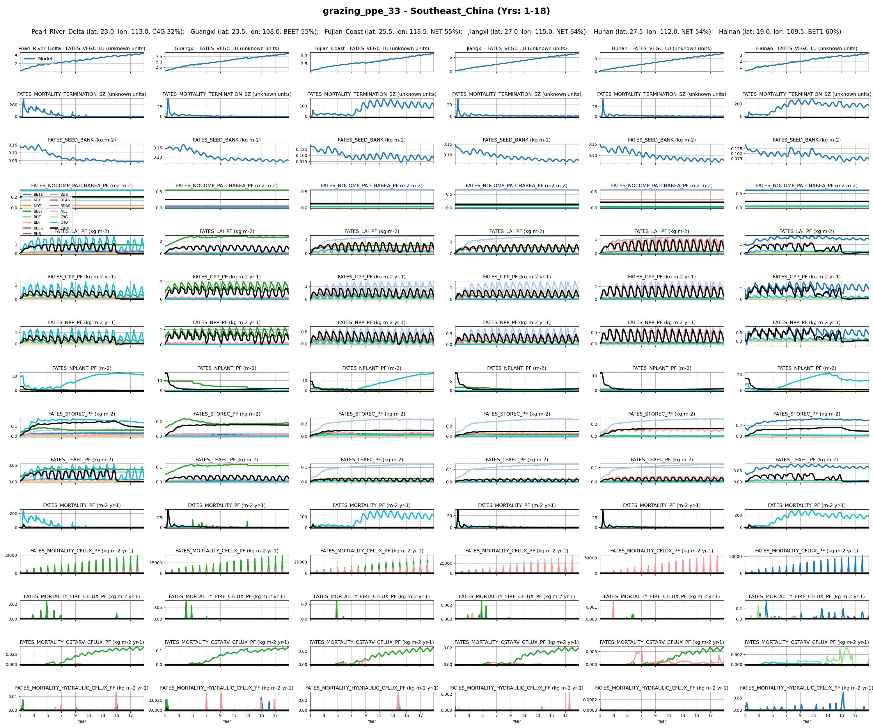
Southeast_China
4

Slide 24
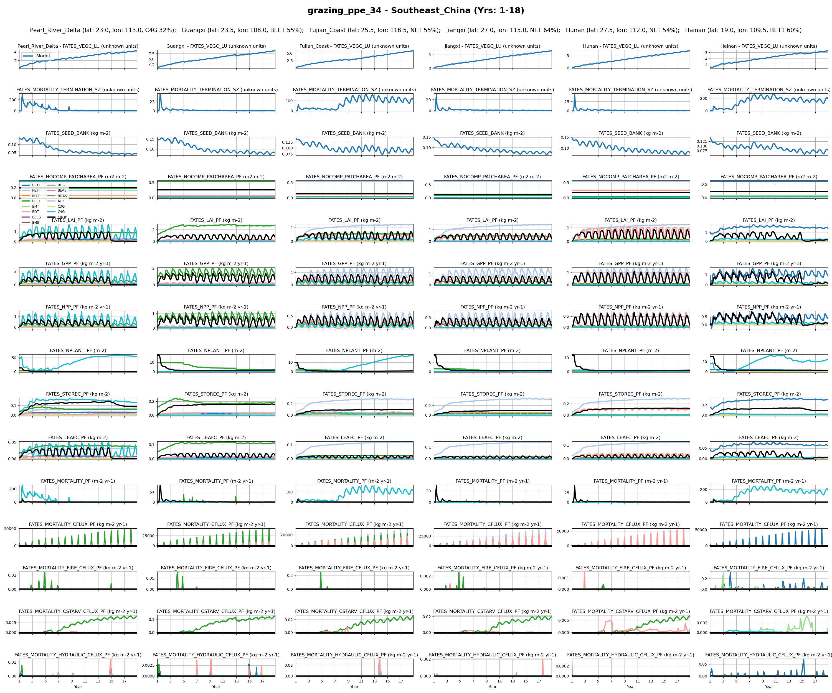
Southeast_China
5

Slide 25
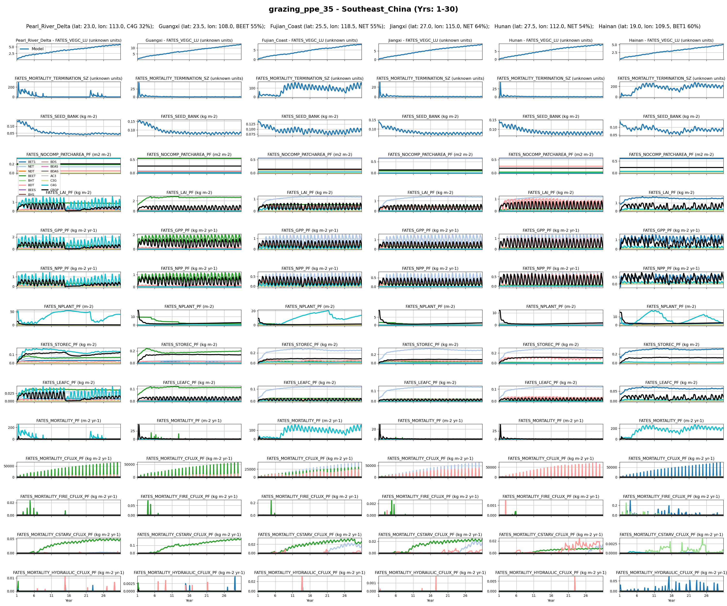
Southeast_China
6

Slide 26
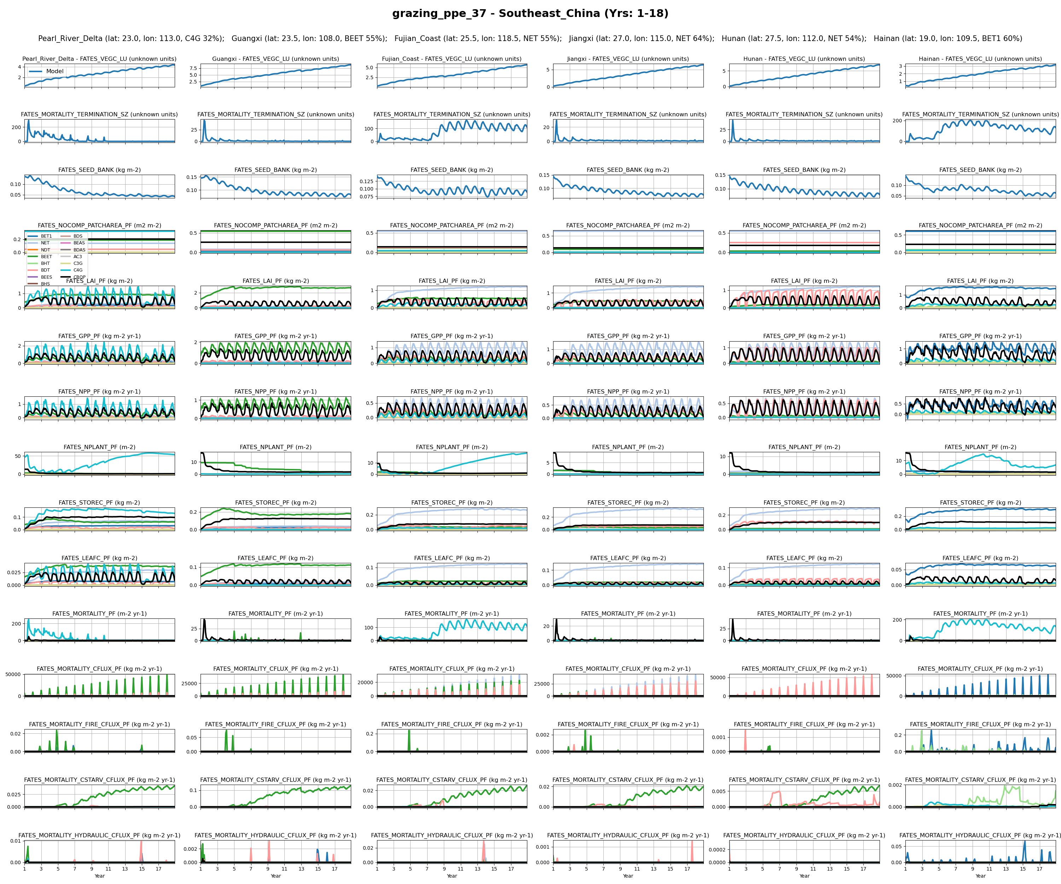
Southeast_China
7

Slide 27
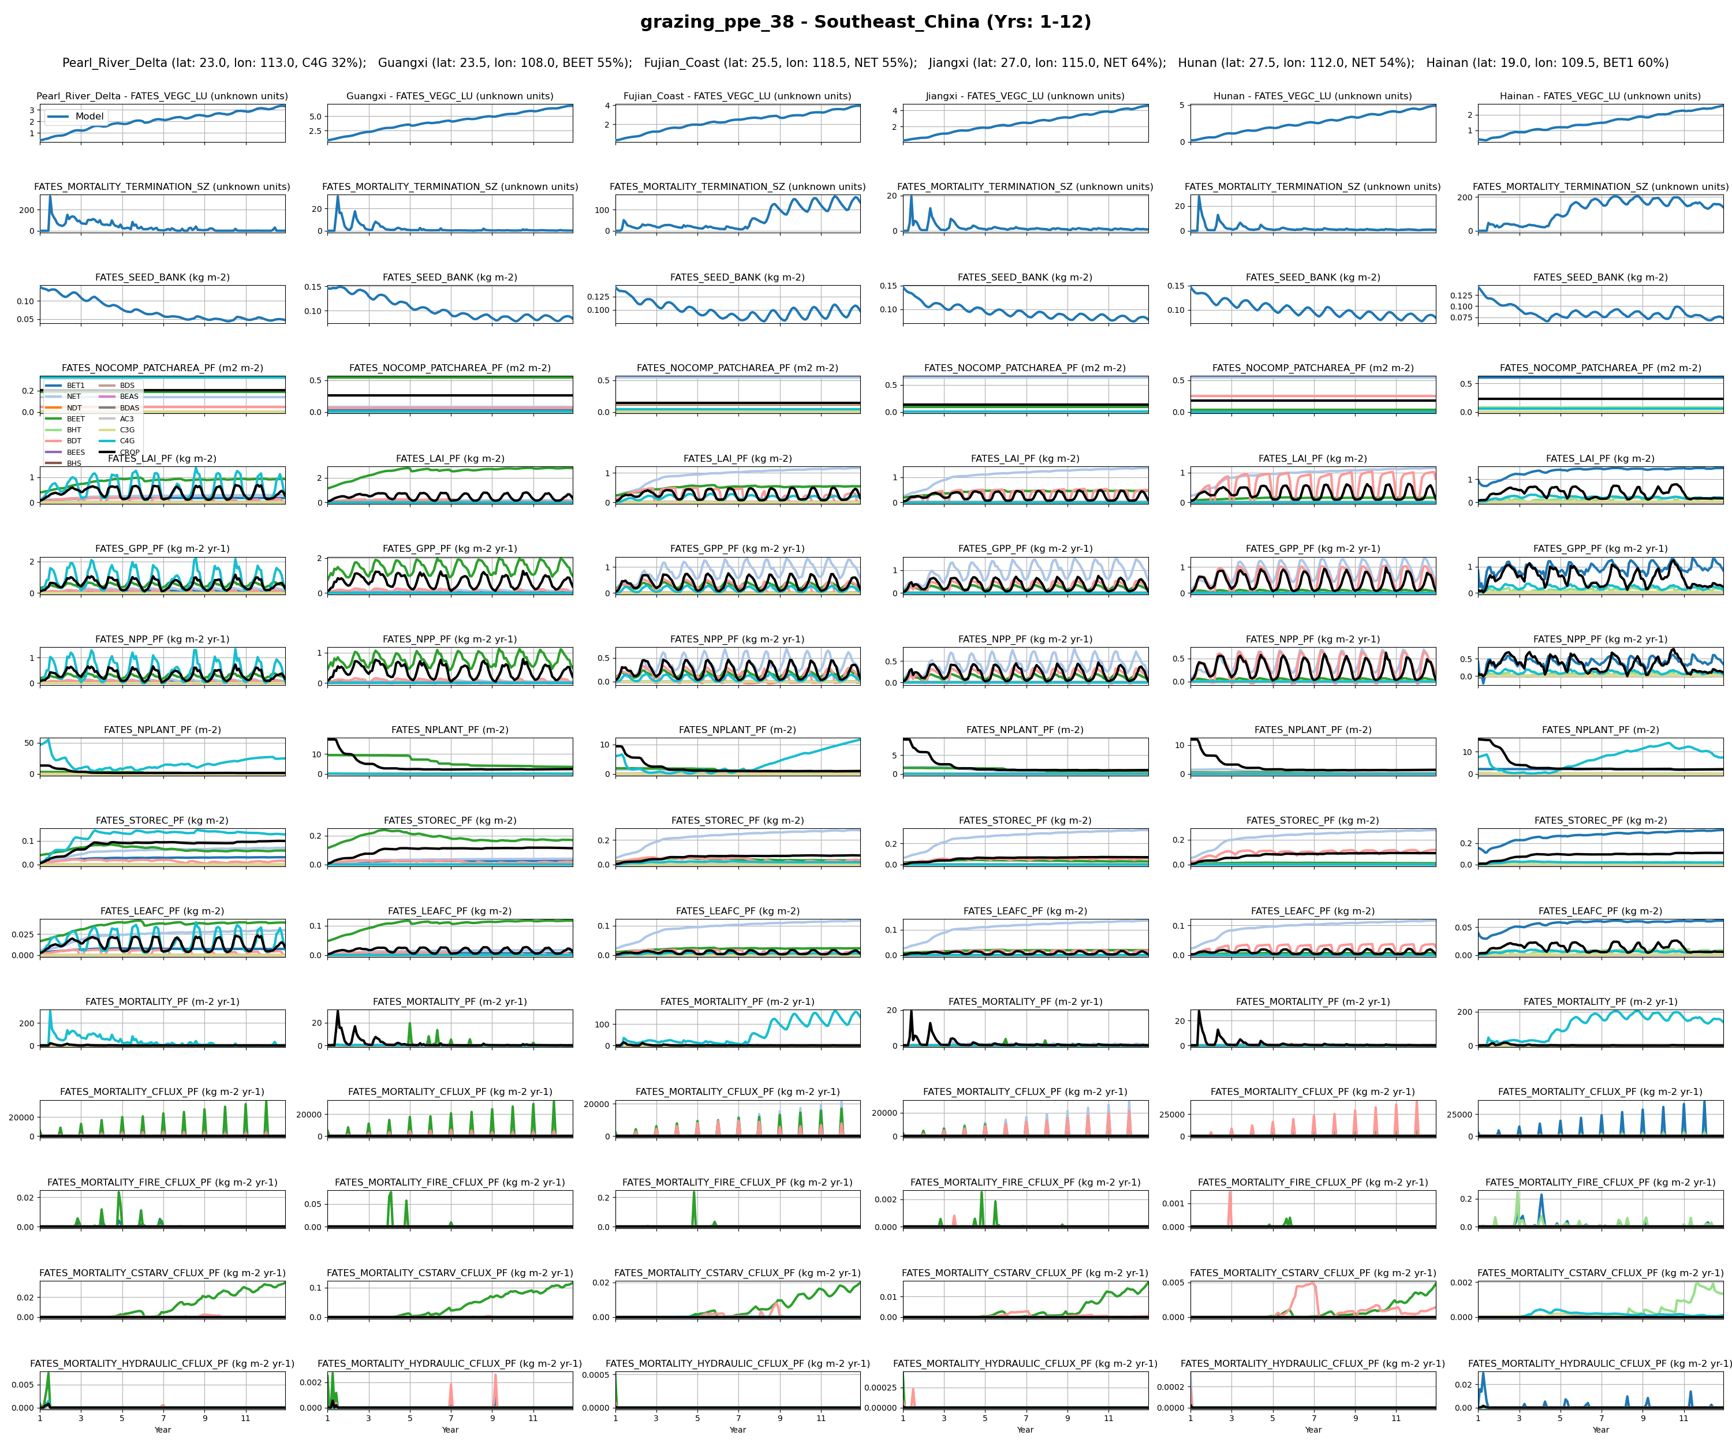
Southeast_China
8

Slide 28
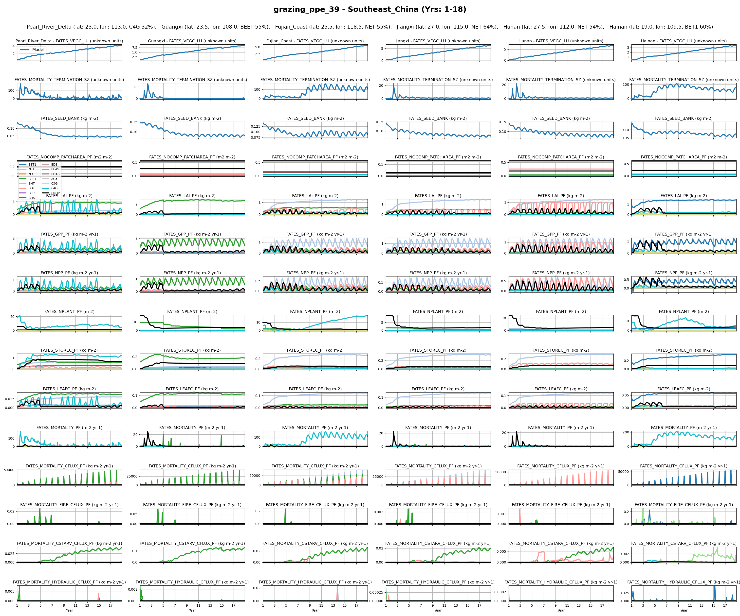
Southeast_China
9

Slide 29
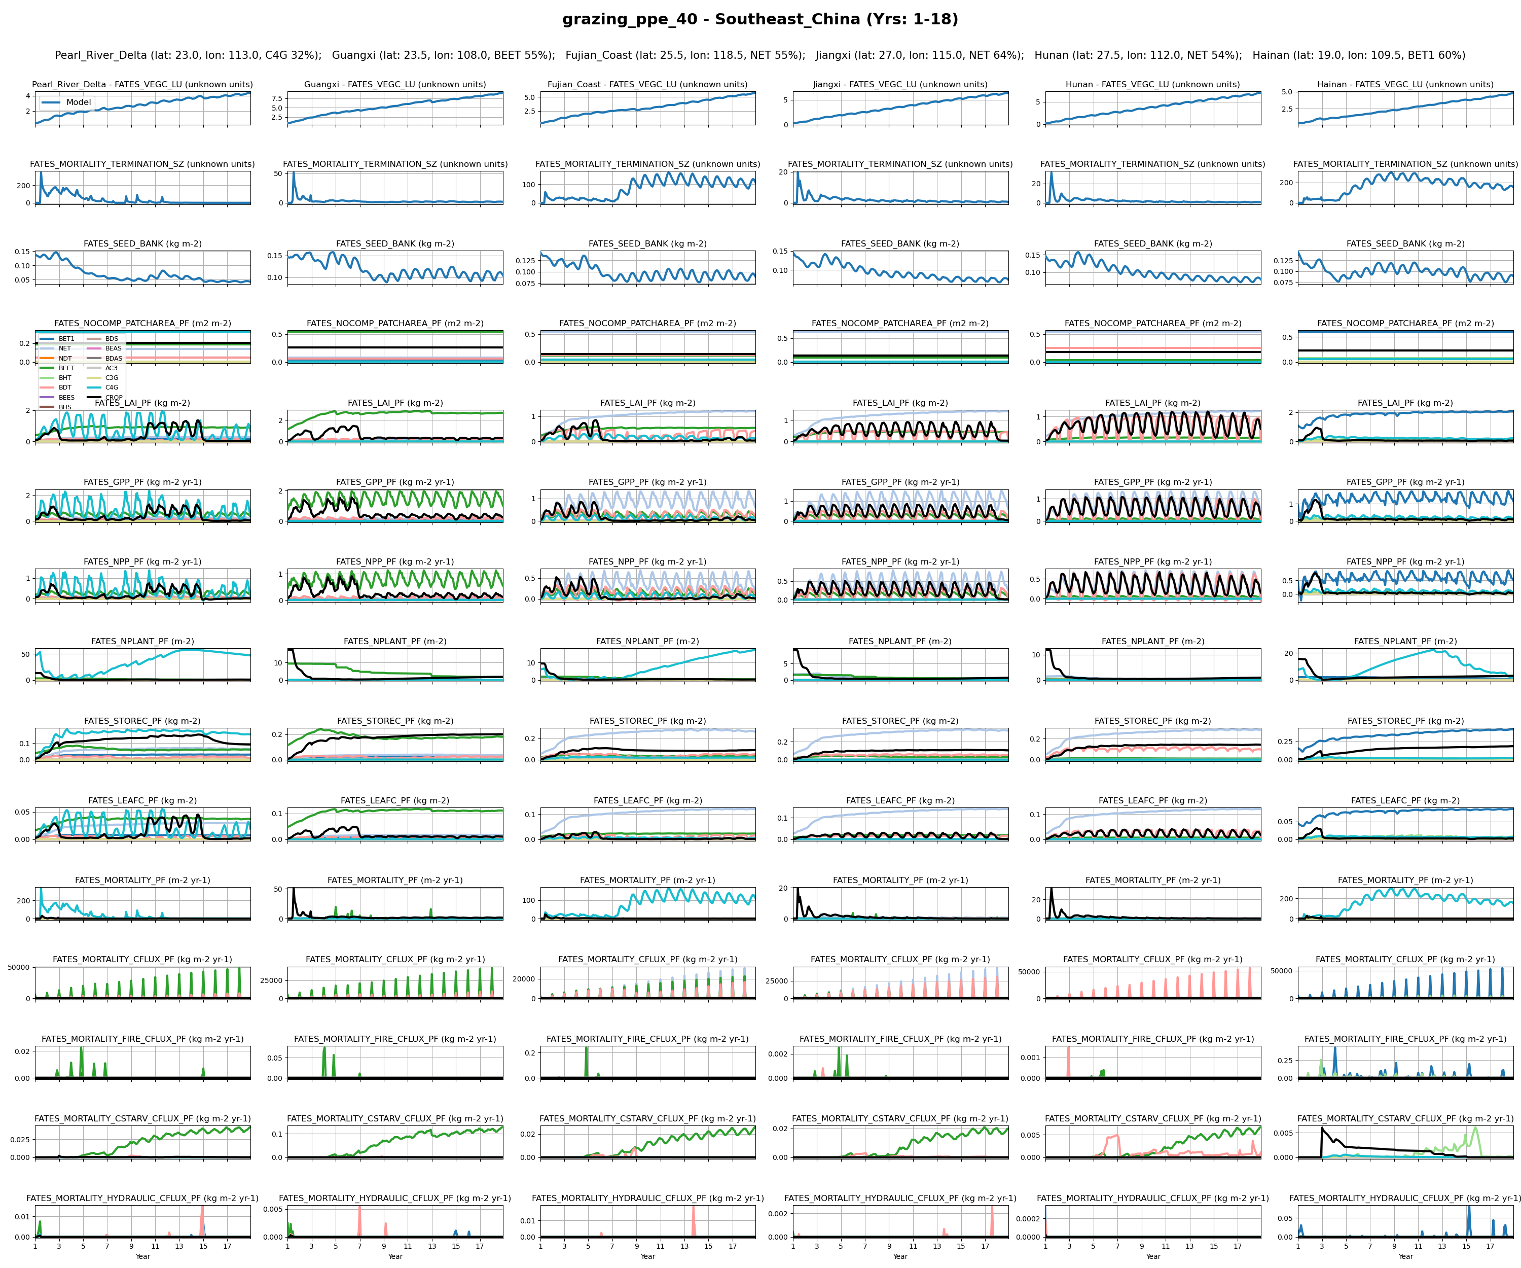
Southeast_China
12

Slide 30
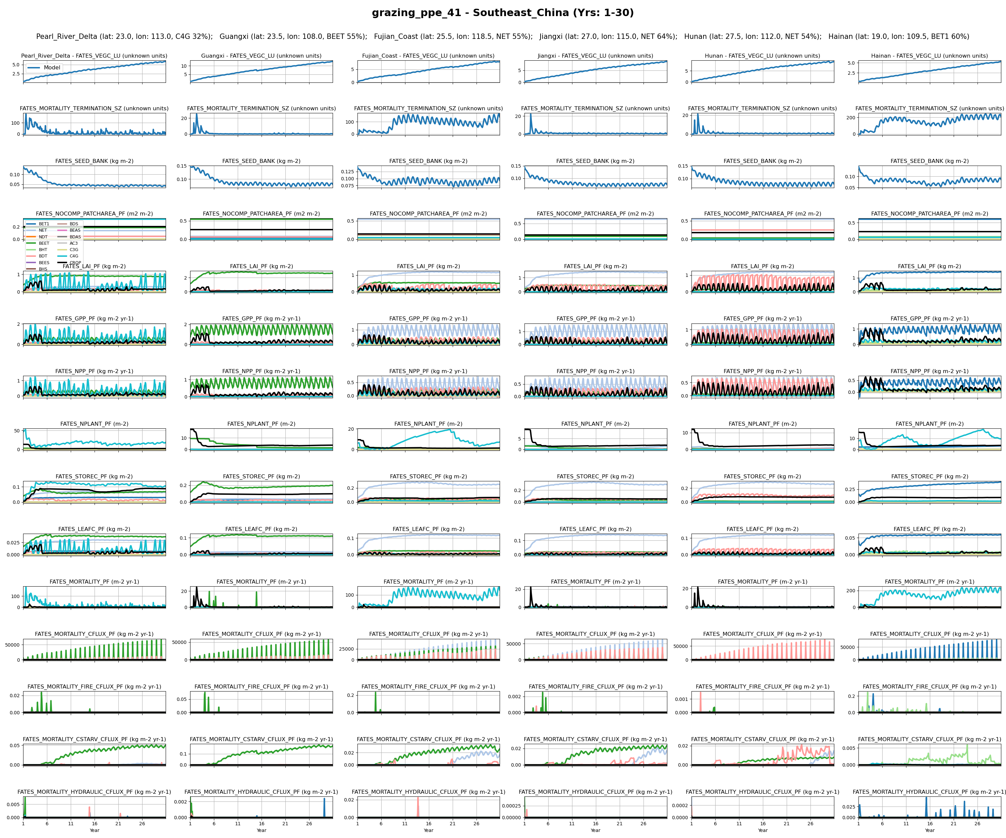
Southeast_China
14

Slide 31
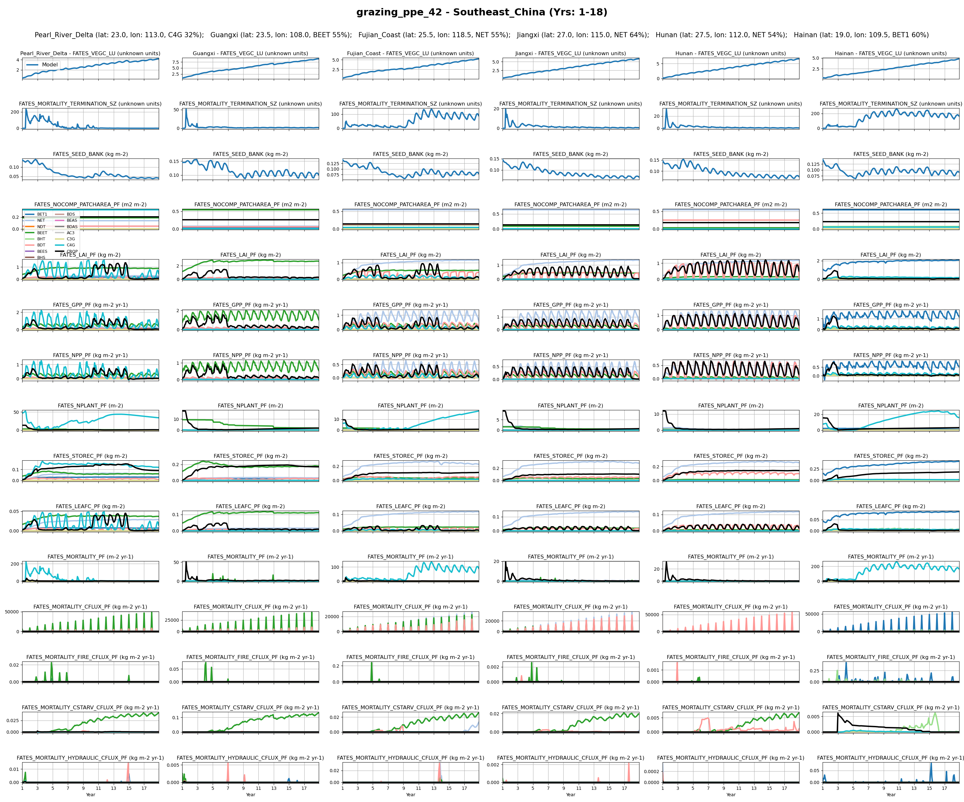
Southeast_China
16

Slide 32
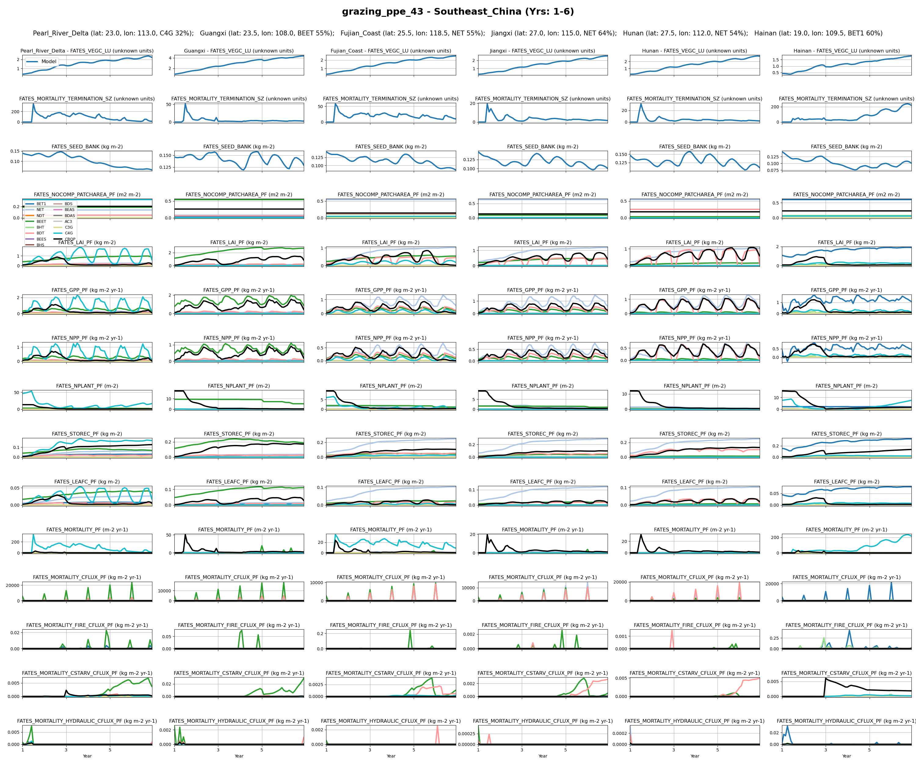
Southeast_China
18

Slide 33
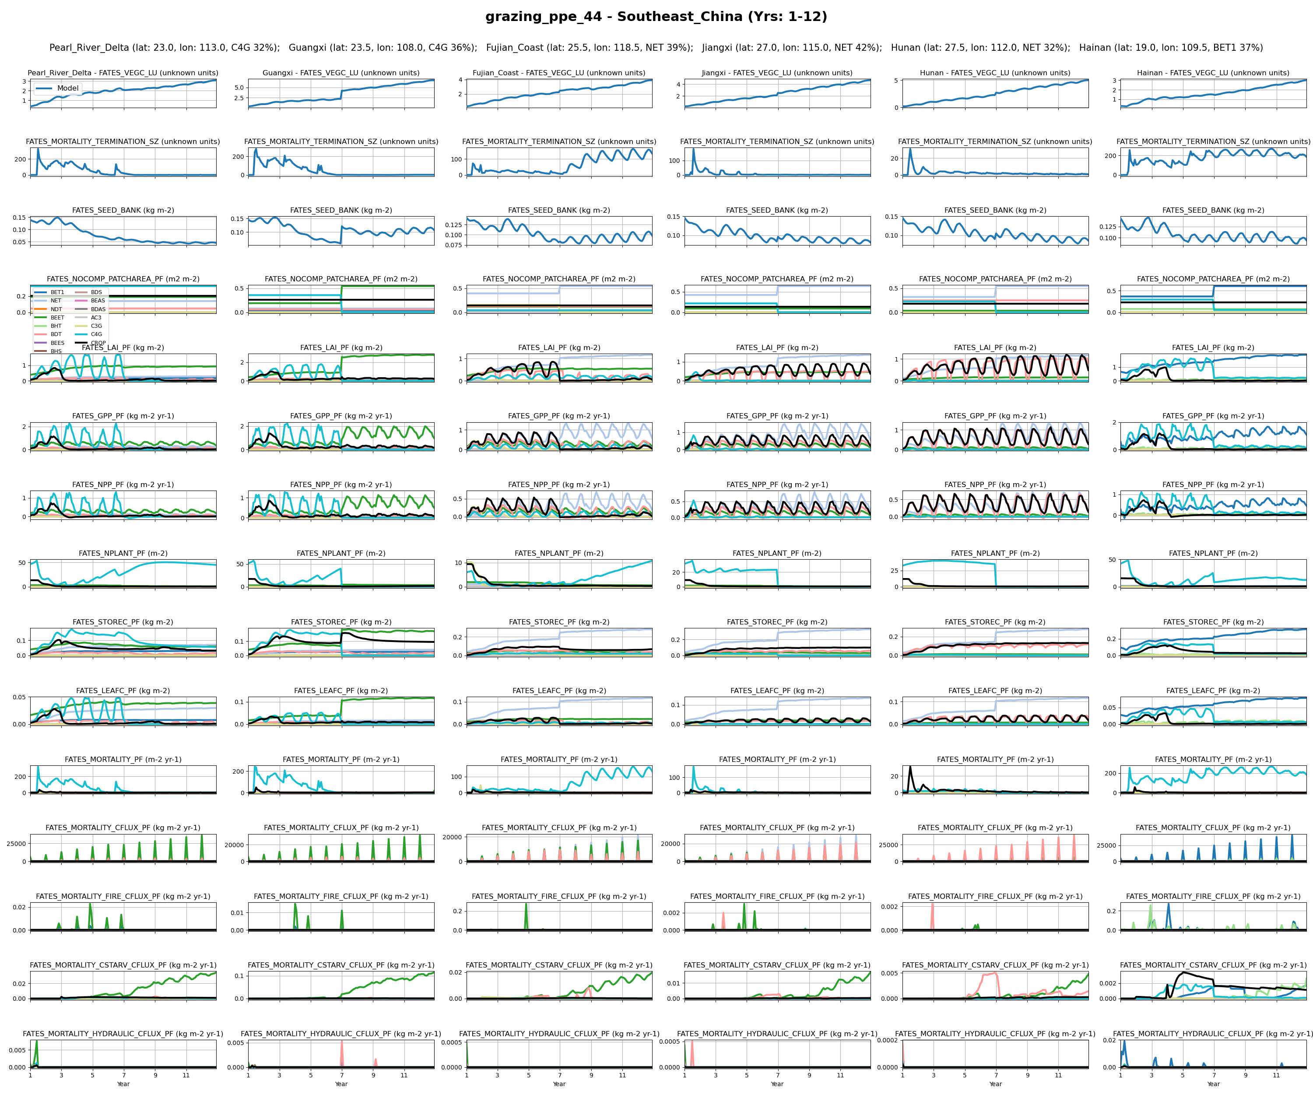
Southeast_China
20

Slide 34
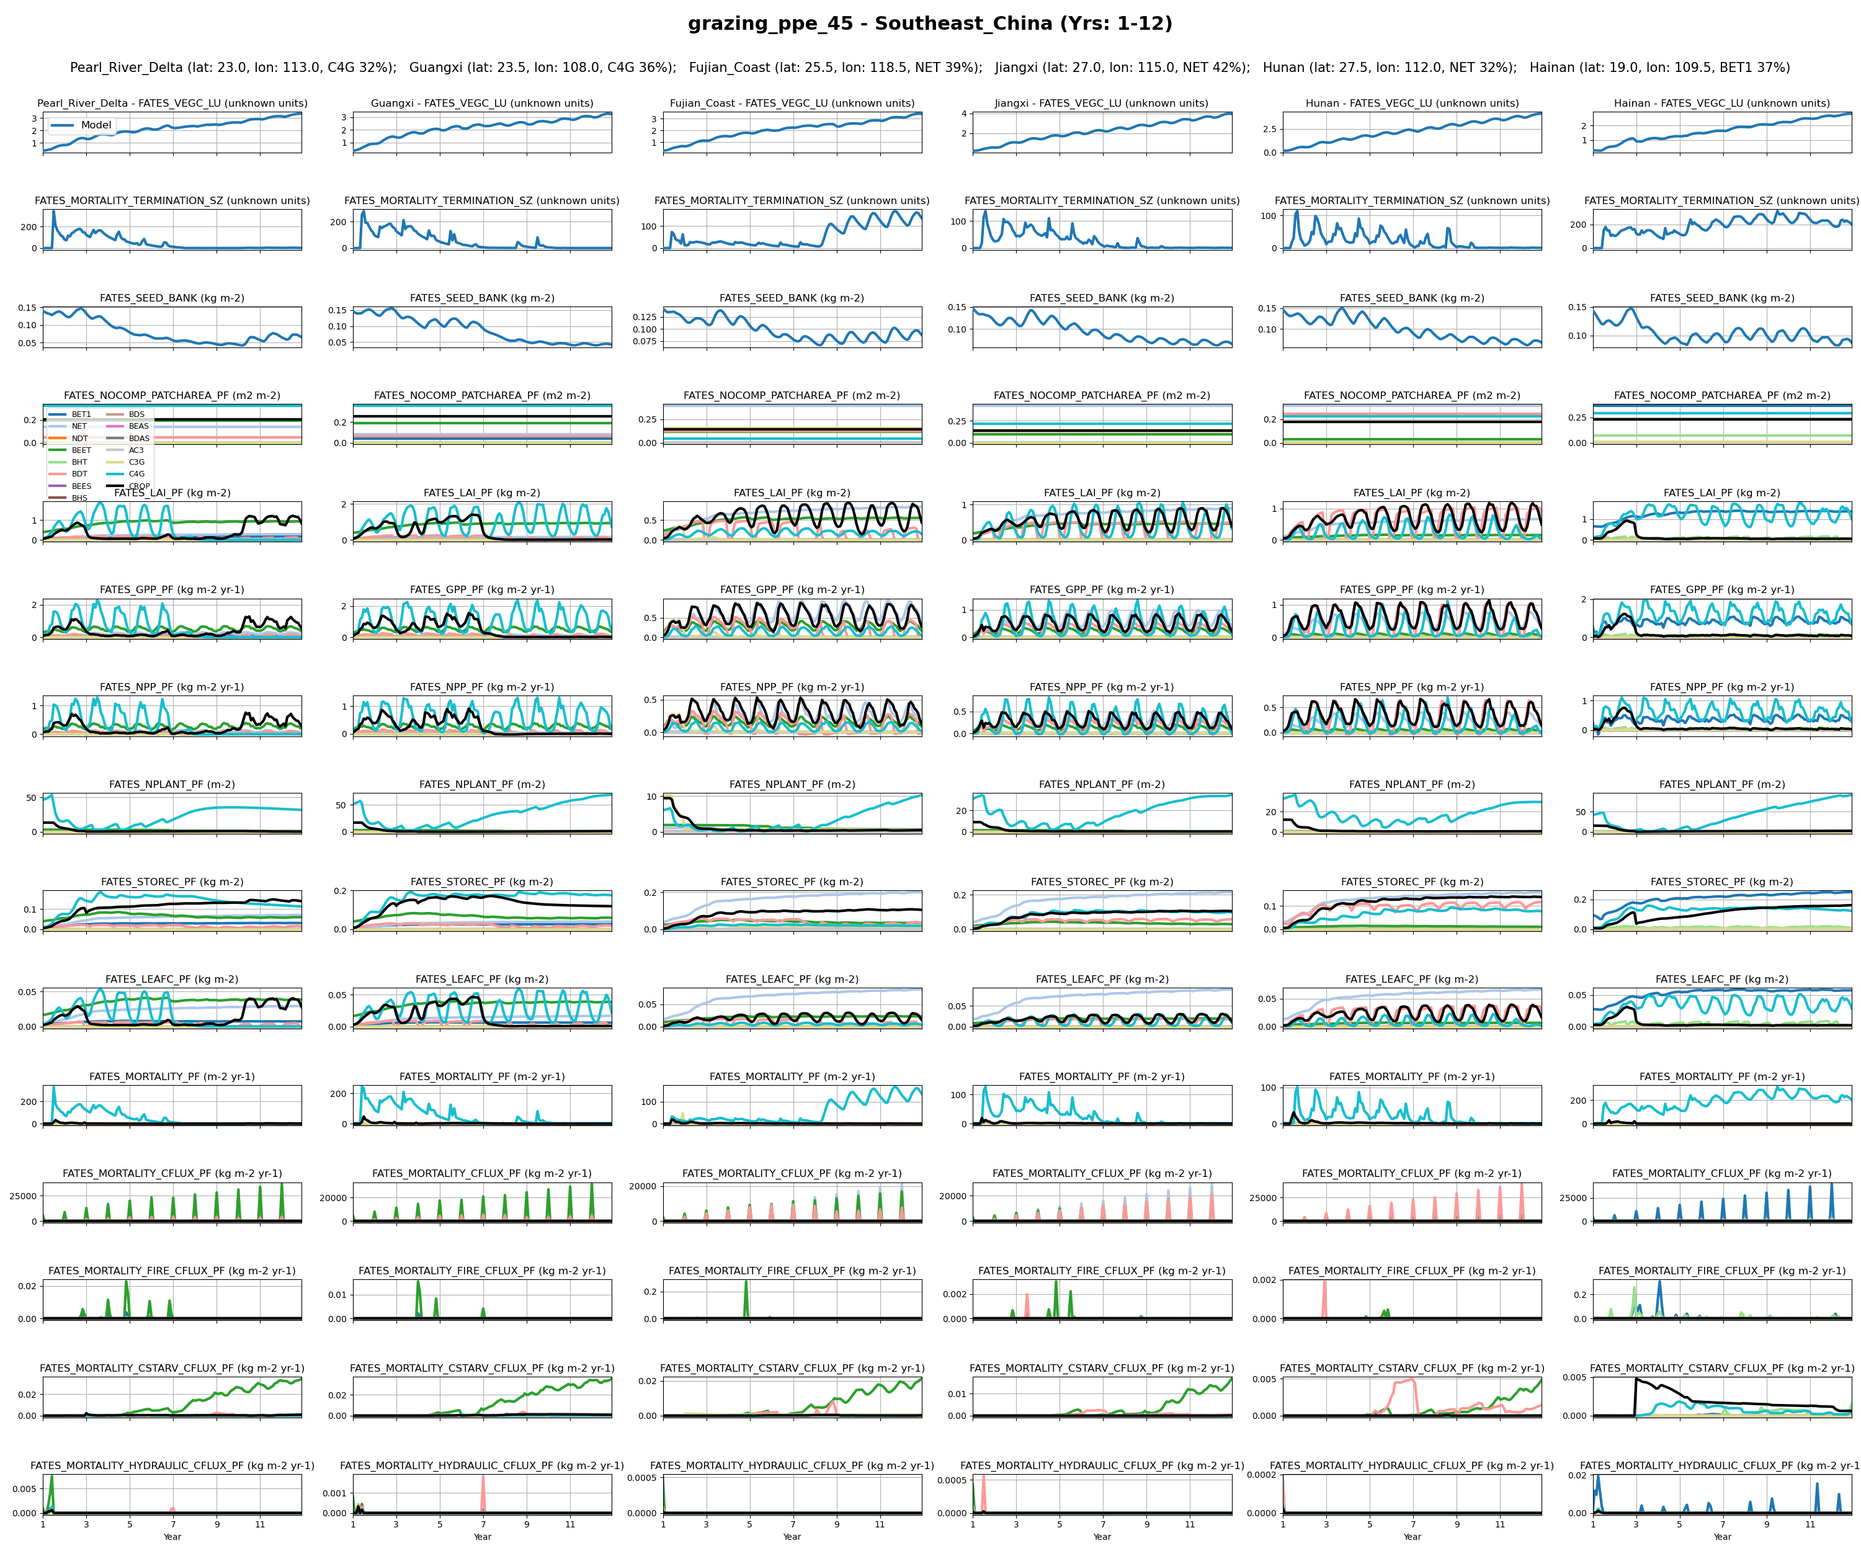
Southeast_China
21

Slide 35
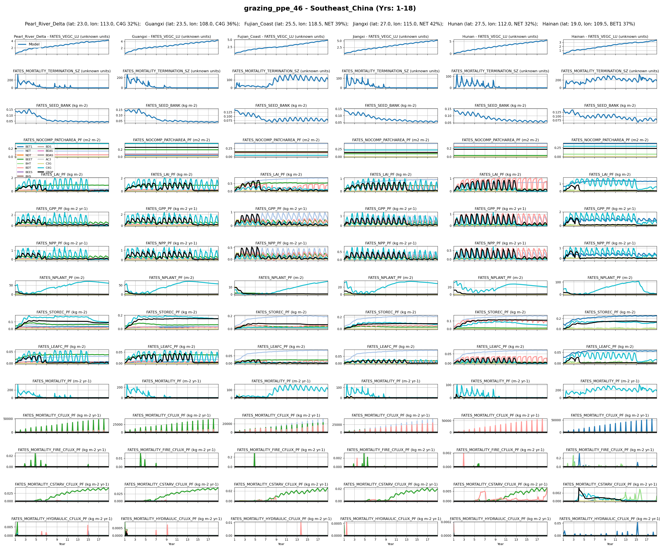
Southeast_China
22

Slide 36
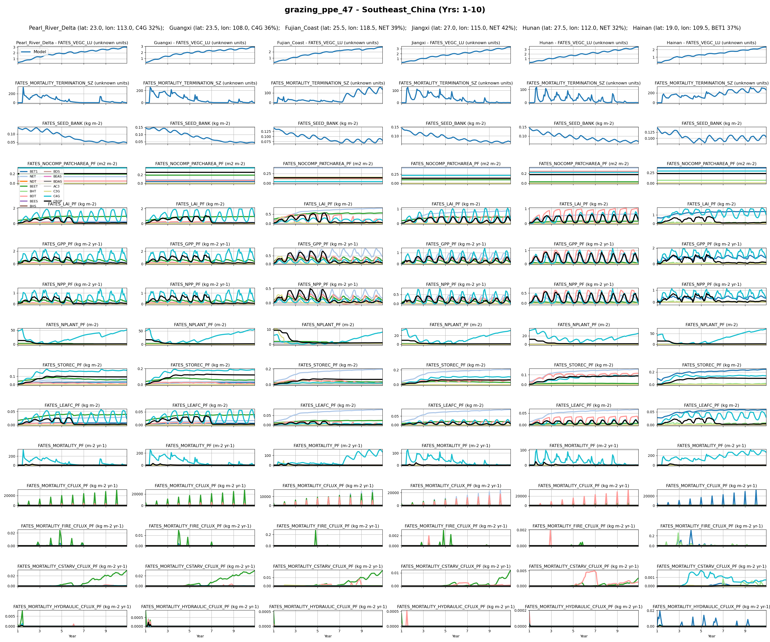
Southeast_China
23

Slide 37
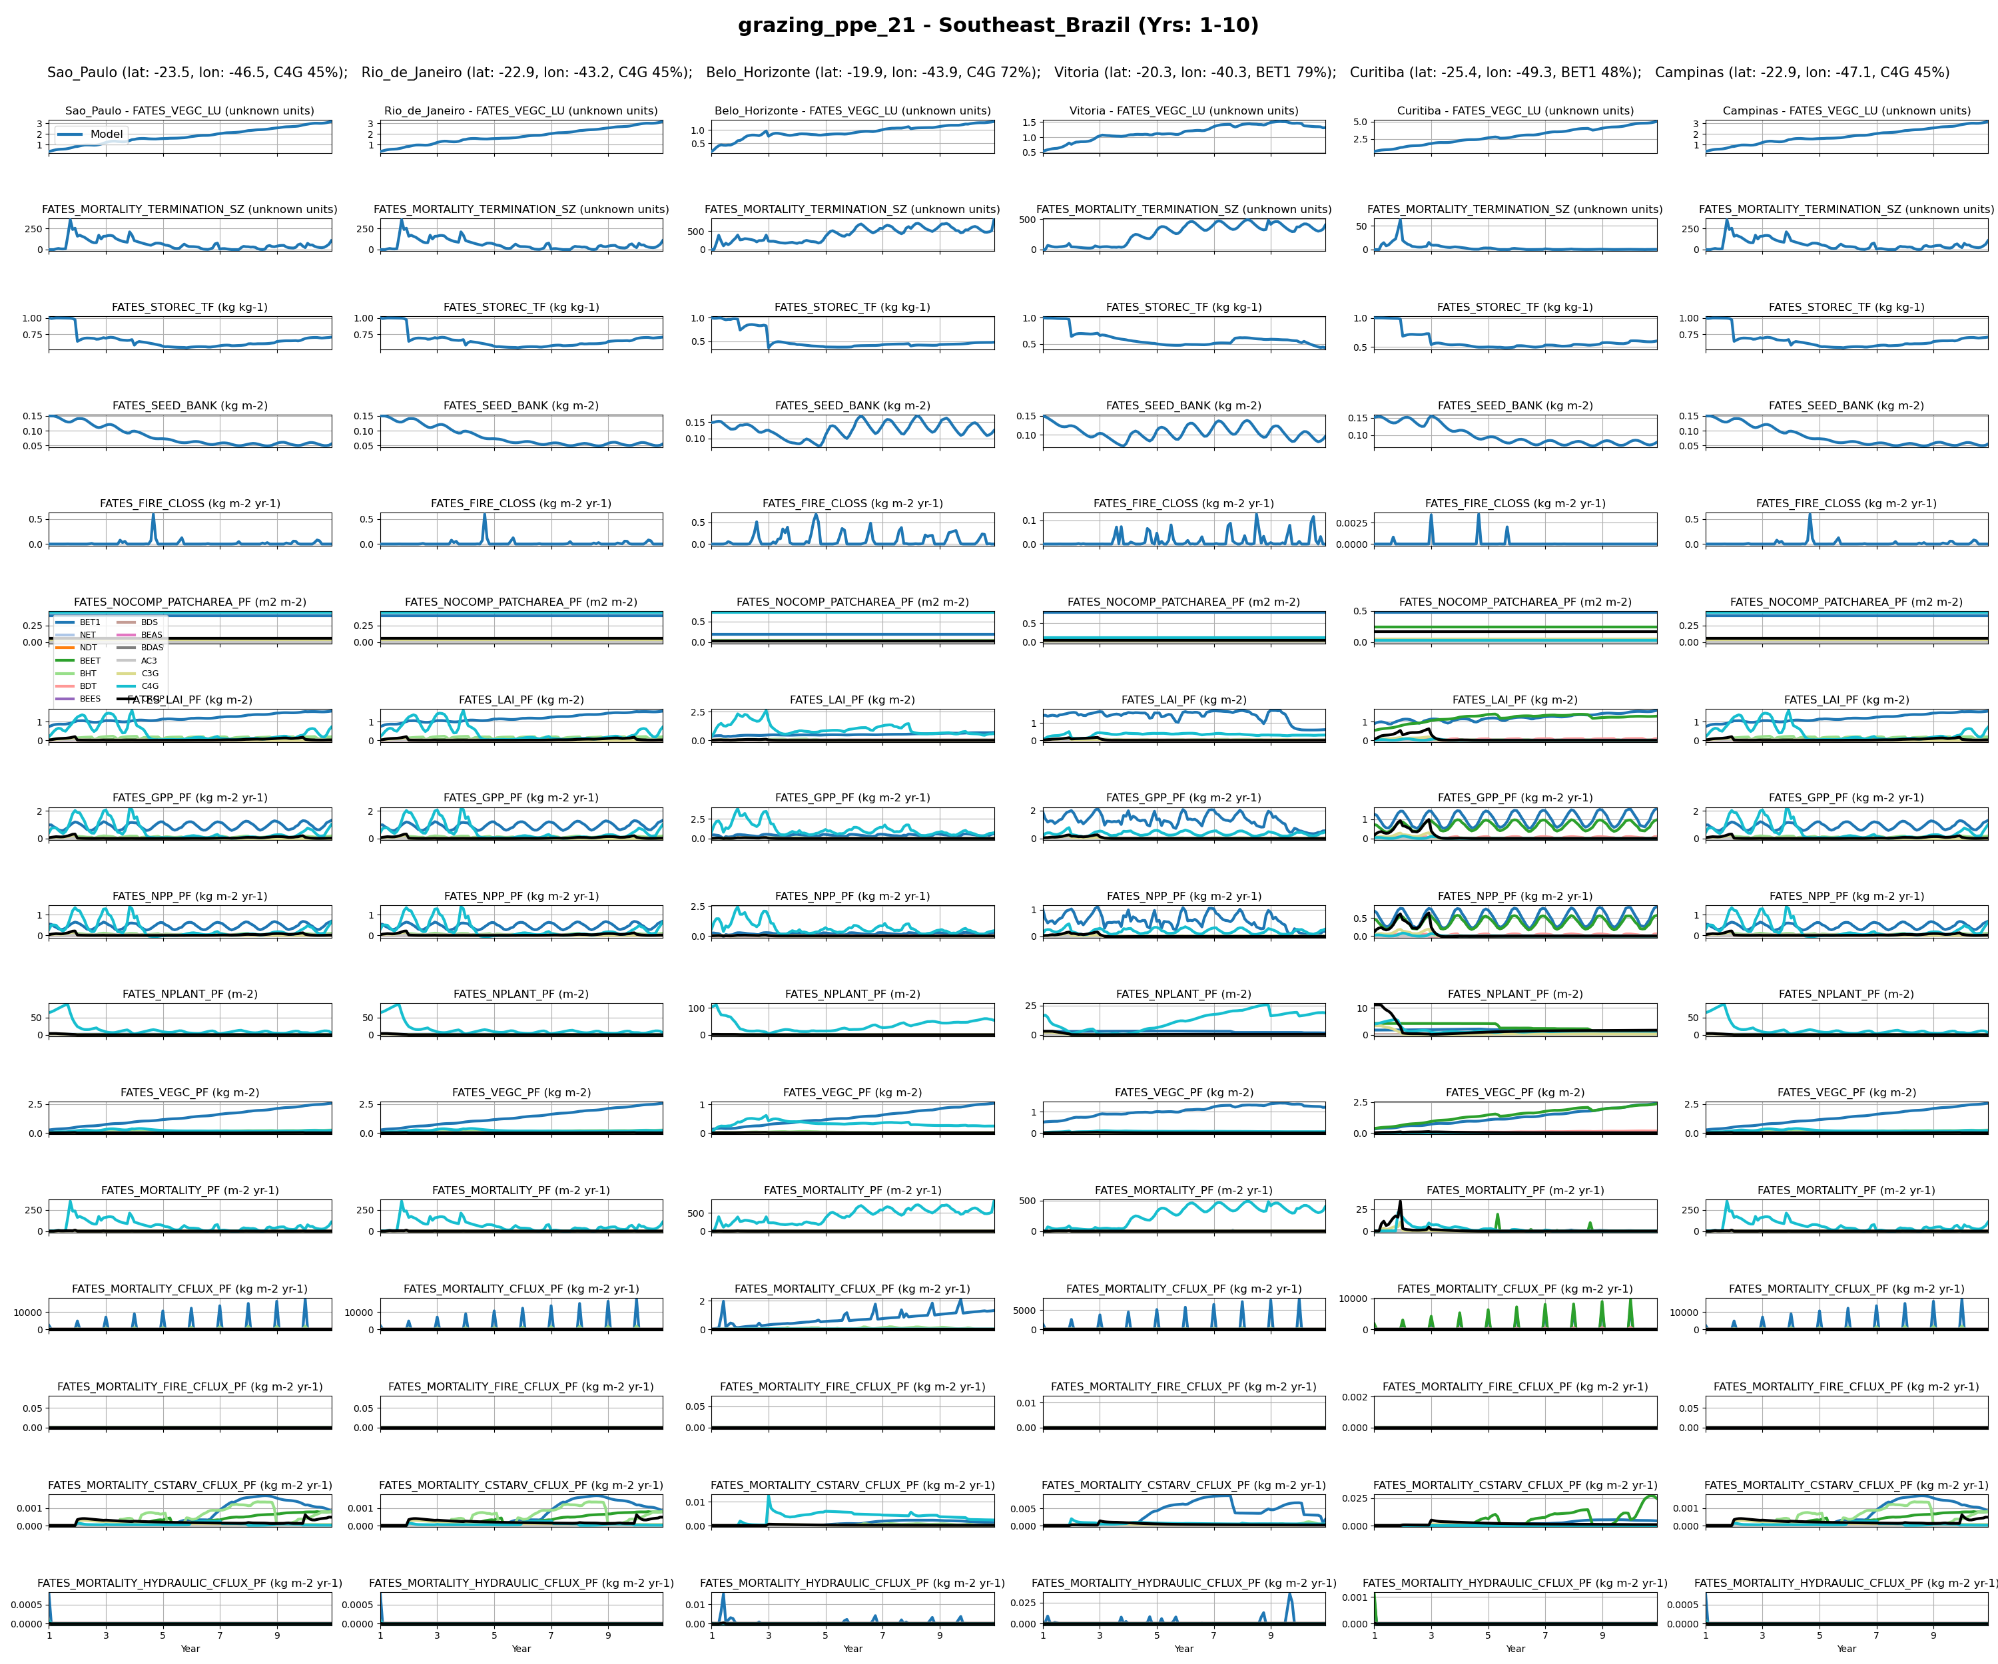
SouthEast_Brazil
0

Slide 38
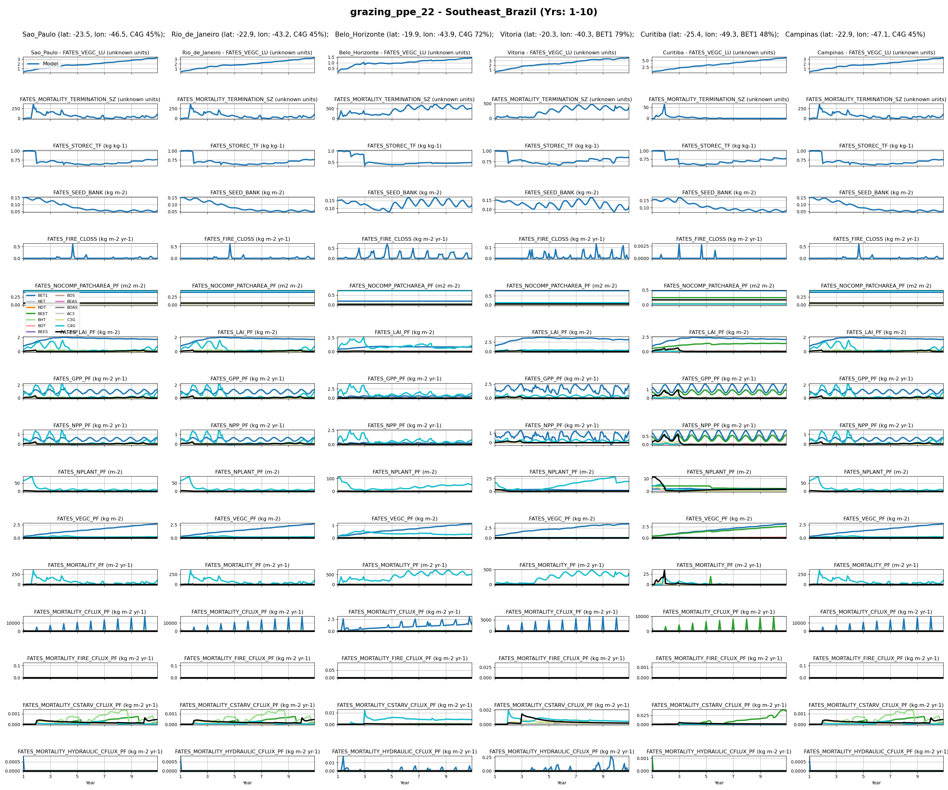
SouthEast_Brazil
1

Slide 39
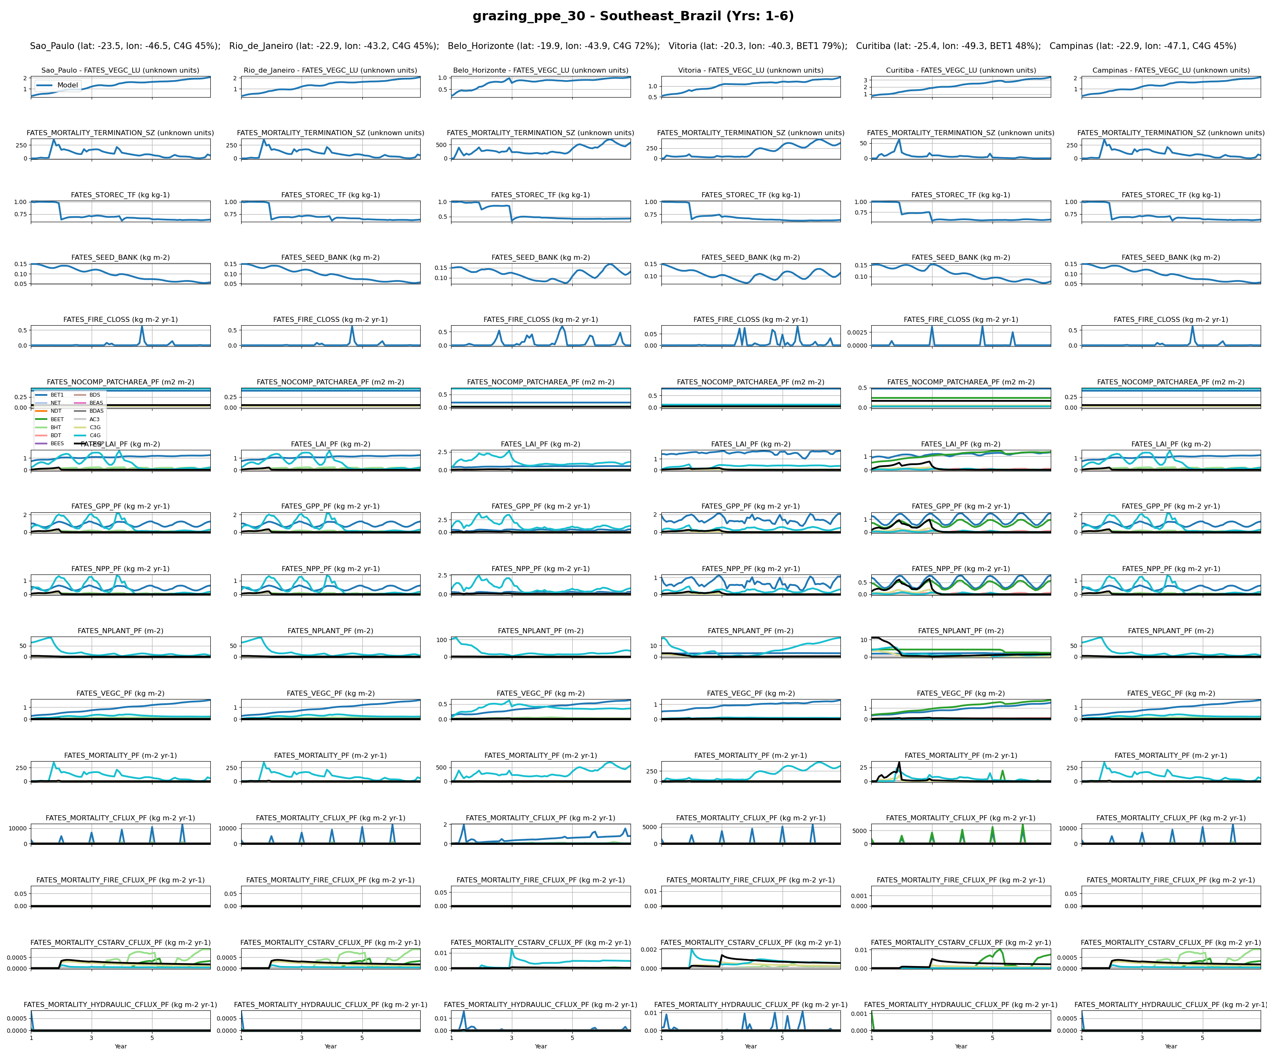
SouthEast_Brazil
2

Slide 40
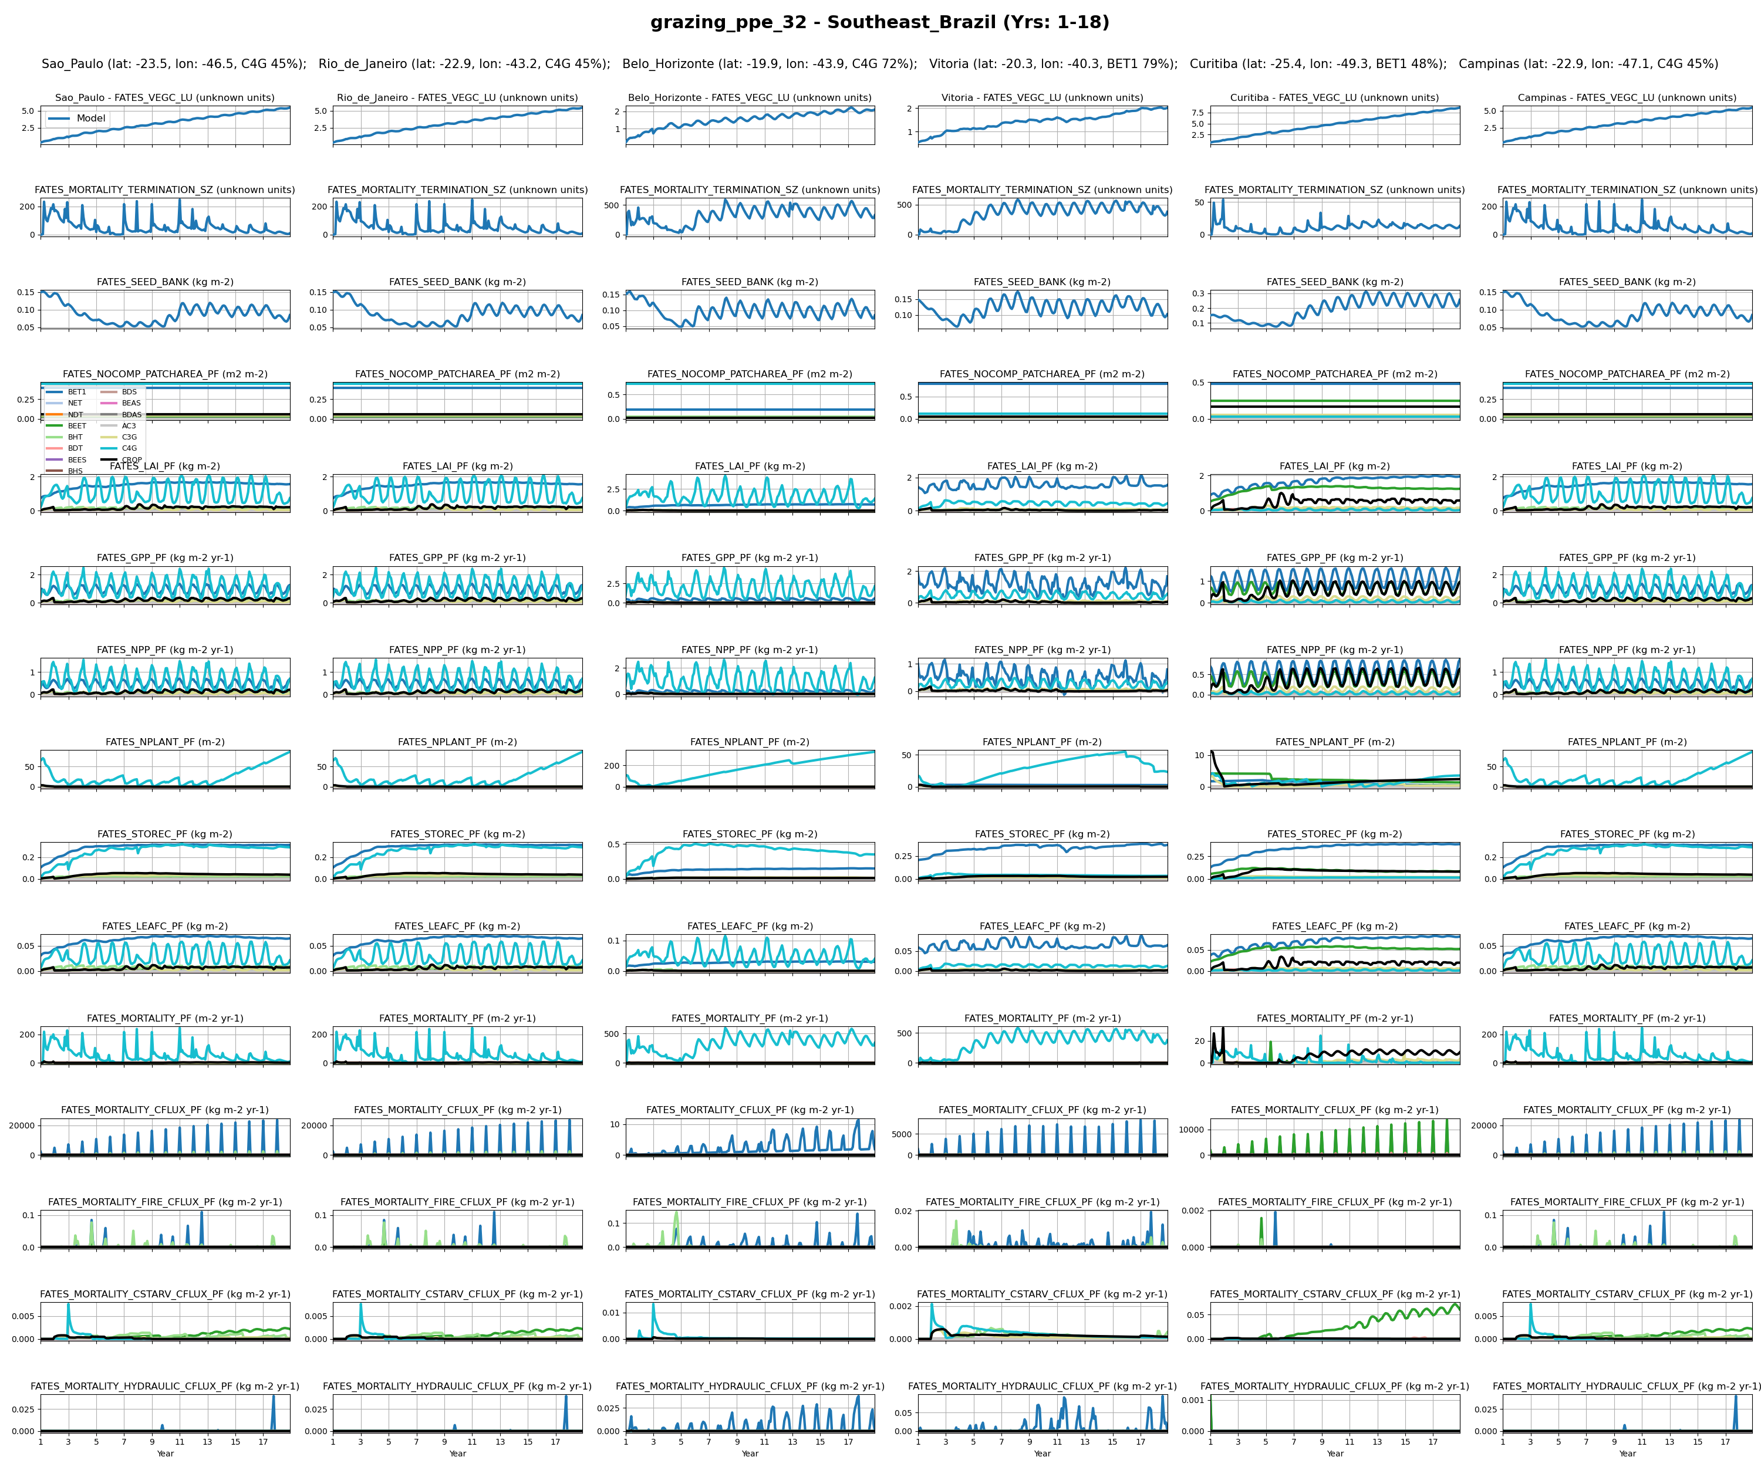
SouthEast_Brazil
3

Slide 41
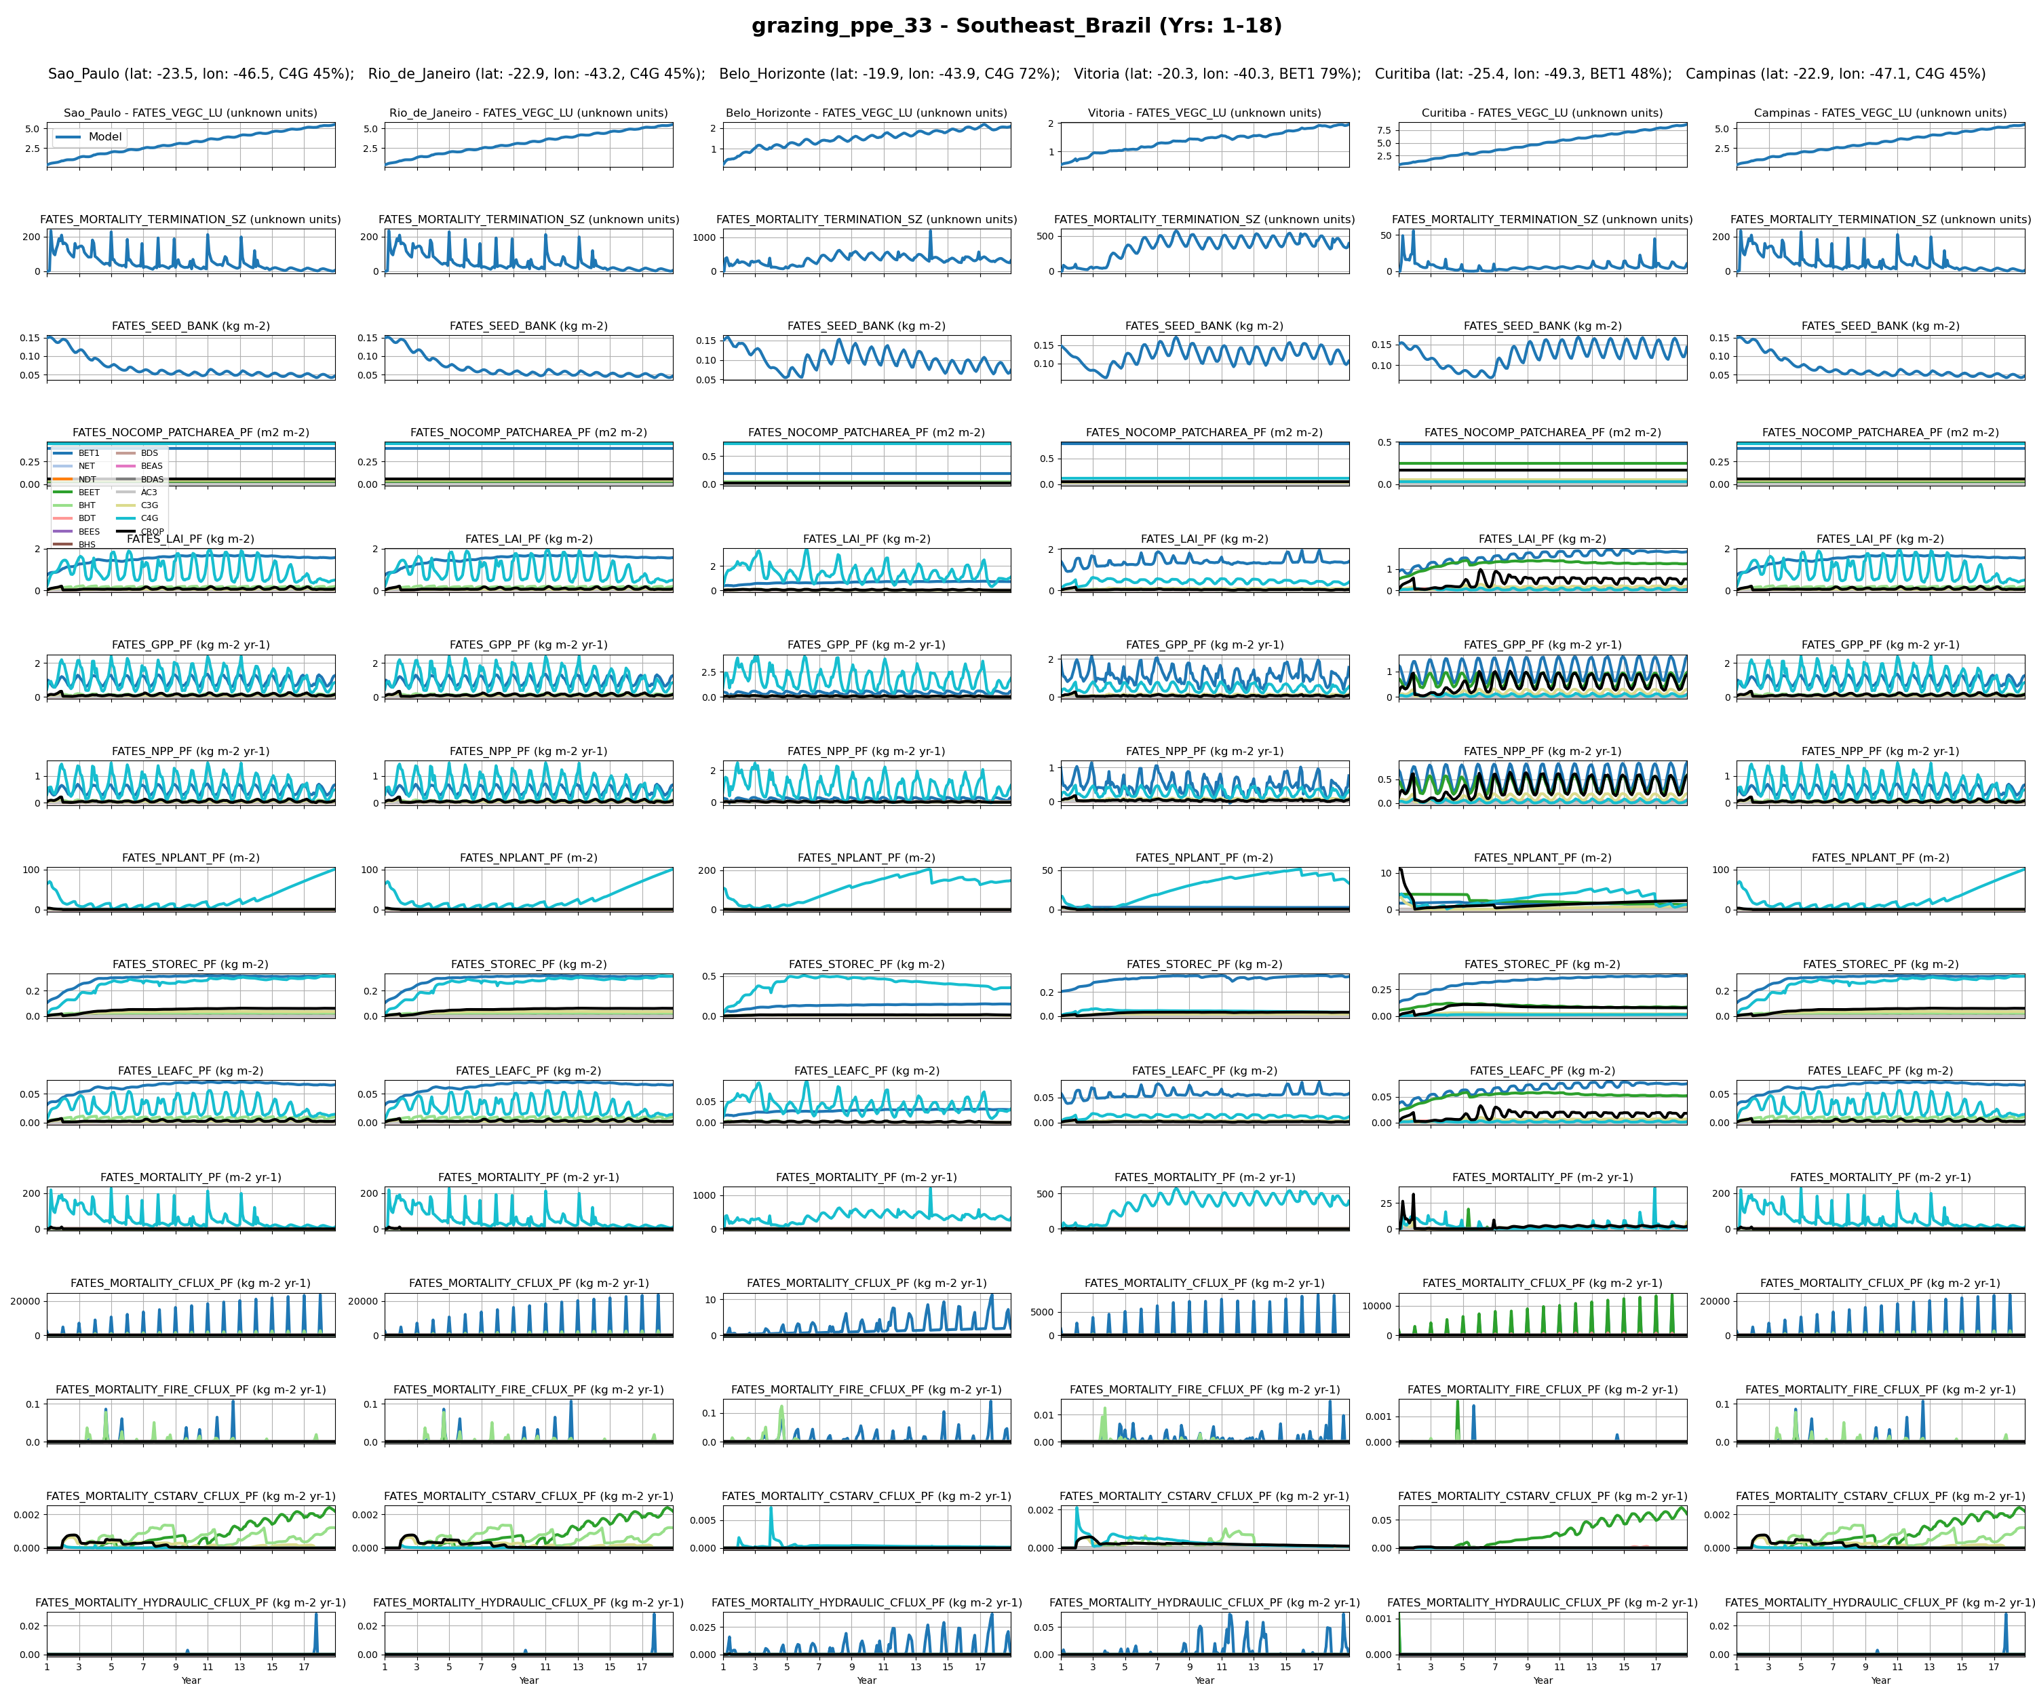
SouthEast_Brazil
4

Slide 42
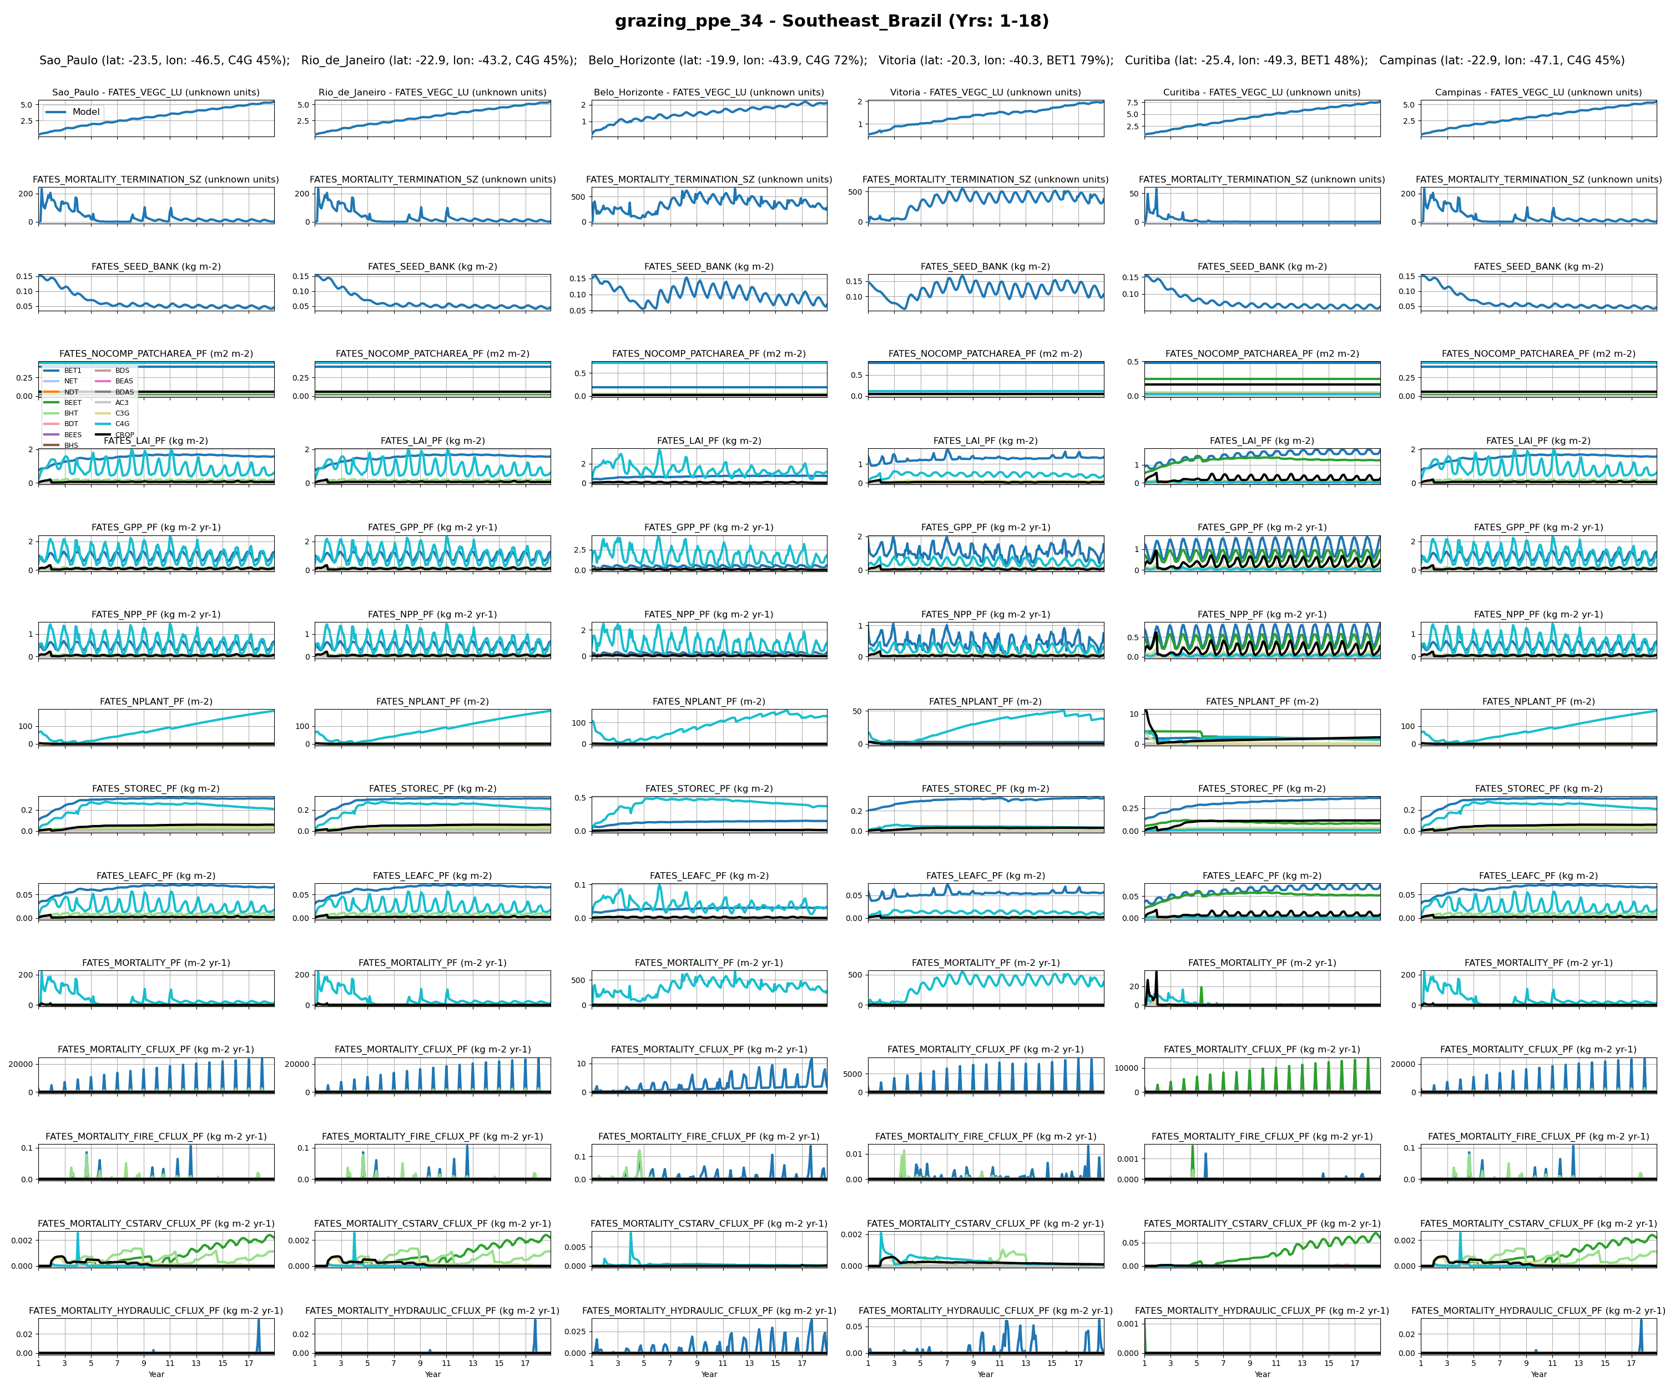
SouthEast_Brazil
5

Slide 43
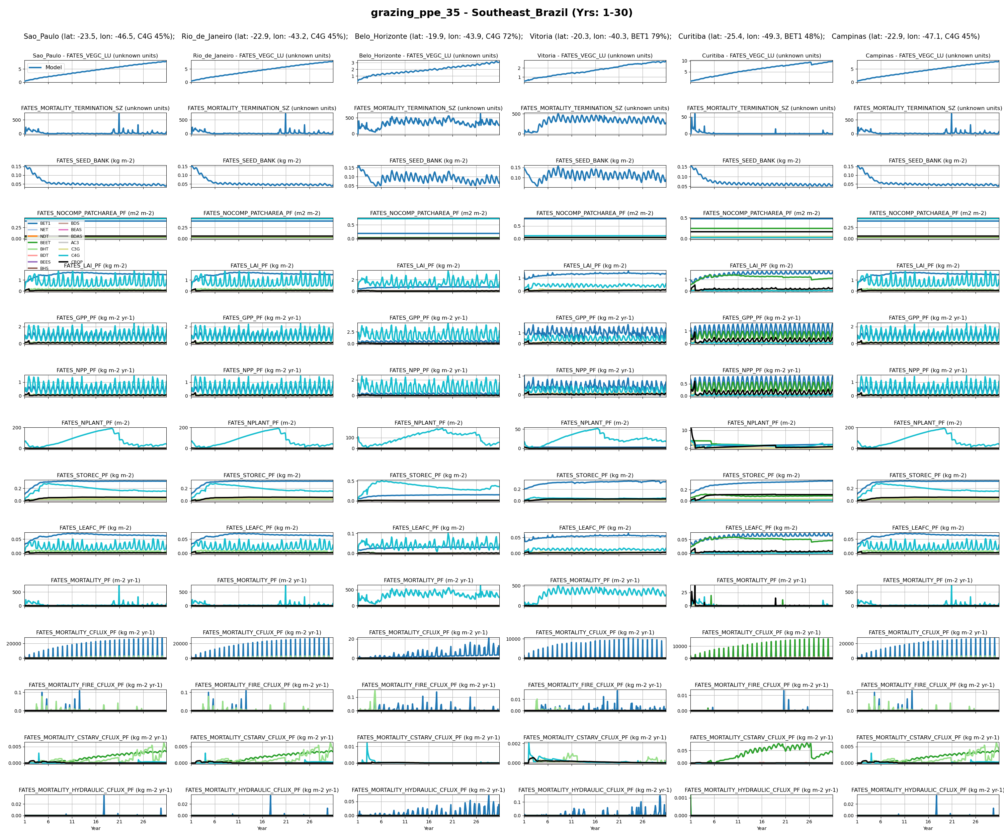
SouthEast_Brazil
6

Slide 44
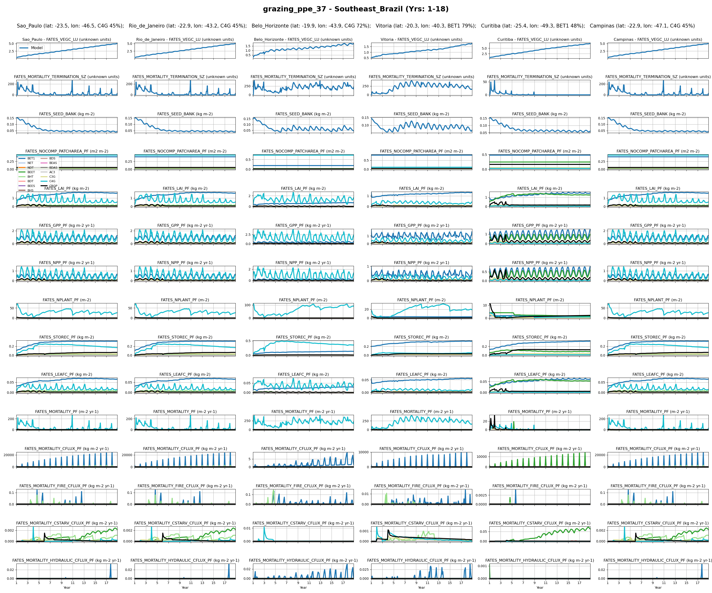
SouthEast_Brazil
7

Slide 45
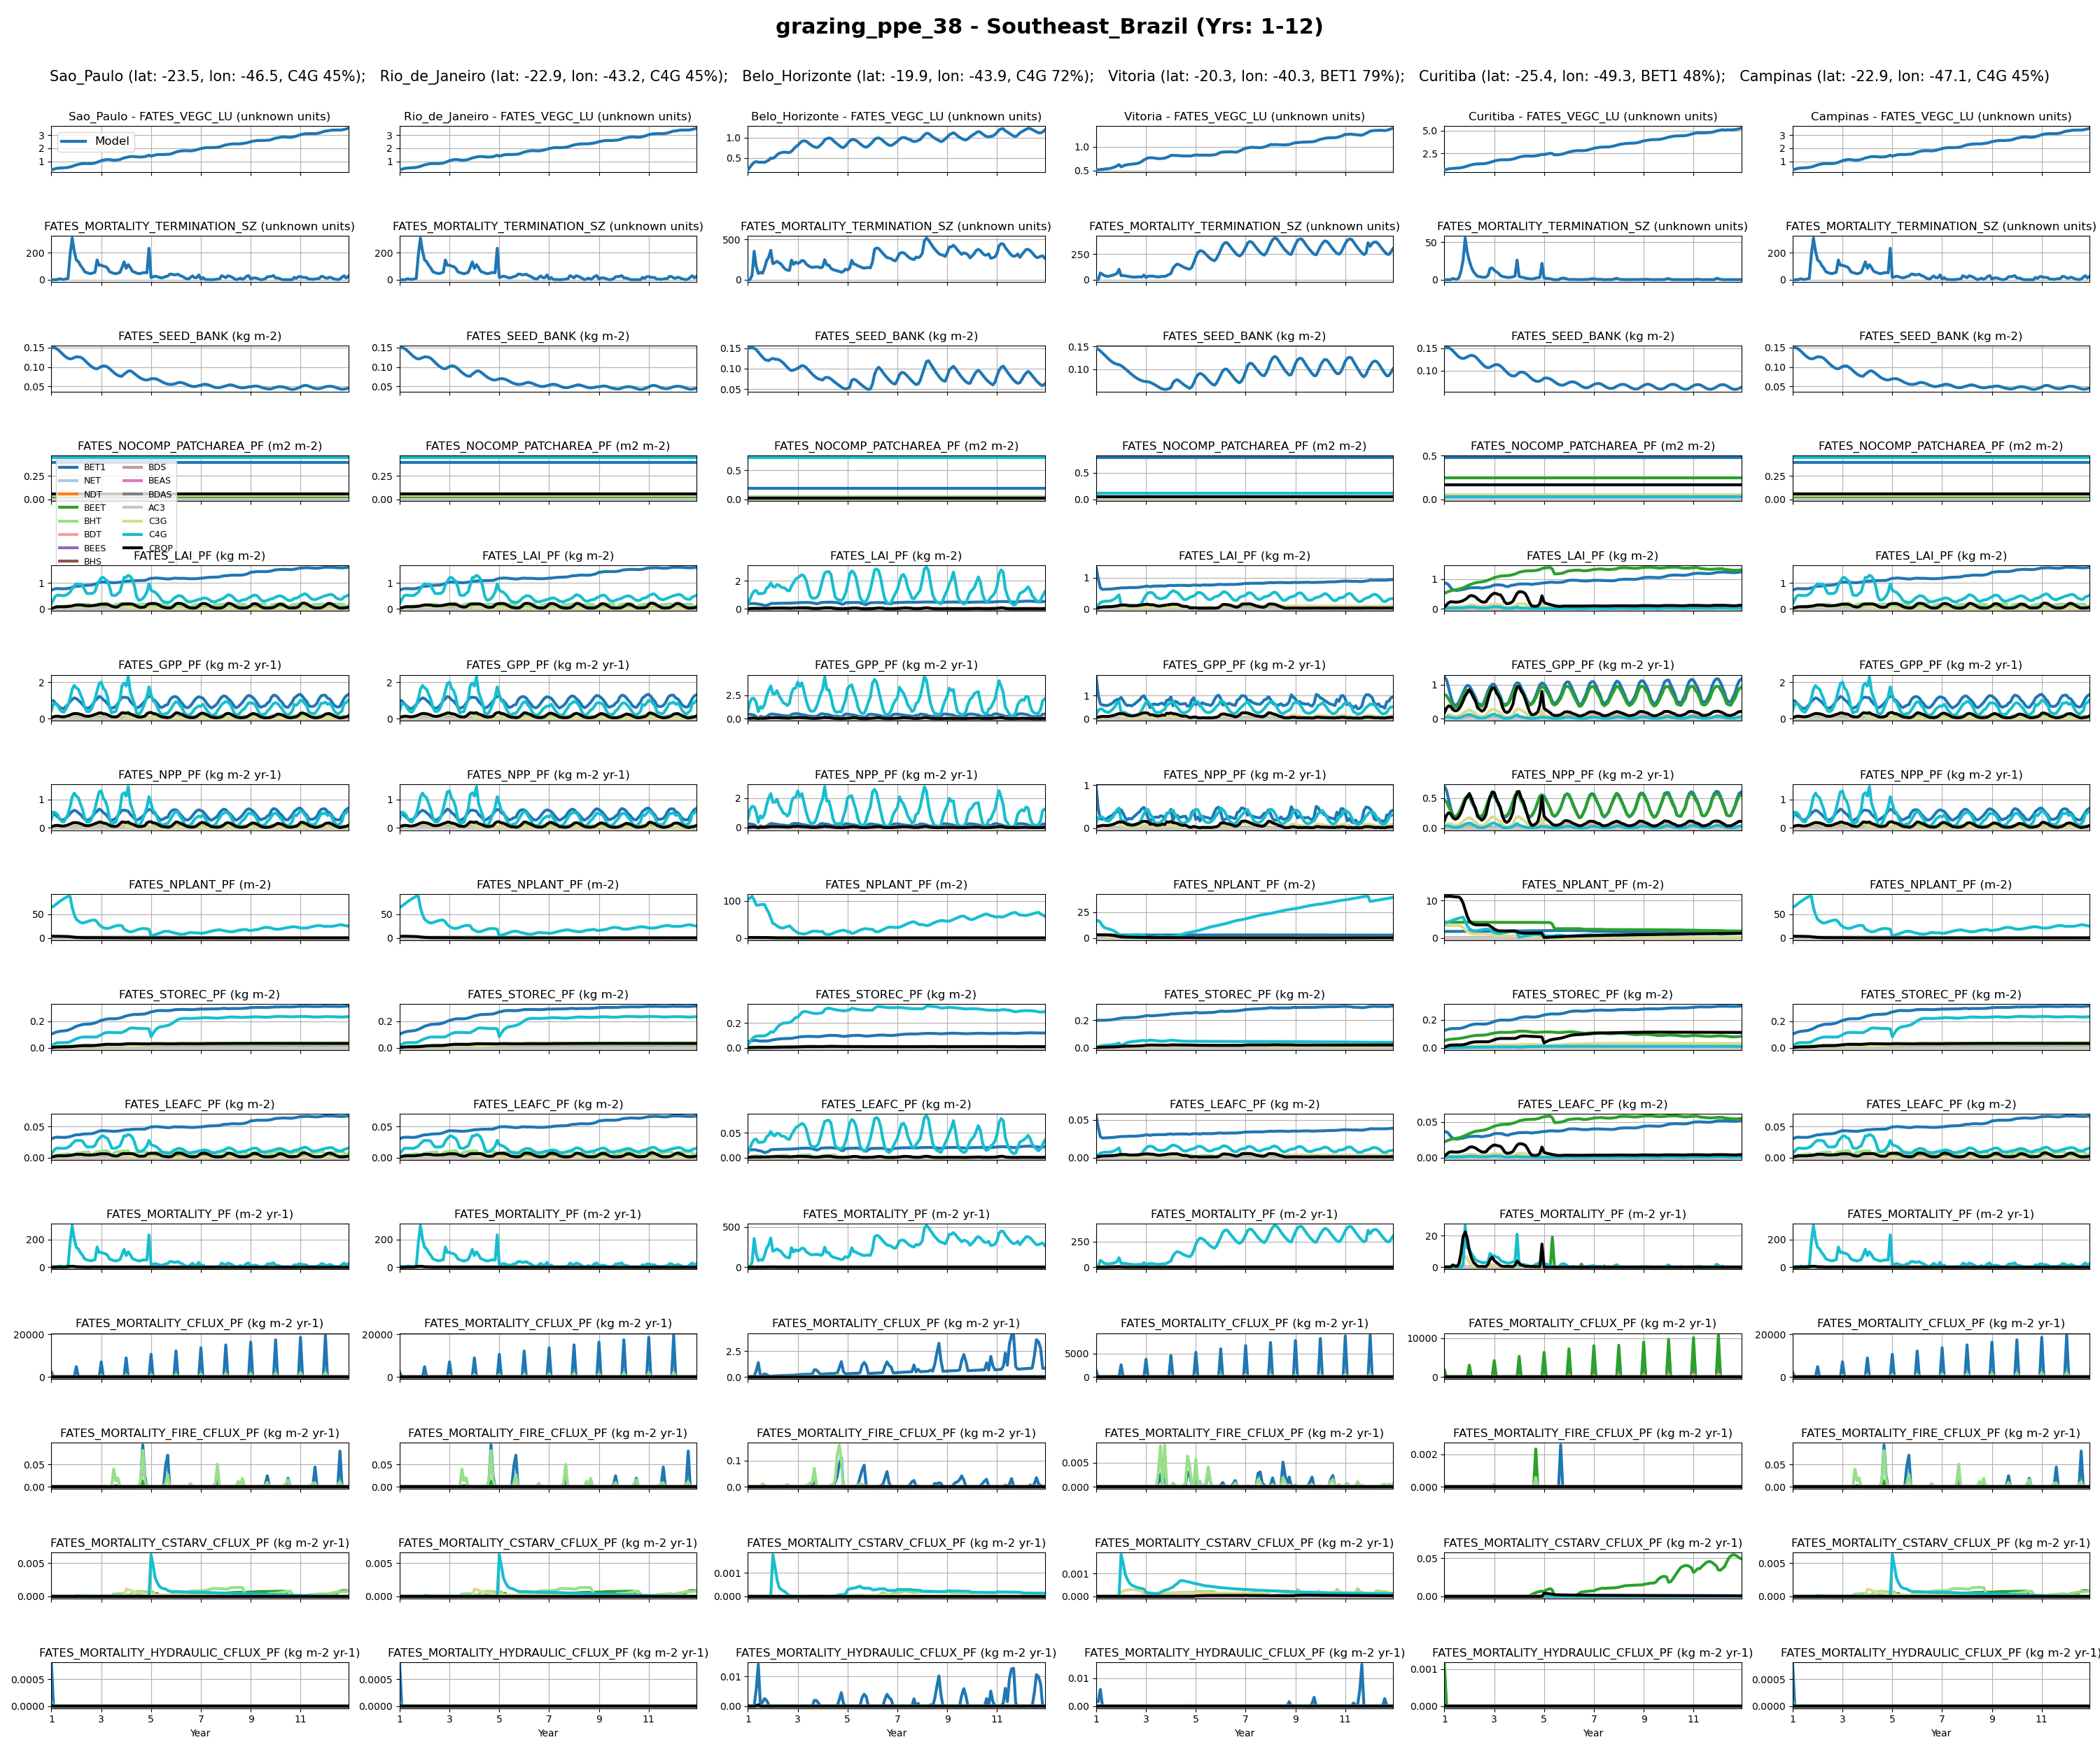
SouthEast_Brazil
8

Slide 46
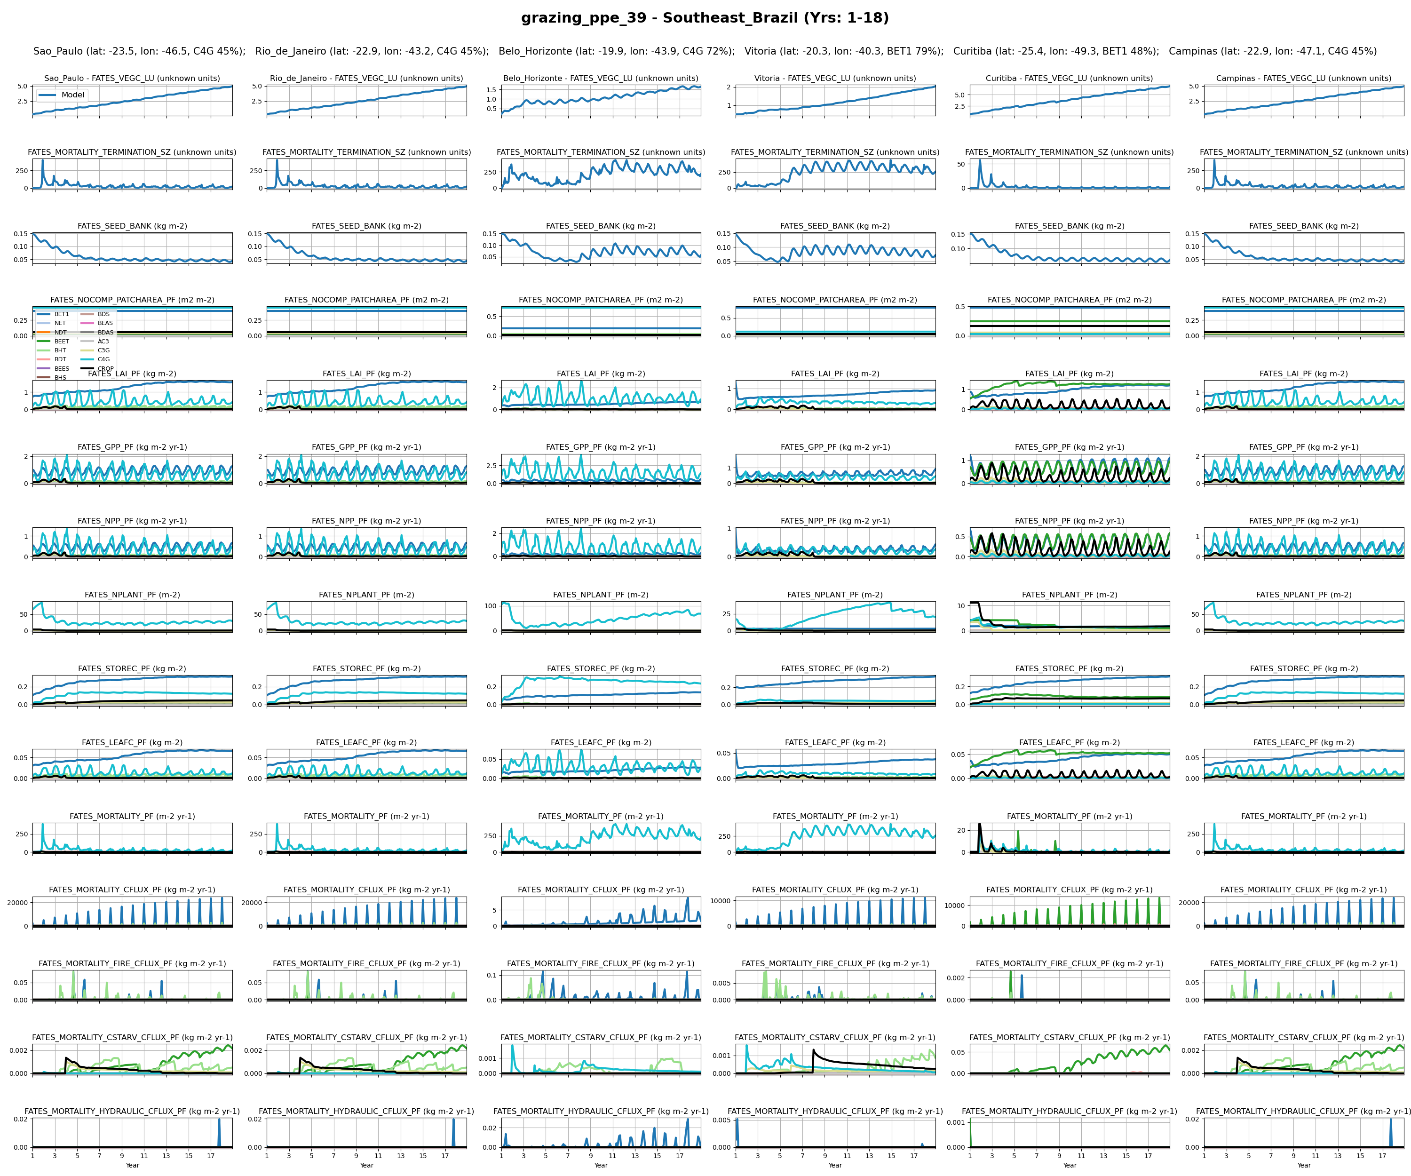
SouthEast_Brazil
9

Slide 47
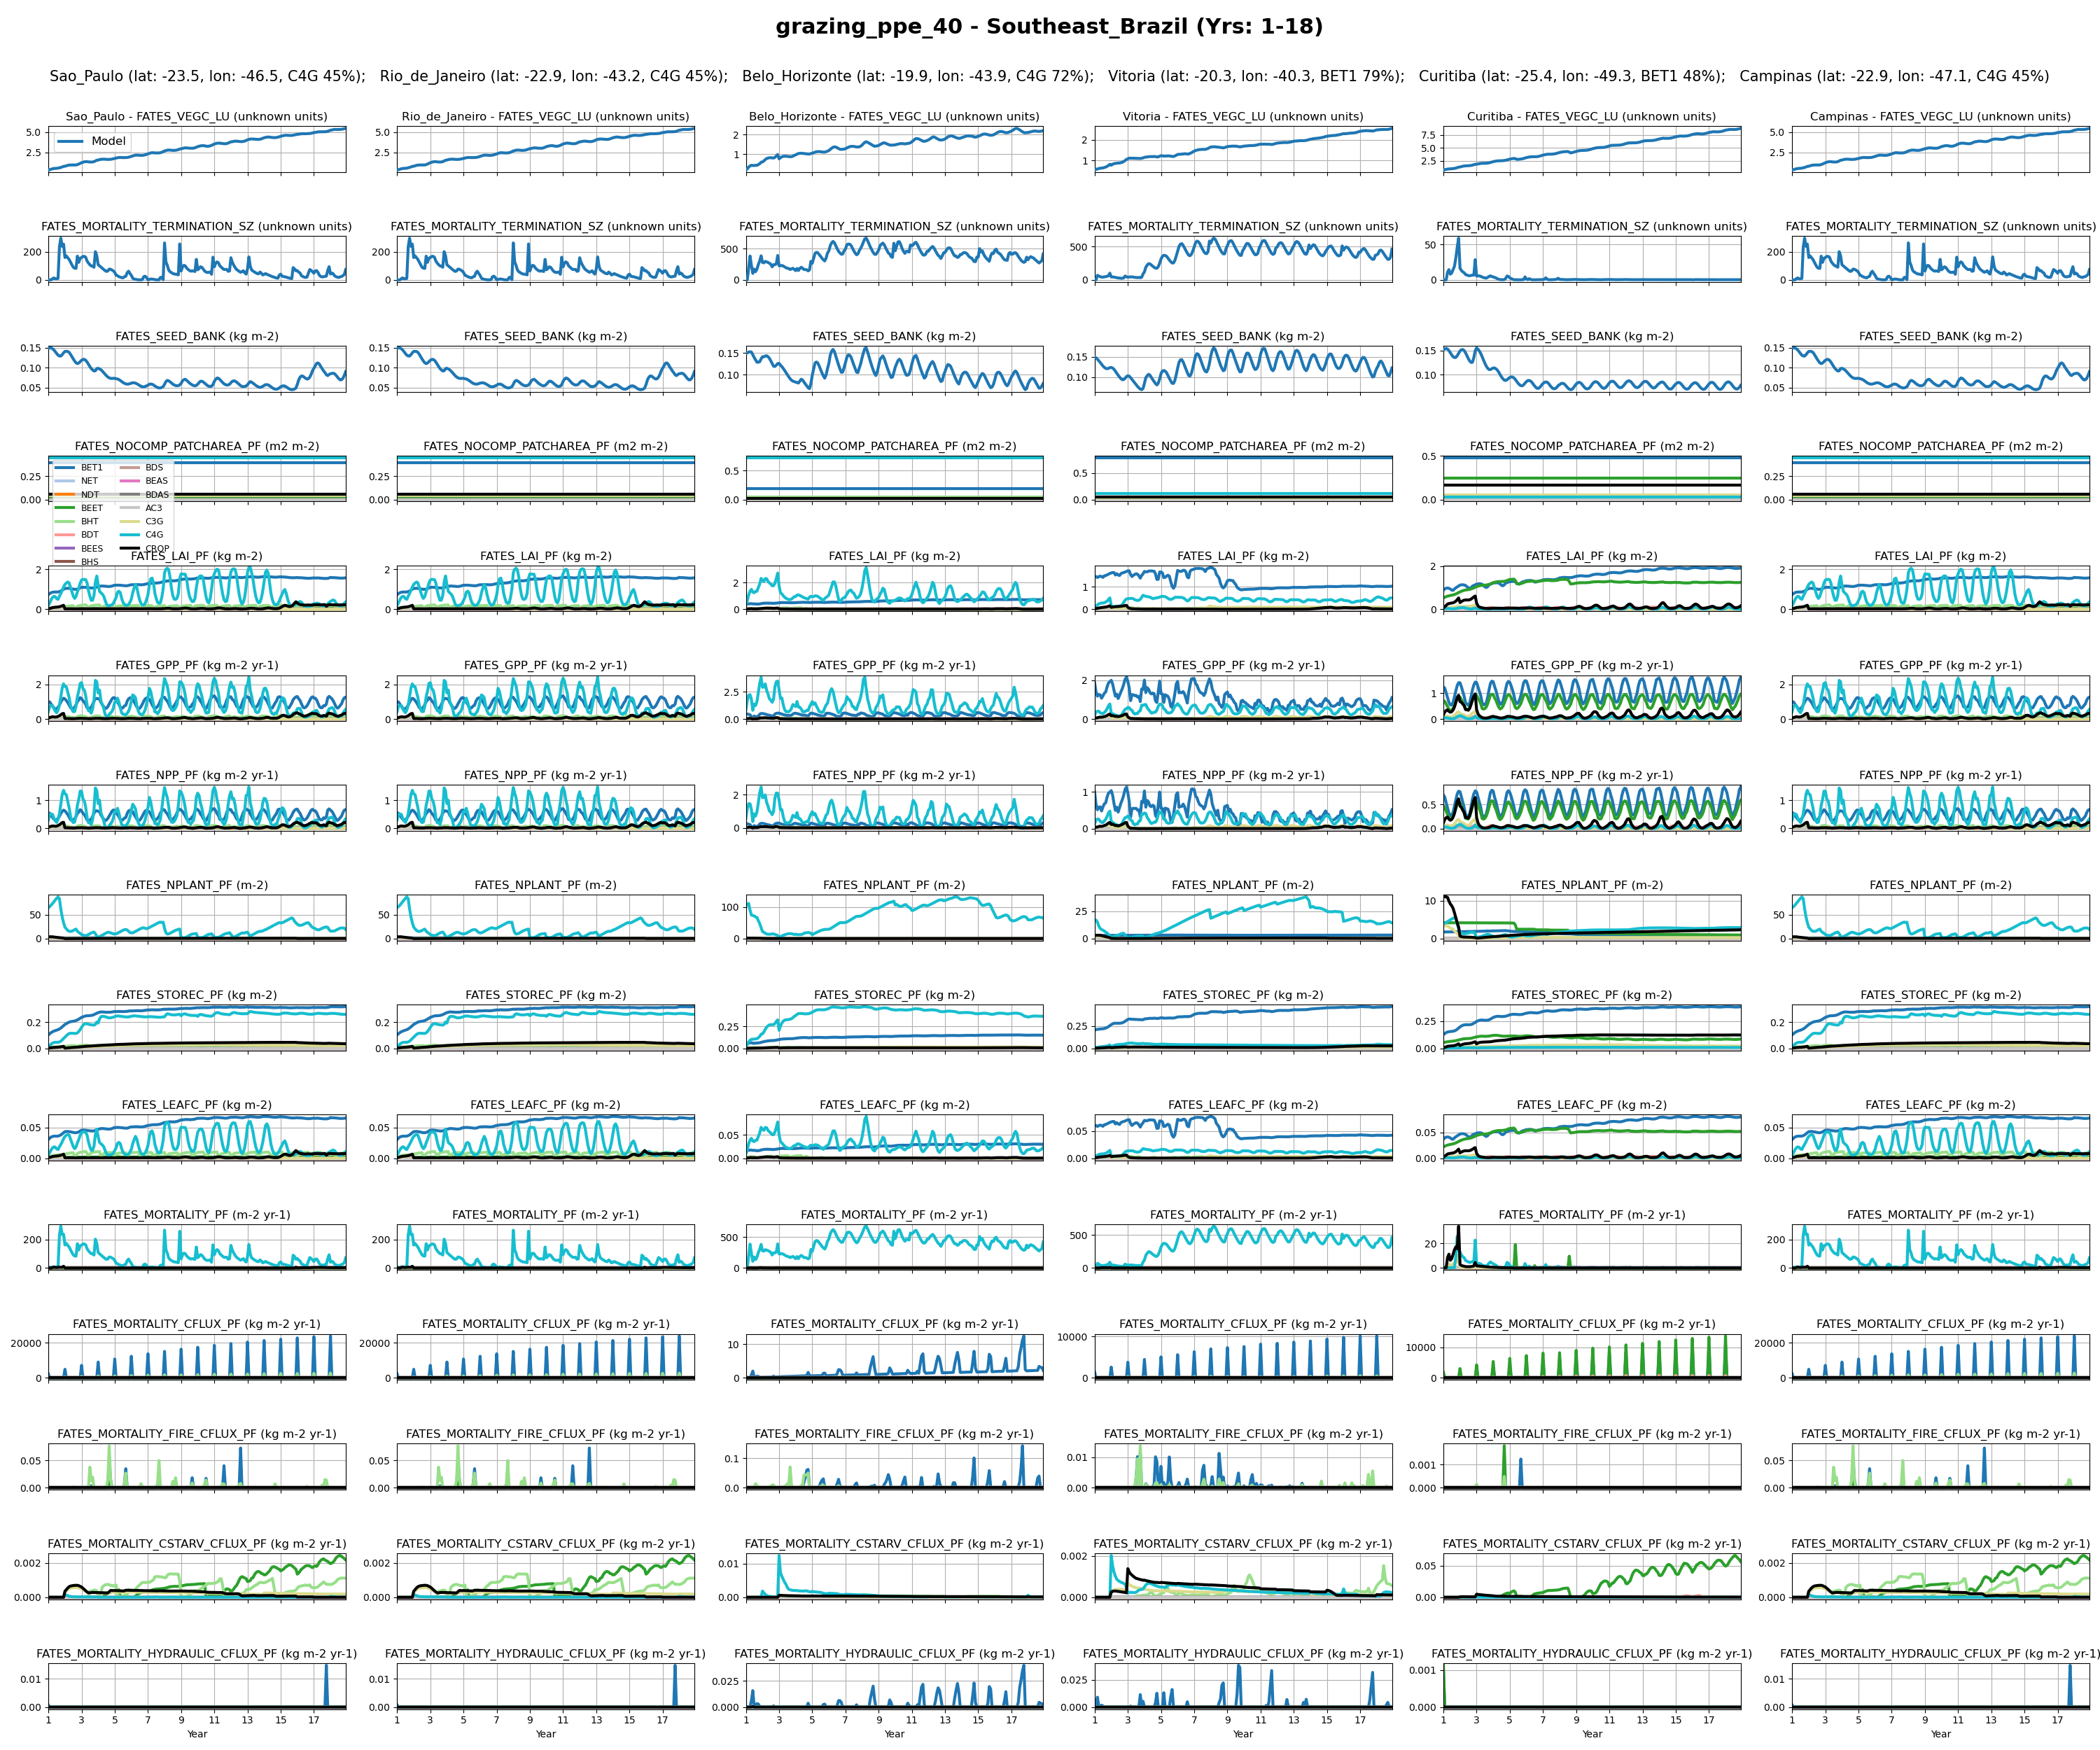
SouthEast_Brazil
12

Slide 48
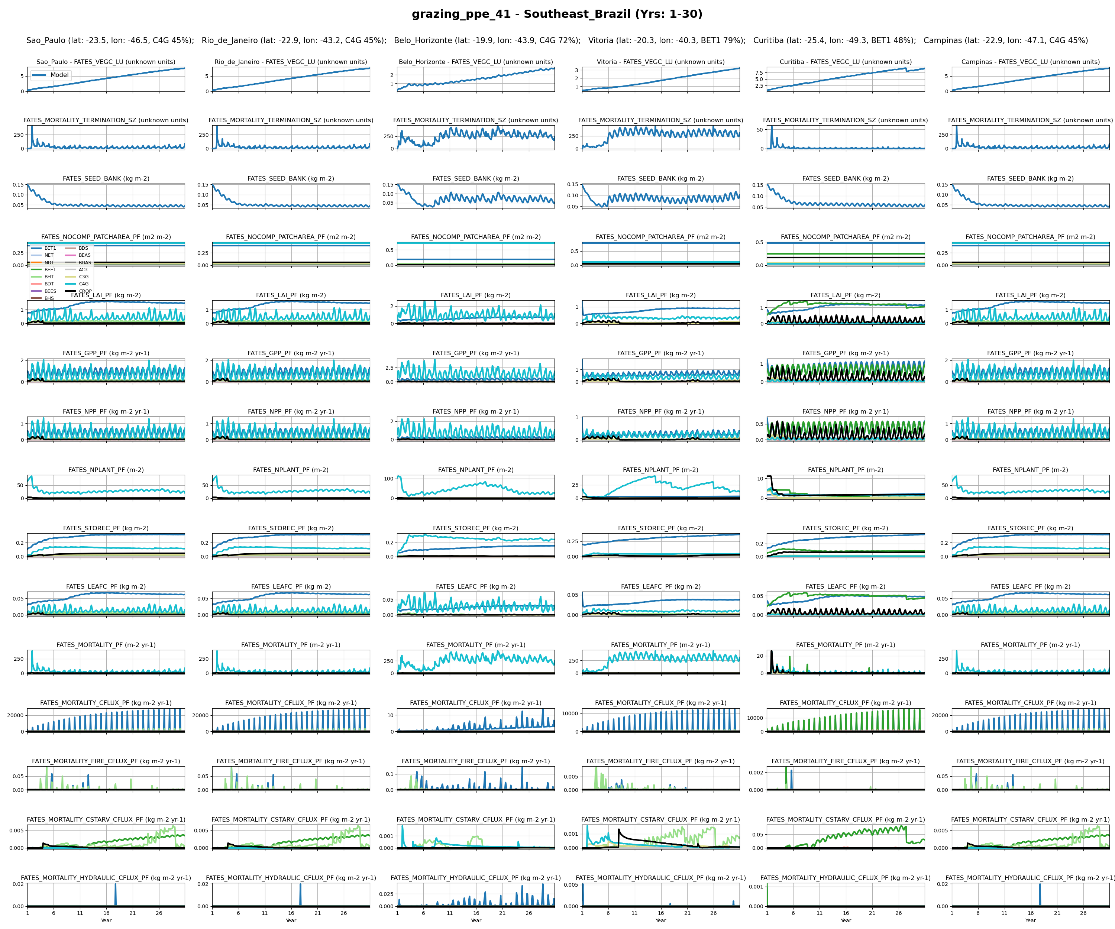
SouthEast_Brazil
14

Slide 49
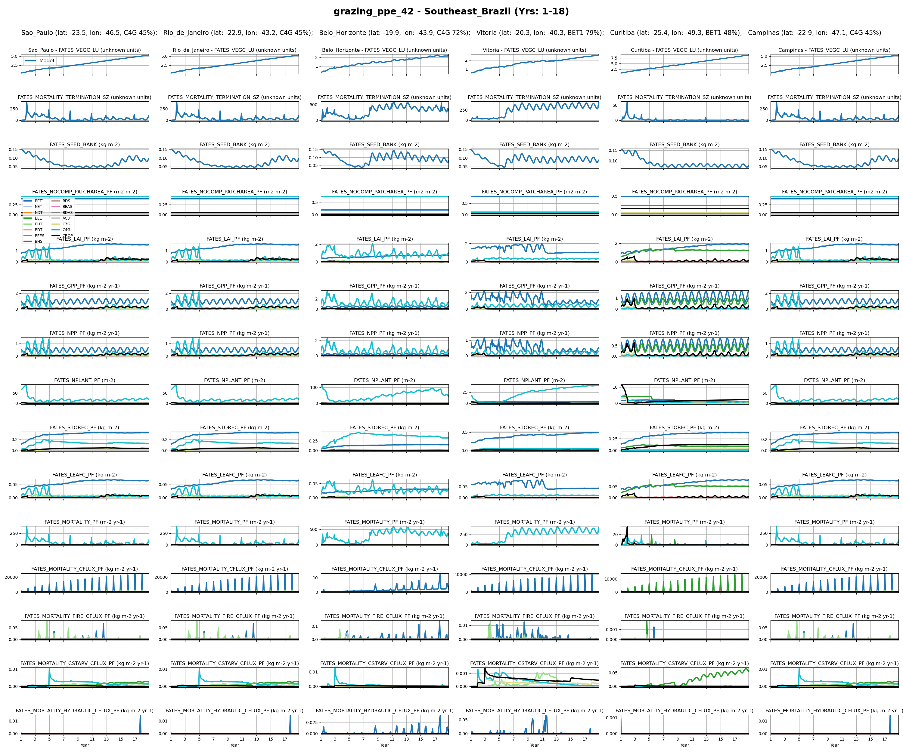
SouthEast_Brazil
16

Slide 50
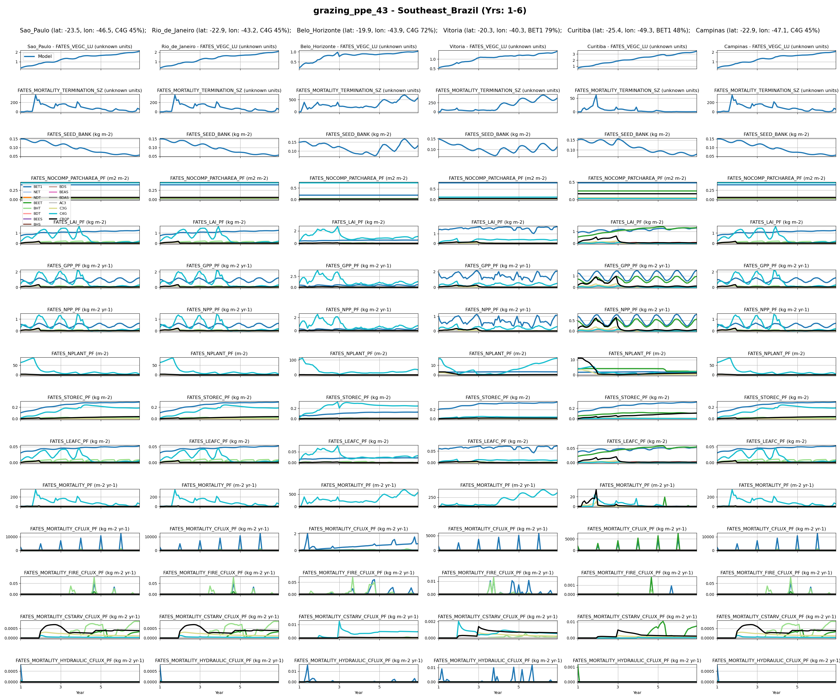
SouthEast_Brazil
18

Slide 51

SouthEast_Brazil
20

Slide 52

SouthEast_Brazil
21

Slide 53

SouthEast_Brazil
22

Slide 54

SouthEast_Brazil
23

Slide 55

India
0

Slide 56

India
1

Slide 57

India
2

Slide 58

India
3

Slide 59

India
4

Slide 60

India
5

Slide 61

India
6

Slide 62

India
7

Slide 63

India
8

Slide 64

India
9

Slide 65

India
12

Slide 66

India
14

Slide 67

India
16

Slide 68

India
18

Slide 69

India
20

Slide 70

India
21

Slide 71

India
22

Slide 72

India
23

Slide 73

Global
0

Slide 74

Global
1

Slide 75

Global
2

Slide 76

Global
3

Slide 77

Global
4

Slide 78

Global
5

Slide 79

Global
6

Slide 80

Global
7

Slide 81

Global
8

Slide 82

Global
9

Slide 83

Global
12

Slide 84

Global
14

Slide 85

Global
16

Slide 86

Global
18

Slide 87

Global
20

Slide 88

Global
21

Slide 89

Global
22

Slide 90

Global
23

