Slide 1
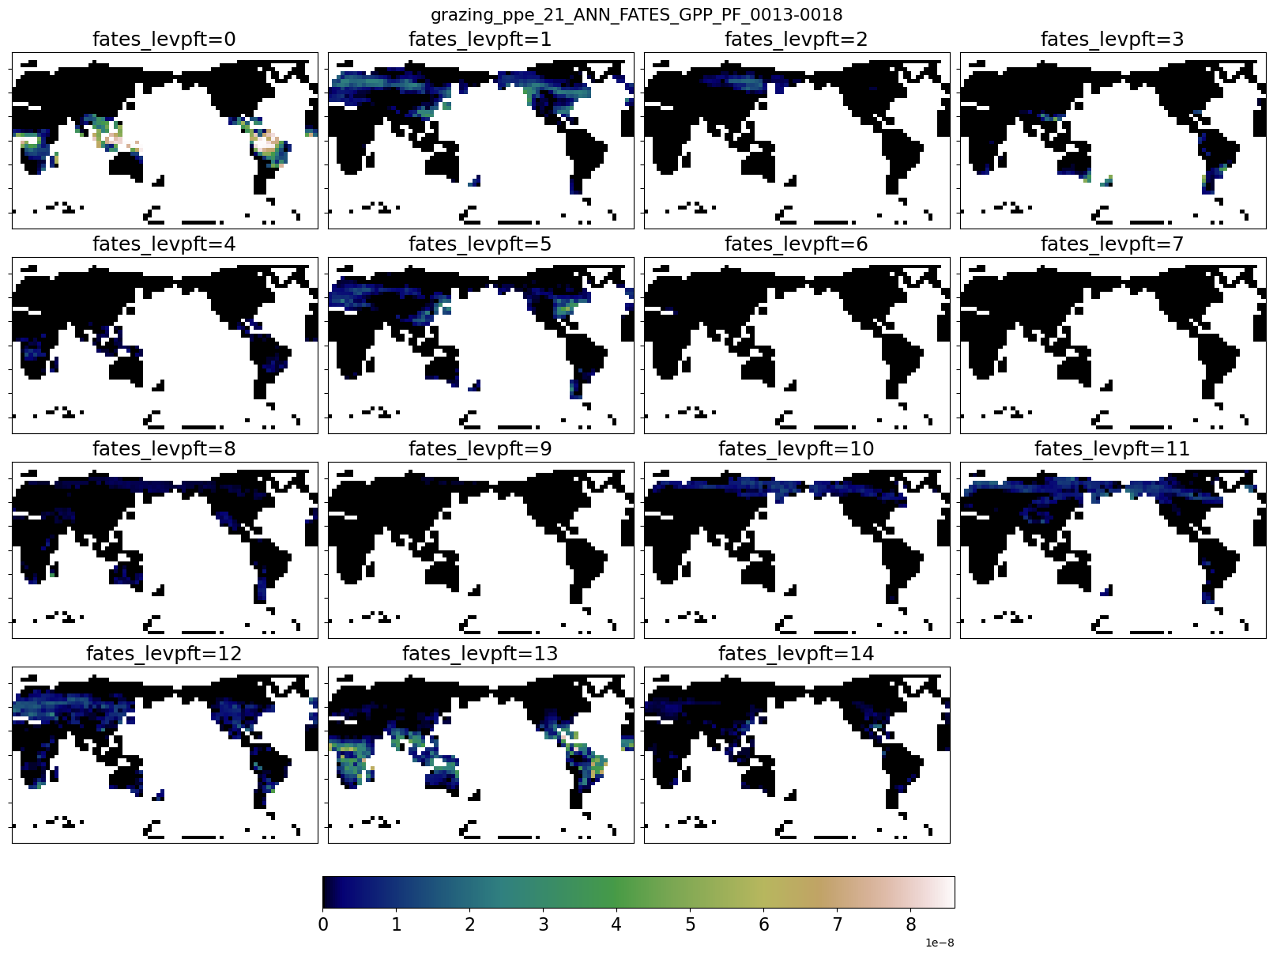
FATES_GPP_PF_0
Ens 20: all grzing 0.02, no Pr.gr

Slide 2

FATES_GPP_PF_0
Ens 21: Pr grazing 0->0.007

Slide 3
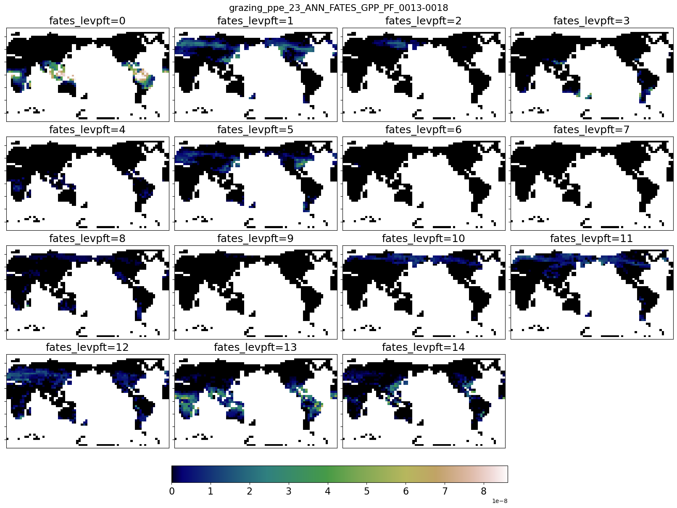
FATES_GPP_PF_0
Ens 22: Tree Palat 1.0->0

Slide 4

FATES_GPP_PF_0
Ens 23: graz.rate crop 0.02->0.01

Slide 5

FATES_GPP_PF_0
Ens 24: graz.rate past 0.02->0.03, Pr 0.007-> 0.003

Slide 6
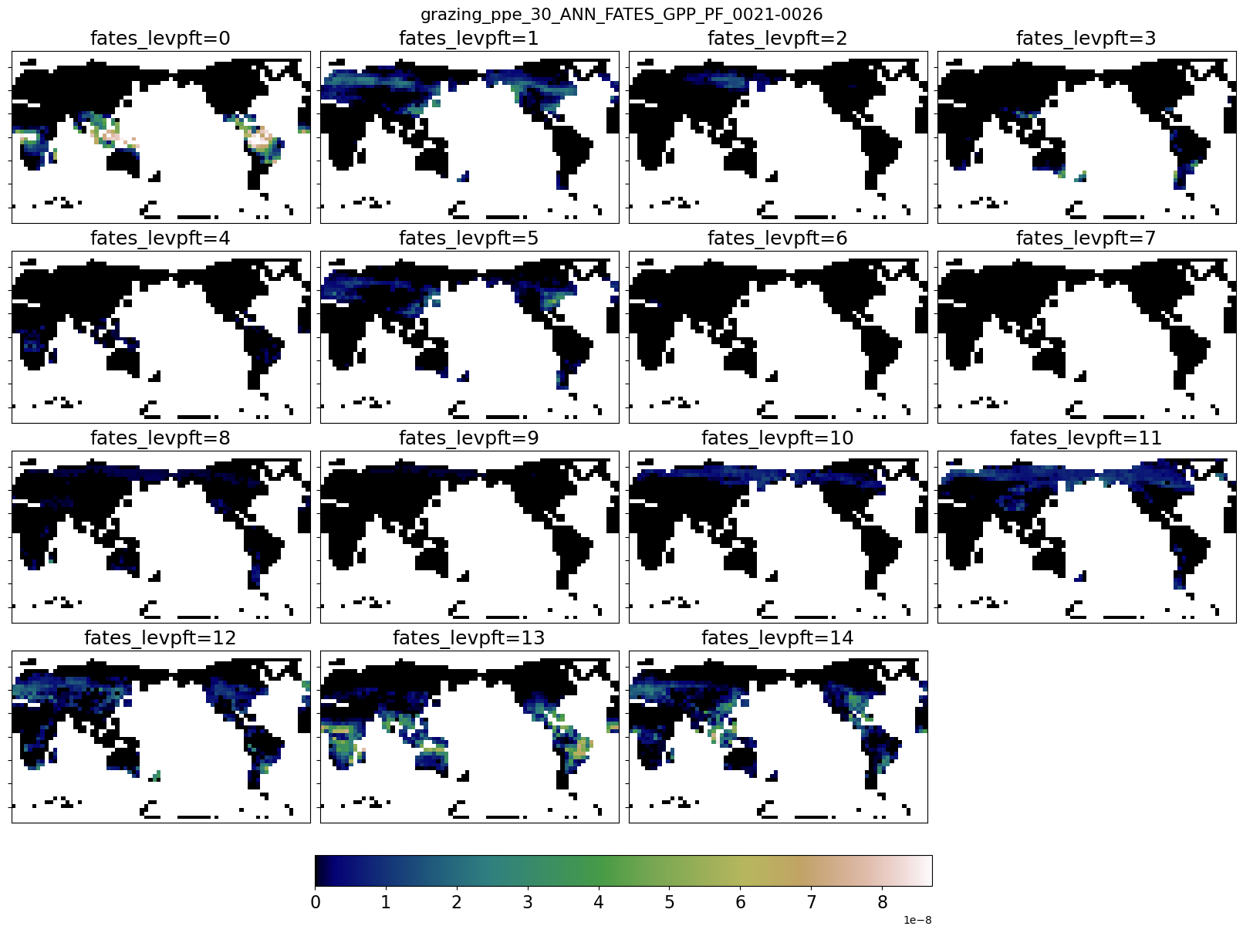
FATES_GPP_PF_0
clim_maps

Slide 7

FATES_GPP_PF_0
clim_maps

Slide 8

FATES_GPP_PF_0
clim_maps

Slide 9

FATES_GPP_PF_0
clim_maps

Slide 10

FATES_GPP_PF_0
clim_maps

Slide 11

FATES_GPP_PF_0
clim_maps

Slide 12

FATES_GPP_PF_0
clim_maps

Slide 13

FATES_GPP_PF_0
clim_maps

Slide 14

FATES_GPP_PF_0
clim_maps

Slide 15

FATES_GPP_PF_0
clim_maps

Slide 16

FATES_GPP_PF_0
clim_maps

Slide 17

FATES_GPP_PF_0
clim_maps

Slide 18

FATES_GPP_PF_0
clim_maps

Slide 19

FATES_GPP_PF_0
clim_maps

Slide 20
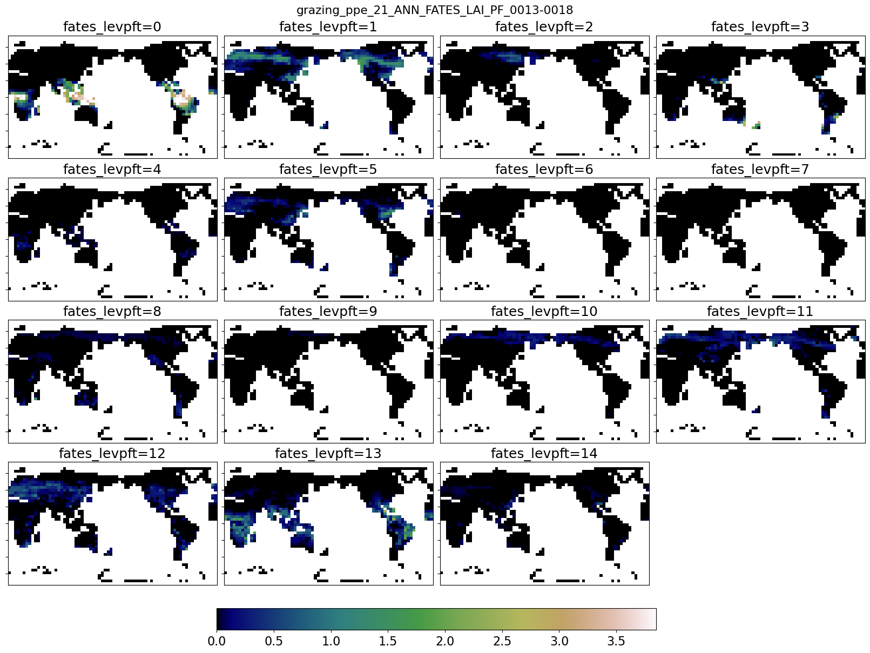
FATES_LAI_PF_0
Ens 20: all grzing 0.02, no Pr.gr

Slide 21

FATES_LAI_PF_0
Ens 21: Pr grazing 0->0.007

Slide 22

FATES_LAI_PF_0
Ens 22: Tree Palat 1.0->0

Slide 23
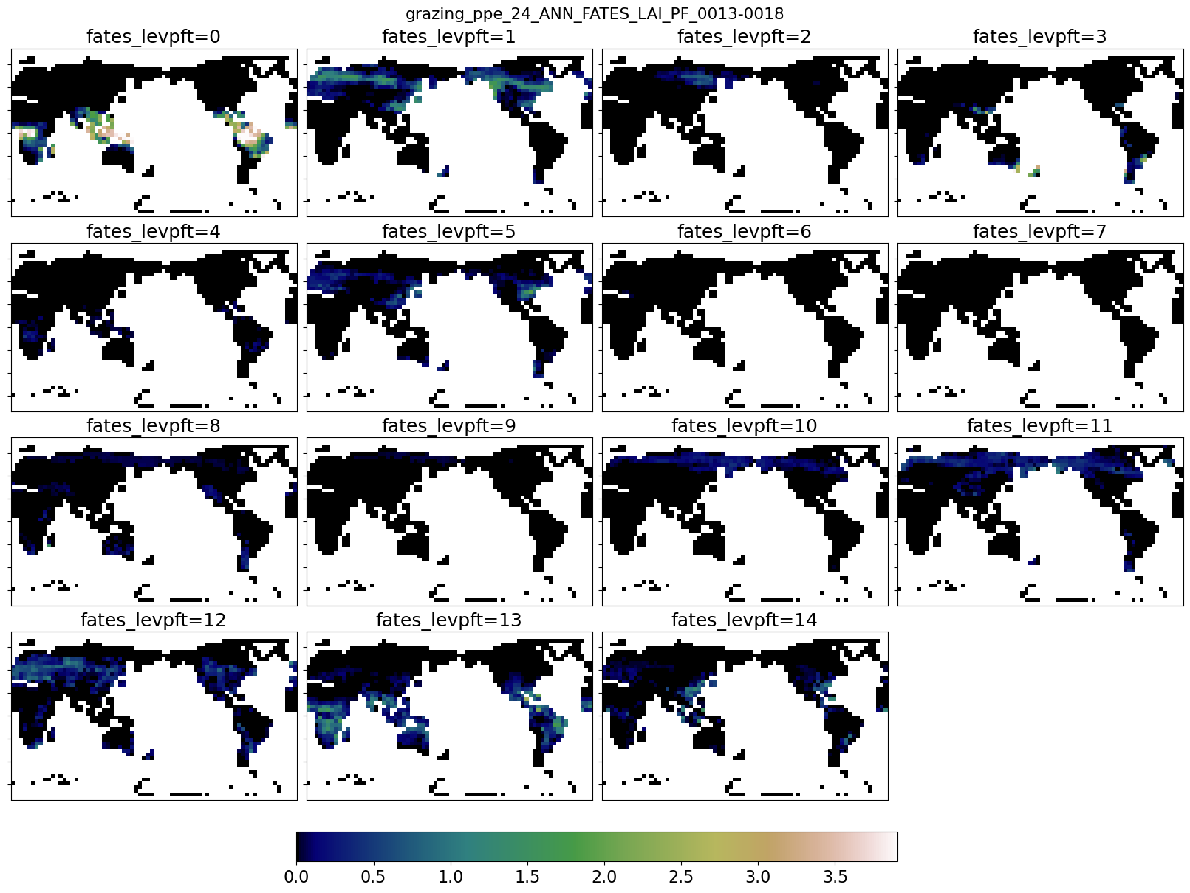
FATES_LAI_PF_0
Ens 23: graz.rate crop 0.02->0.01

Slide 24
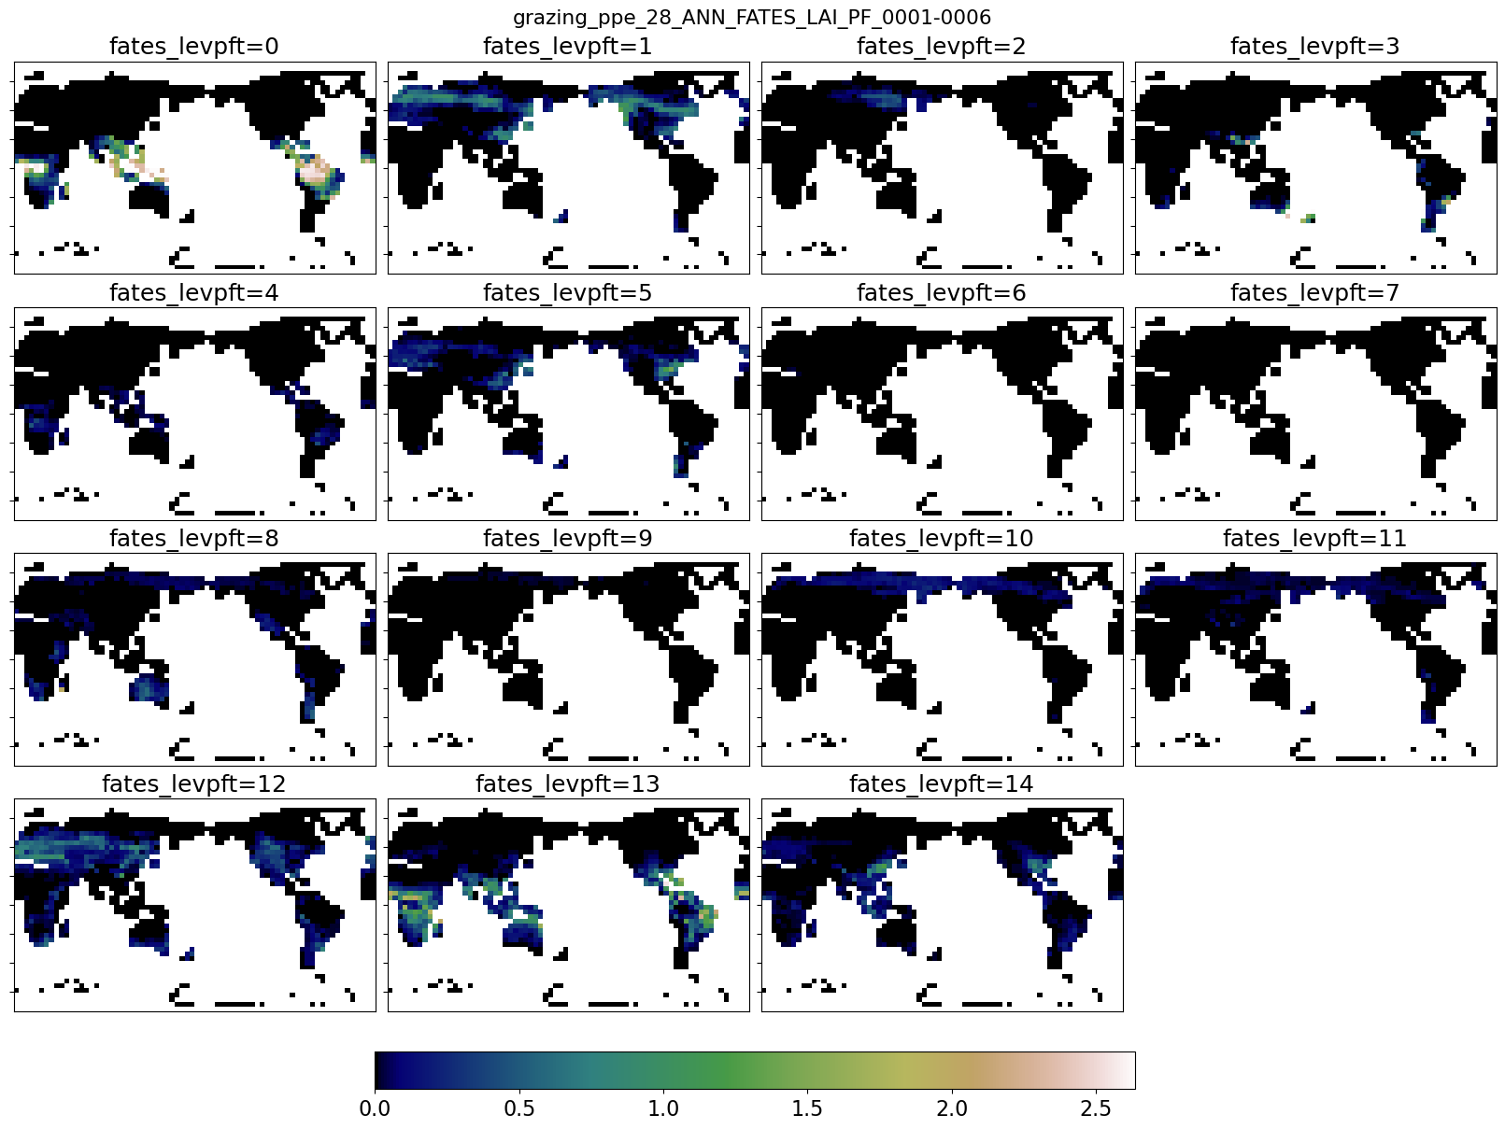
FATES_LAI_PF_0
Ens 24: graz.rate past 0.02->0.03, Pr 0.007-> 0.003

Slide 25
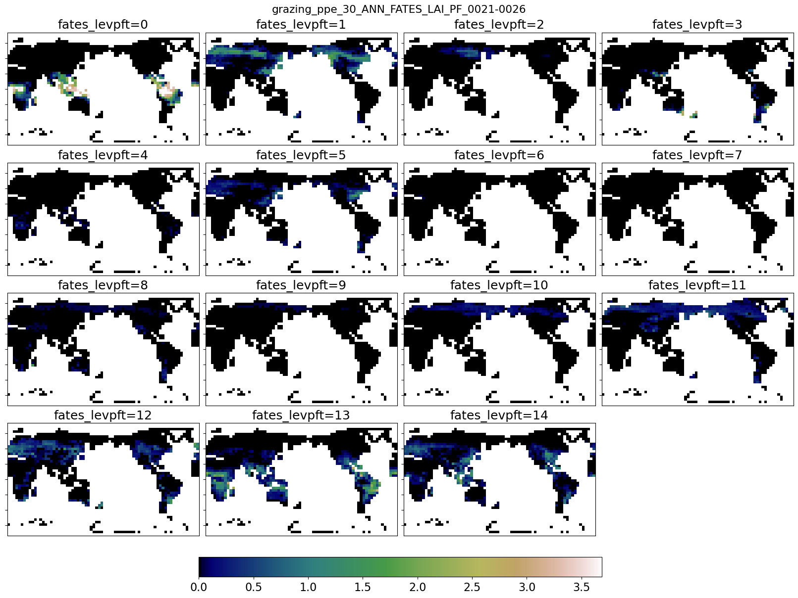
FATES_LAI_PF_0
clim_maps

Slide 26

FATES_LAI_PF_0
clim_maps

Slide 27

FATES_LAI_PF_0
clim_maps

Slide 28

FATES_LAI_PF_0
clim_maps

Slide 29

FATES_LAI_PF_0
clim_maps

Slide 30

FATES_LAI_PF_0
clim_maps

Slide 31

FATES_LAI_PF_0
clim_maps

Slide 32

FATES_LAI_PF_0
clim_maps

Slide 33

FATES_LAI_PF_0
clim_maps

Slide 34

FATES_LAI_PF_0
clim_maps

Slide 35

FATES_LAI_PF_0
clim_maps

Slide 36

FATES_LAI_PF_0
clim_maps

Slide 37

FATES_LAI_PF_0
clim_maps

Slide 38

FATES_LAI_PF_0
clim_maps

Slide 39
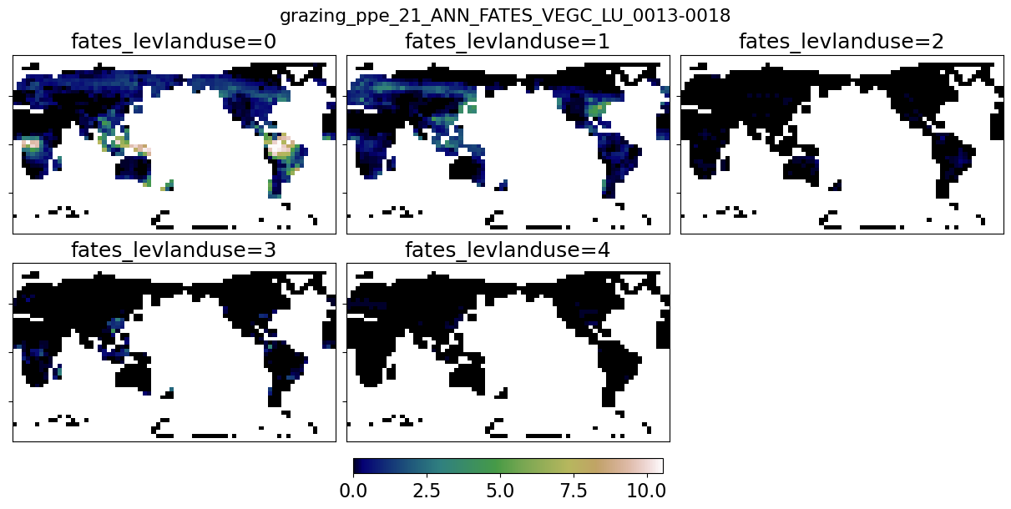
FATES_VEGC_LU_0
Ens 20: all grzing 0.02, no Pr.gr

Slide 40
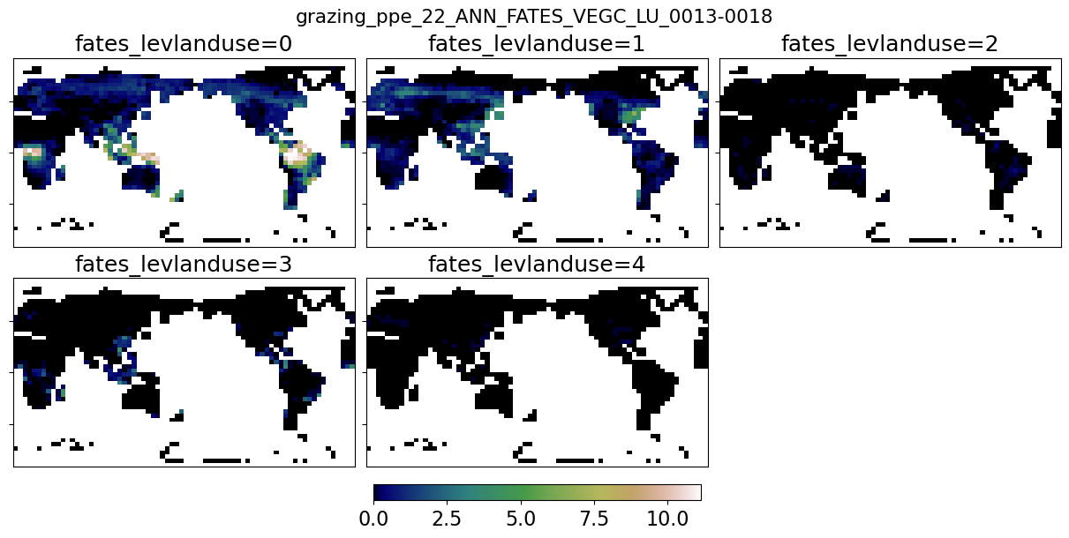
FATES_VEGC_LU_0
Ens 21: Pr grazing 0->0.007

Slide 41
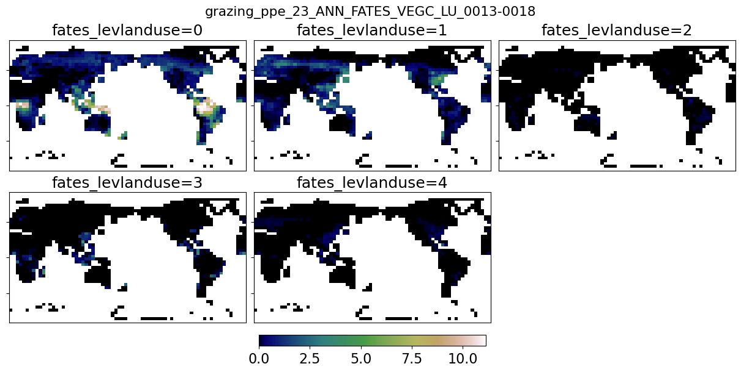
FATES_VEGC_LU_0
Ens 22: Tree Palat 1.0->0

Slide 42
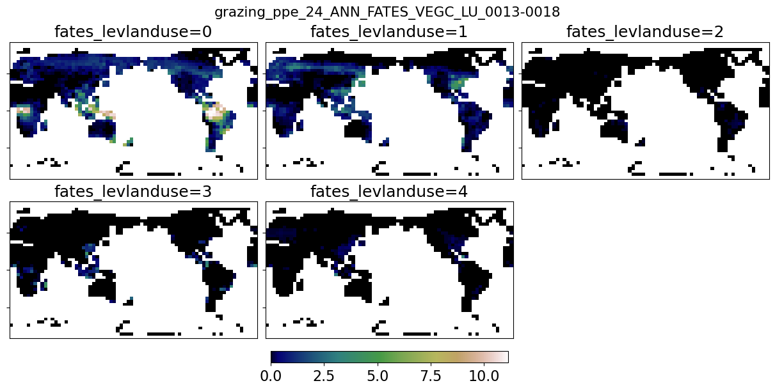
FATES_VEGC_LU_0
Ens 23: graz.rate crop 0.02->0.01

Slide 43
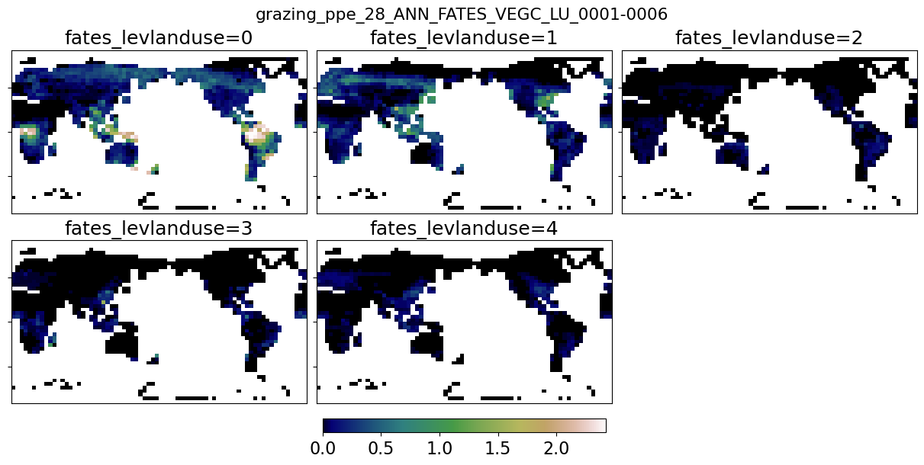
FATES_VEGC_LU_0
Ens 24: graz.rate past 0.02->0.03, Pr 0.007-> 0.003

Slide 44
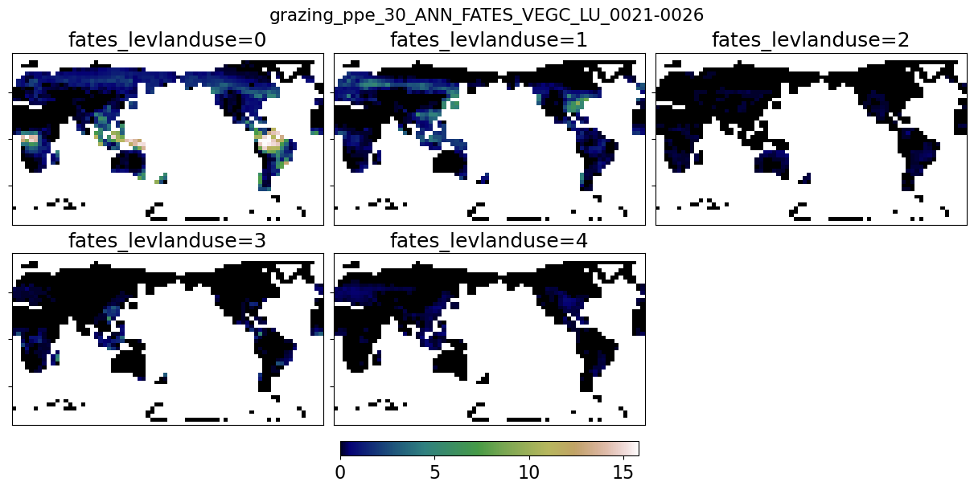
FATES_VEGC_LU_0
clim_maps

Slide 45

FATES_VEGC_LU_0
clim_maps

Slide 46

FATES_VEGC_LU_0
clim_maps

Slide 47

FATES_VEGC_LU_0
clim_maps

Slide 48

FATES_VEGC_LU_0
clim_maps

Slide 49

FATES_VEGC_LU_0
clim_maps

Slide 50

FATES_VEGC_LU_0
clim_maps

Slide 51

FATES_VEGC_LU_0
clim_maps

Slide 52

FATES_VEGC_LU_0
clim_maps

Slide 53
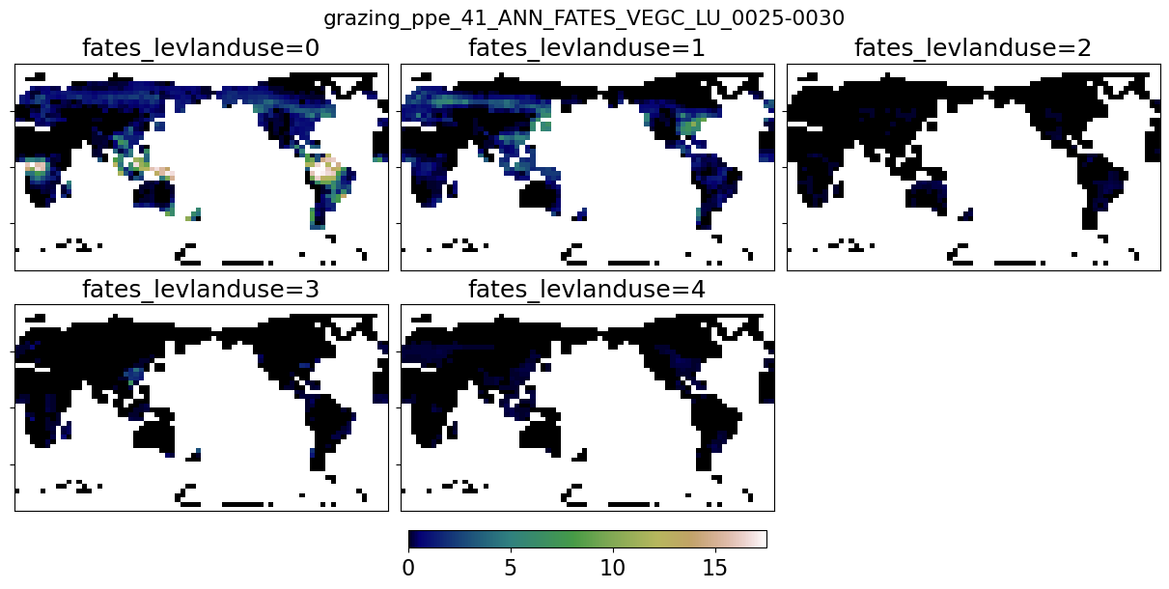
FATES_VEGC_LU_0
clim_maps

Slide 54

FATES_VEGC_LU_0
clim_maps

Slide 55

FATES_VEGC_LU_0
clim_maps

Slide 56

FATES_VEGC_LU_0
clim_maps

Slide 57

FATES_VEGC_LU_0
clim_maps

