Slide 1
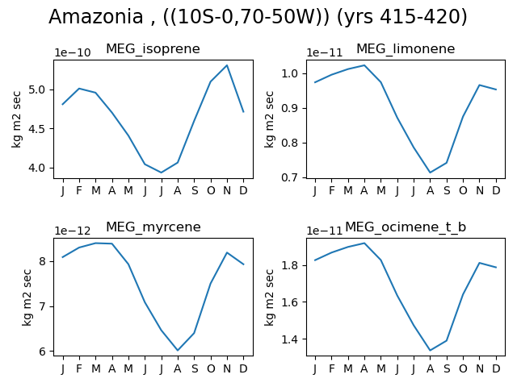
Amazonia
Ens 19: dm:14 dsl:0.54 ms:1.17 mt:1.15 z0:0.88

Slide 2
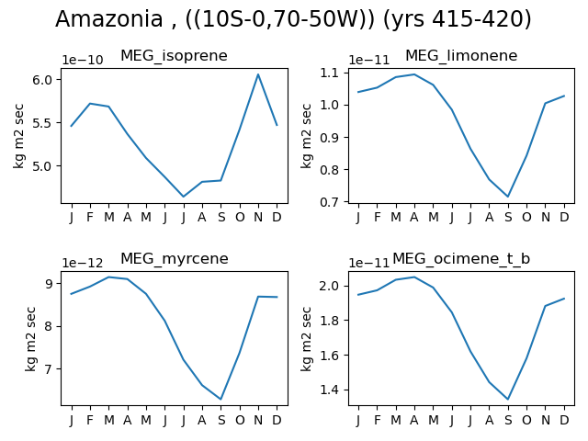
Amazonia
Ens 21: dm:57 dsl:0.98 ms:0.82 mt:0.82 z0:1.17

Slide 3
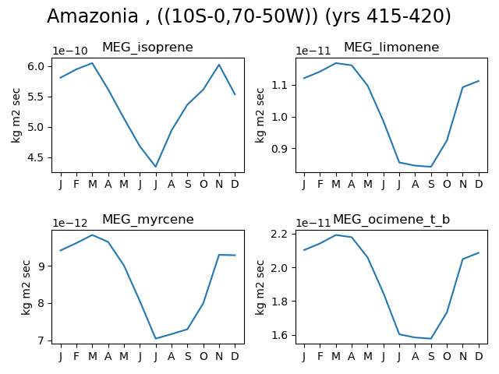
Amazonia
Ens 32: dm:28 dsl:0.68 ms:1.05 mt:0.84 z0:1.13

Slide 4
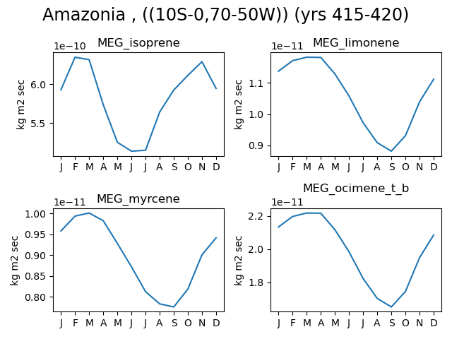
Amazonia
Ens 65: dm:37 dsl:0.78 ms:0.98 mt:0.96 z0:0.93

Slide 5
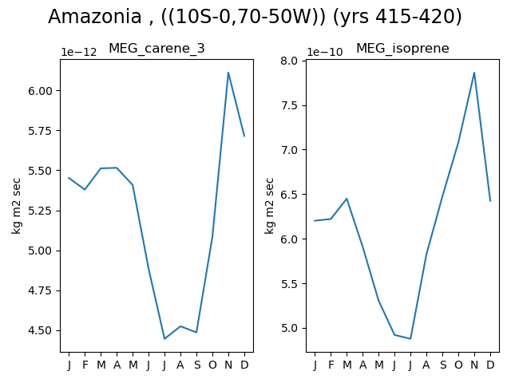
Amazonia
Ens 69: dm:39 dsl:0.79 ms:0.97 mt:1.12 z0:1.08

Slide 6
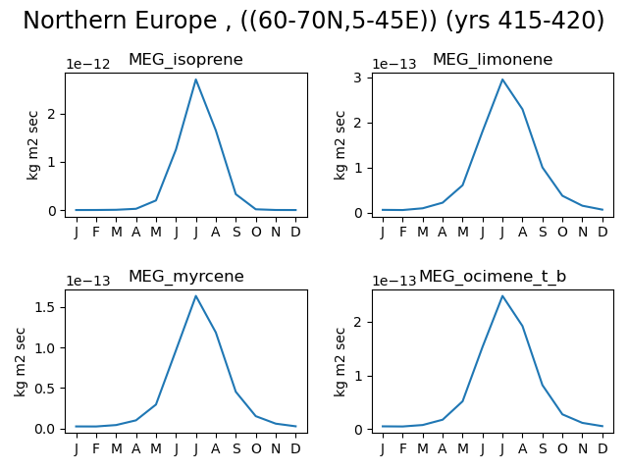
Europe
Ens 19: dm:14 dsl:0.54 ms:1.17 mt:1.15 z0:0.88

Slide 7
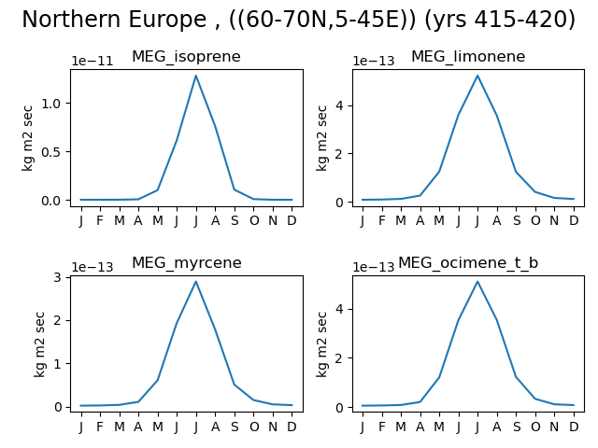
Europe
Ens 21: dm:57 dsl:0.98 ms:0.82 mt:0.82 z0:1.17

Slide 8
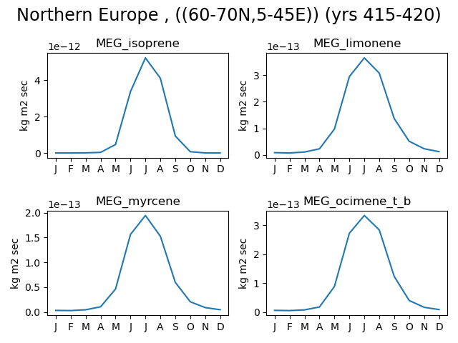
Europe
Ens 32: dm:28 dsl:0.68 ms:1.05 mt:0.84 z0:1.13

Slide 9
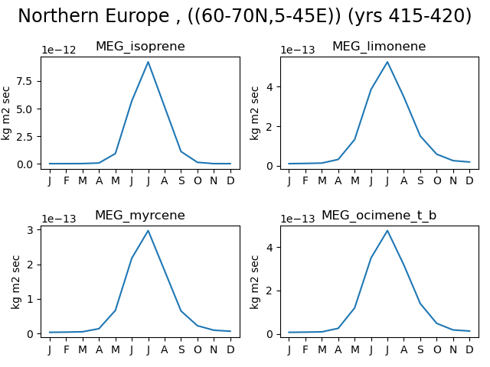
Europe
Ens 65: dm:37 dsl:0.78 ms:0.98 mt:0.96 z0:0.93

Slide 10
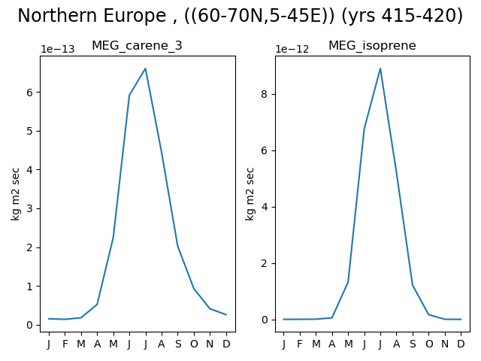
Europe
Ens 69: dm:39 dsl:0.79 ms:0.97 mt:1.12 z0:1.08

